Slide 1
The Dynamic Definition of Creativity:
Potentially Adjacent Possibles
Prof. Giovanni Emanuele Corazza

Slide 2




Evolving society and human skills
INDUSTRIAL SOCIETY
  STANDARDIZATION
  CONCENTRATION
  SYNCHRONIZATION
EDUCATIONxIND
  ROTE LEARNING
  SPECIALIZATION
  CREATIVITY FOR GENIUS
INFORMATION SOCIETY
  PERSONALIZATION
  DISTRIBUTION
  S/T DESTRUCTURING
EDUCATIONxINFO
  FLEXIBILITY
  FILTERING
  CREATIVITY FOR DIGNITY
POST-INFORMATION SOCIETY
  HYPER-INTELLIGENCE
  HYPER-CONNECTIVITY
EDUCATIONxPOST-INFO
  A.I. CONTROL
  ENTREPRENEURSHIP
  CREATIVITY FOR SURVIVAL

Slide 3
Creativity is a necessity for our survival !
The main take-away...

Slide 4

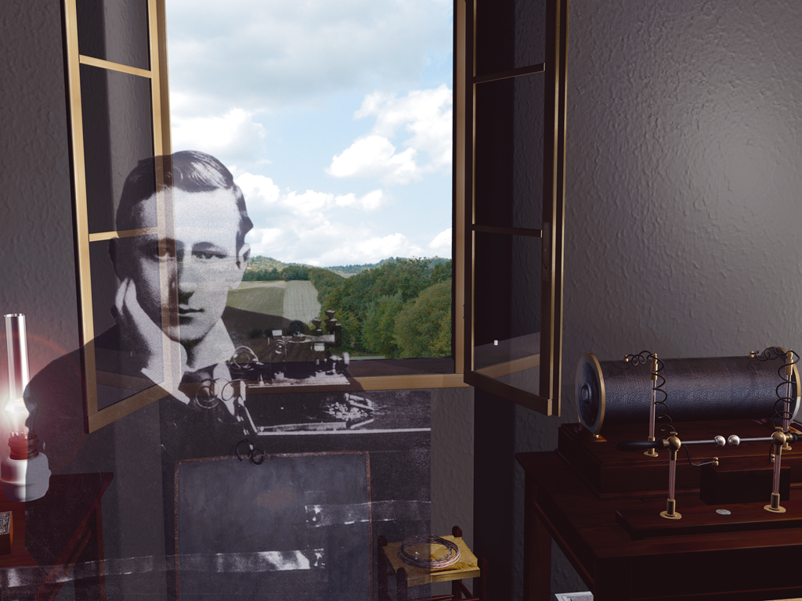
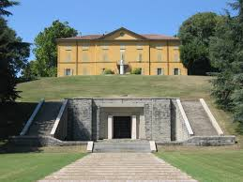
Marconi Institute for Creativity
mic.fgm.it
research
education
application

Slide 5
Definitions for “creative”, “creativity”
Product, person, process, press
Criteria
  novelty
  originality
  intentionality
  utility
  surprise
  authenticity
  aesthtics
  …
... an elusive construct!

Slide 6
Creativity: the standard definition
Creativity requires originality and effectiveness
Runco, M.A., Jaeger, G.J. (2012). The standard definition of creativity. Creativity Research Journal. 24, 92–96.

Slide 7
Let’s challenge the state-of-the-art
Can creativity exist without originality…
and without effectiveness?

Slide 8
Pragmatist requirements
Pragmatism: the world is still in the making
PR1) the definition of creativity should encompass the overall phenomenon in all its experiential manifestations
PR2) the definition of creativity should be useful in the pursuit of the goal of general education in creative thinking
PR3) the definition of creativity should scientifically account for the time-dependent and context-dependent subjectivity of judgment

Slide 9
Thomas Alva Edison
“I never allow myself to become discouraged under any circumstances. I recall that after we had conducted thousands of experiments on a certain project without solving the problem, one of my associates […] expressed discouragement and disgust over our having failed ‘to find out anything’. I cheerily assured him that we had learned something. For we had learned for a certainty that the thing couldn’t be done that way, and that we would have to try some other way. We sometimes learn a lot from our failures if we have put into the effort the best thought and work we are capable of.”

Slide 10
Vincent Van Gogh (letter to Theo)
“I also worked on a large [figure] and have scraped it off twice, which you perhaps would have thought too rash if you had seen the effect; but it was not impatience, it was because I feel I can do better by grinding and trying, and I absolutely want to succeed in doing better, however much time, however much trouble it may cost.”

Slide 11
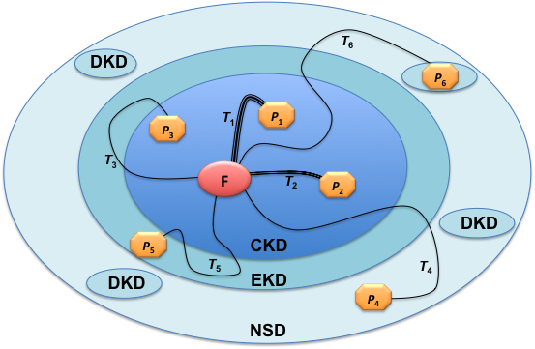
Dynamically exploring unknown territory
The creative process is dynamic
A priori, the result of creative activity is
  Invisible, unpredictable, unconceivable
Frustration is a very real possibility
Creative inconclusiveness is not failure
The definition of creativity cannot stop at creative achievement!
CKD: Common Knowledge Domain
EKD: Evolutionary Knowledge Domain
NSD: Non-Sense Domain
DKD: Discontinuous Knowledge Domain

Slide 12

Estimating ideas: pragmatist maxim
“Consider what effects, which might conceivably have practical bearings, we conceive the object of our conception to have.
Then, our conception of those effects is the whole of our conception of the object.”
  Peirce, C.S., (1992-1999). The Essential Peirce.

Slide 13
The Dynamic Definition of Creativity
Creativity requires potential originality and effectiveness
G.E. Corazza (2016). Potential originality and effectiveness: The dynamic definition of creativity. Creativity Research Journal, 28(3), 258–267.

Slide 14
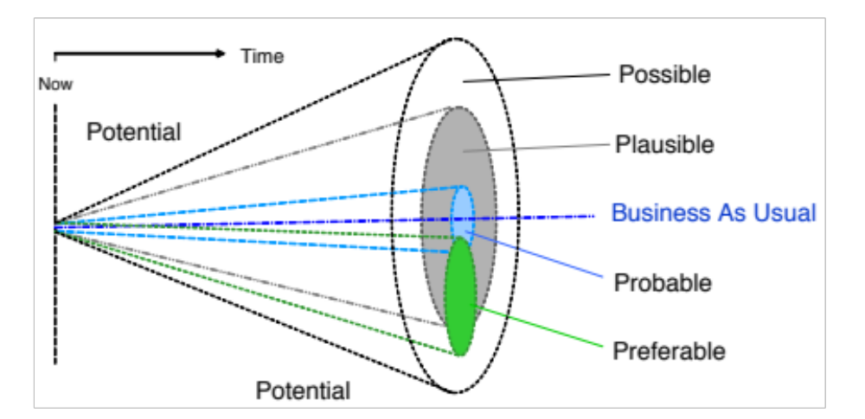
Potentially adjacent possibles
Estimating the value of a creative idea
is an exercise in anticipating the future(s)
G.E. Corazza (2017). Creativity and anticipation. In Handbook of anticipation, R. Poli (ed.)
  Figure from Voros (2003)

Slide 15

DUCP
The Dynamic Universal Creativity Process
The process resulting from the active linking and blending of all creativity episodes in the course of cosmic evolution

Slide 16
Challenging the state-of-the-art
Why is it so difficult?

Slide 17


Brain vs. Supercomputer
38 petaflops
15 W
20 petaflops
3 MW

Slide 18

Energy saving: threshold lowering

Slide 19
Consequences of energy saving
Most of the brain processes are automatic and unaware
Reason works with models, prototypes, heuristics
Only strictly necessary areas are activated
This is absolutely great, but it has a few drawbacks...
  Cultural blocks
  Perceptual blocks
  Emotional blocks

Slide 20



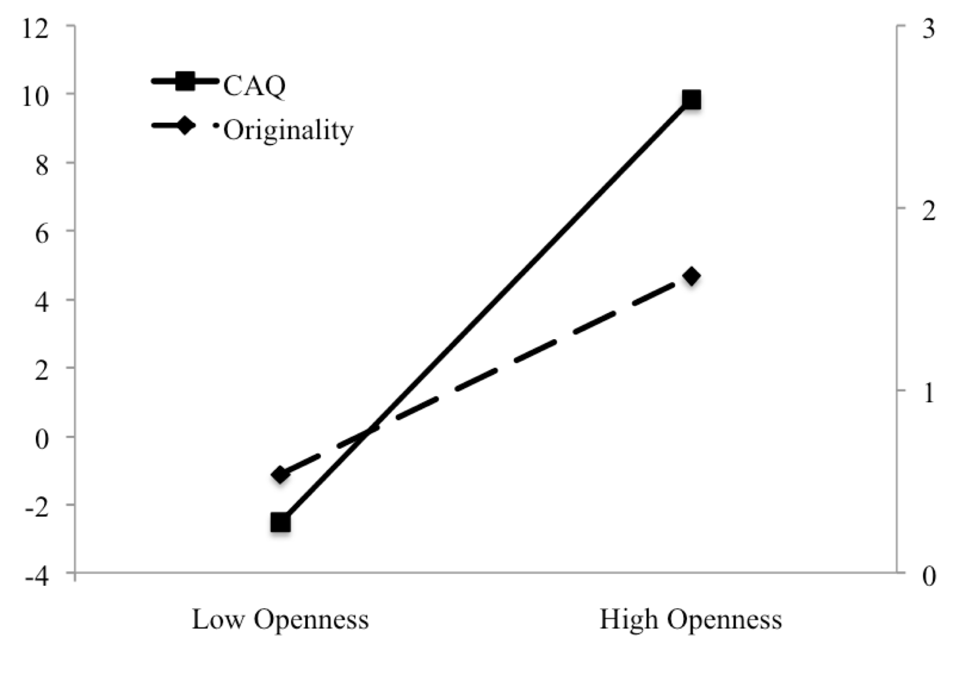


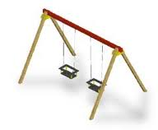

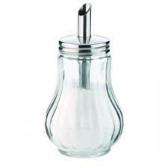

Irrelevant information processing
Estimated creative achievement
Estimated originality
  Agnoli, S., Franchin, L., Rubaltelli, E., & Corazza, G. E. (2015). An eye-tracking analysis of irrelevance processing as moderator of Openness and creative performance. Creativity Research Journal, 27, 125-132.

Slide 21
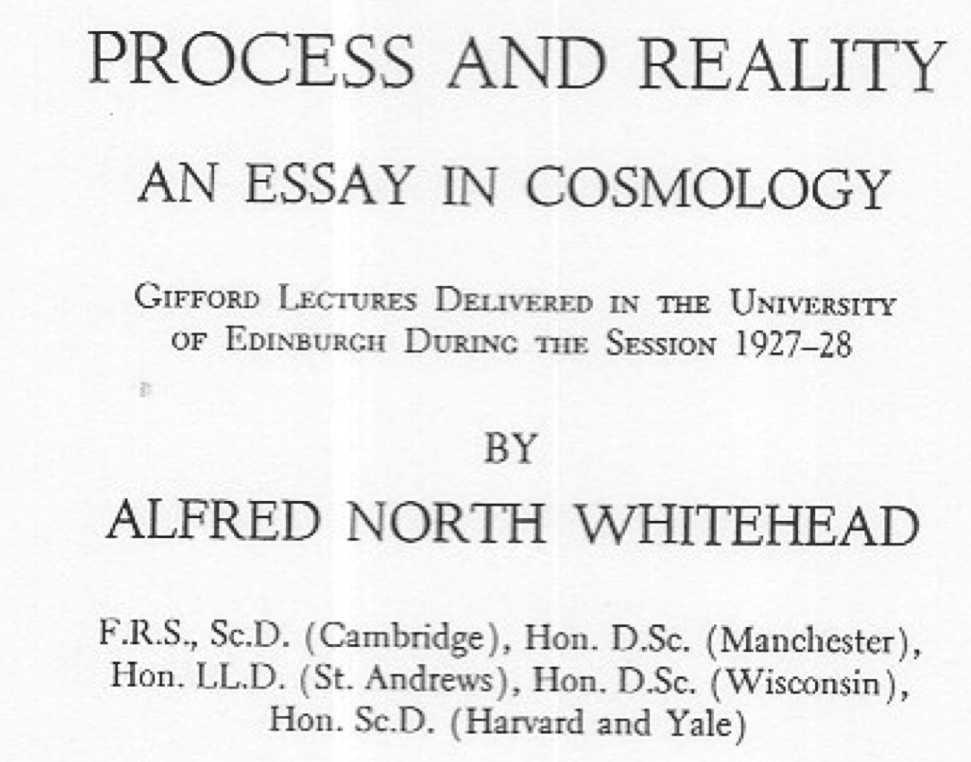
Alfred North Whitehead

Slide 22
Thank you! giovanni.corazza@unibo.it

