Slide 1

Exaptation and innovation
Pierpaolo Andriani
Kedge Business School, France
Email: pier2paolo@gmail.com
Part of this work has been done in collaboration with Mariano Mastrogiorgio and Ayfer Ali

Slide 2
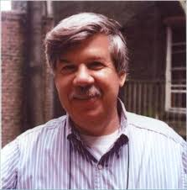

Definition
“We suggest that such characters, evolved for other usages (or for no function at all), and later “coopted” for their current role, be called exaptations” (Gould and Vrba, 1982).
“Refers to cases in which an entity was selected for one trait but eventually ended up carrying out a related but different function” (Mokyr, 1998).
"The later exploitation in a new context of an acquisition originally made in another entirely (Tattersal, 1998).

Slide 3
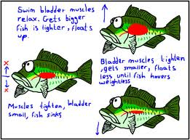
A Darwinian example
The concept of exaptation was already in the Origin of species!
“The illustration of the swimbladder in fishes is a good one, because it shows us clearly that an organ originally constructed with one purpose, namely flotation, may be converted into one for a wholly different purpose, namely, respiration.”
(Darwin, 1859, Chapter V – Difficulties on theory, Organs of extreme perfection and complication)
Giuseppe Carignani – Udine University and Istituto Malignani
Notes:
The term exaptation was first introduced by Gould and Vrba (1982) to describe the concept of functional shift in structural continuity within a Darwinian evolutionary system. Exaptation describes the cases in which a part of an organism, previously shaped for a particular function (an adaptation) or whose origin is not connected to natural selection (a nonaptation) is coopted for a new use.
The term ‘preadaptation’, already in use when the new term was coined, with a meaning very close to that of exaptation, was discarded by Gould and Vrba because it seems to imply a teleological interpretation of Darwinian evolutionary systems, in opposition with the fundamental mechanistic Darwinian concept of descent with modification.
The concept of functional change in structural continuity addresses an important objection to Darwin’s evolutionary theory. The objection, championed in particular by St. George Mivart, asserts that natural selection can hardly explain the incipient stages of organs that can improve the fitness of an individual only when completely developed and functional.
Darwin himself took very seriously this objection, that he considered an important difficulty on his theory. He proposed as a possible explaination the concept of functional change and exposed it very clearly using different examples. A beautiful Darwinian example is that of the supposed exaptation of swimbladdes as lungs:
The illustration of the swimbladder in fishes is a good one, because it shows us clearly that an organ originally constructed with one purpose, namely flotation, may be converted into one for a wholly different purpose, namely, respiration (Darwin, 1861, Chapter VI, page 160)
Indeed, the whole concept of exaptation was very clear to Darwin since the first editions of Origin, published in 1859.
The double meaning given to the term exaptation by Gould and Vrba (the cooptation of both ‘adaptations’ and ‘nonaptations’) can have some confusing effects when ‘exapting’ the concept of exaptation to the domain of technological change. See for example the critical view of Dennet (1995) about the spandrels of San Marco (Gould and Lewontin, 1979), discussed later.
Note: Mivart’s powerful objection to Darwin’s theory is clearly exposed in his essay ‘On the genesis of Species’: “Natural Selection, simply and by itself, is potent to explain the maintenance or the further extension and development of favourable variations, which are at once sufficiently considerable to be useful from the first to the individual possessing them. But Natural Selection utterly fails to account for the conservation and development of the minute and rudimentary beginnings, the slight and infinitesimal commencements of structures, however useful those structures may afterwards become.” (Mivart, 1871, Chapter 2, page 24)

Slide 4
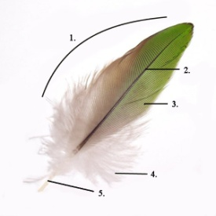
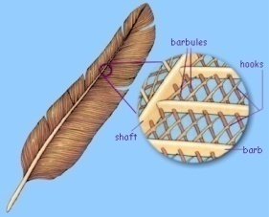
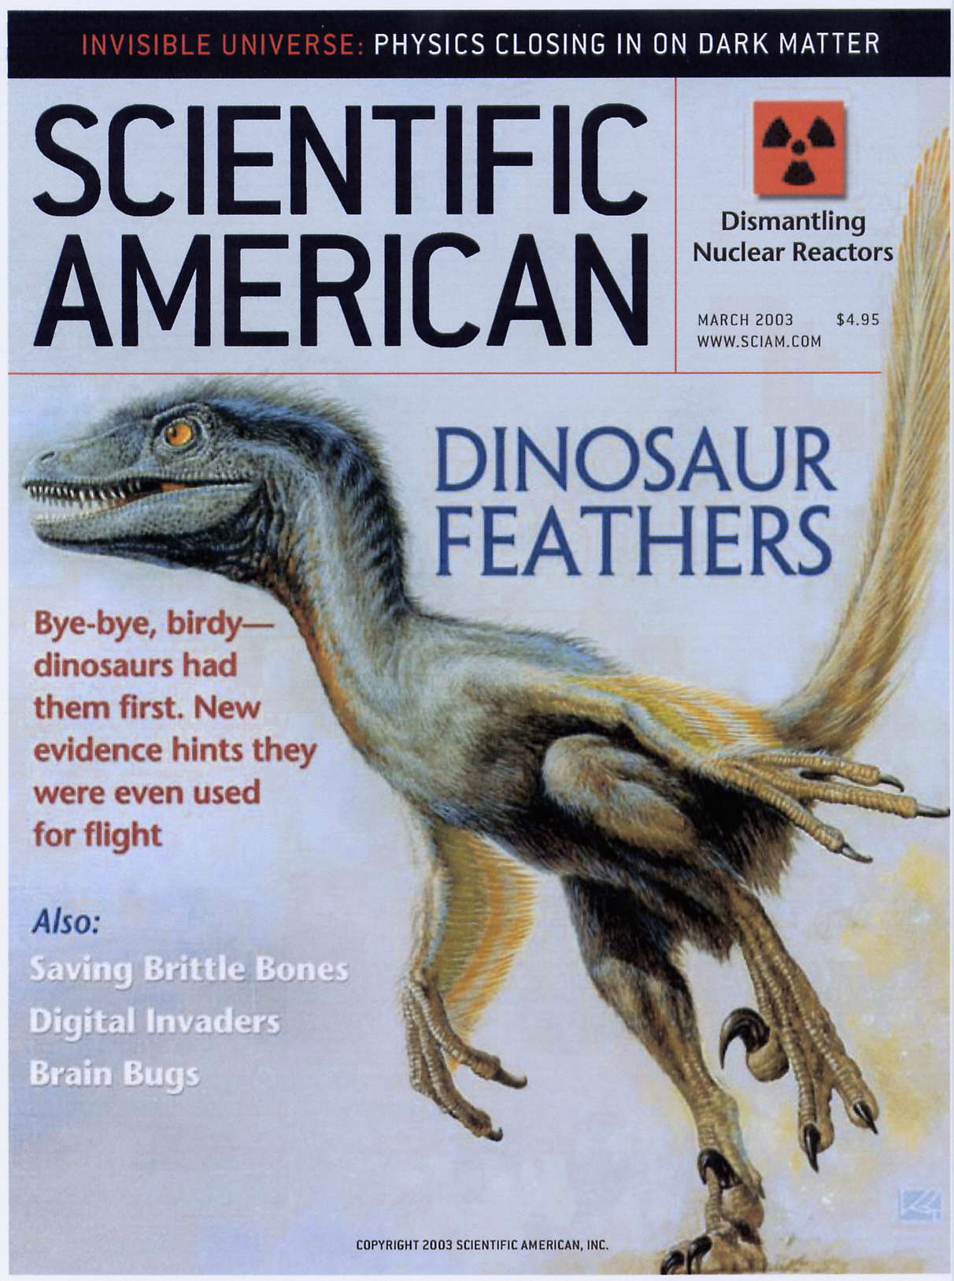

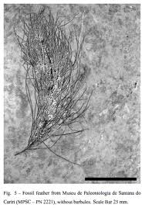
Exaptation and the evolution of feathers
Feathers evolved for thermal insulation and decor feathers for sexual selection
http://www.spwickstrom.com/flight/
http://people.eku.edu/ritchisong/554notes1.html

Slide 5
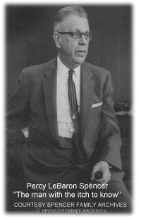
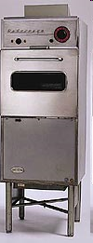
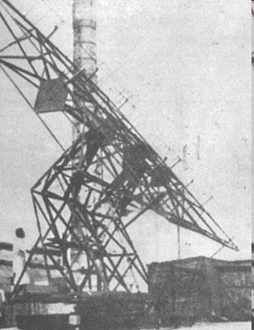
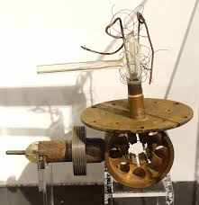


The “invention” of the microwave oven
From a radar system
To the microwave industry
http://www.youtube.com/watch?v=4h1ESUz2H3E&feature=player_detailpage
http://en.wikipedia.org/wiki/Mr._Goodbar

Slide 6
Can we measure the frequency of exaptation?
Emergent uses

Slide 7
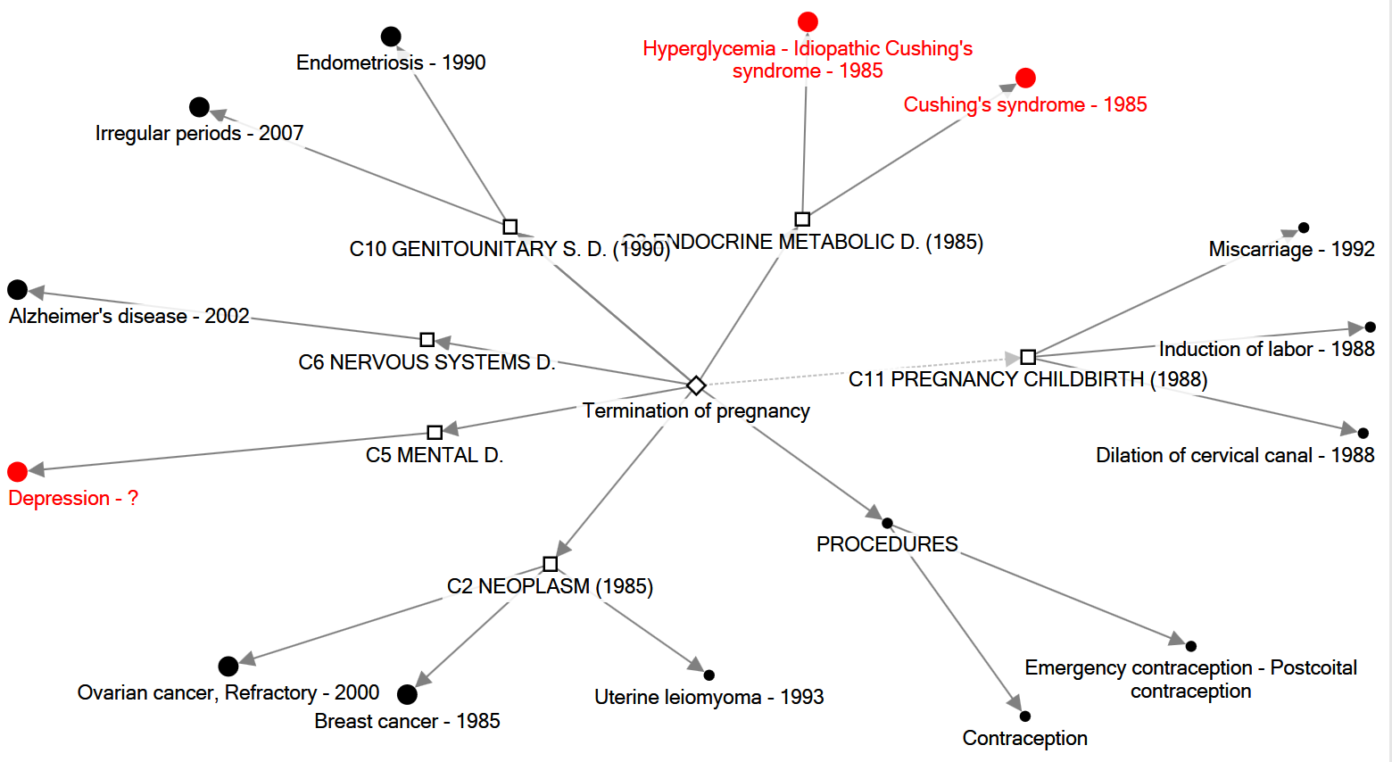
Mifepristone (day-after pill)
Large circles: functionally novel uses (exaptations)
Red circles: radical

Slide 8

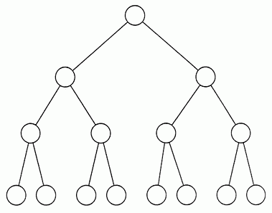
Measure of functional radiation and exaptation
Database
DrugDex
NMEs
Extract Uses and identify
FDA- approved (or original use)
Emergent (mostly off-label)
Need space:ICD9 (International Classification of Diseases)
For each drug, we consider all pairs FDA-emergent and asses functional novelty
Then we plot each pair on a ‘need’ space to measure distance between each original/emergent pair

Slide 9
ICD 9
Diseases and Injuries tabular index
All codes: 001-999
First-order bifurcation
320-389
Diseases of the nervous system and sense organs
290-319
Mental disorders
Others
Second-order bifurcation
330-337
Hereditary and degenerative diseases of central NS
others
others
300-316
Neurotic disorders, personality disorders, and other non psychotic mental disorders
332
Parkinson’s disease
others
others
others
others
others
311
Depressive disorders NOC
others
Tolcapone
FDA –Parkinsons
Drug: Tolcapone
Tolcapone
Off-Label –Depression

Slide 10
Results

Slide 11
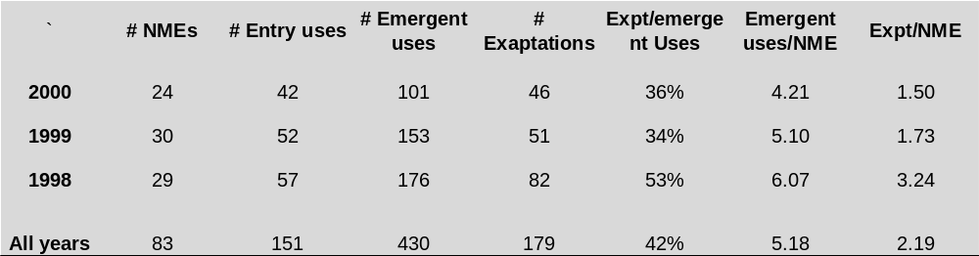
Results
Technologies show ‘fecundity’: each NME generates more than 5 additional uses.
About 40% of emergent uses are functionally novel (exaptive)
About 8% of emergent uses are radical

Slide 12
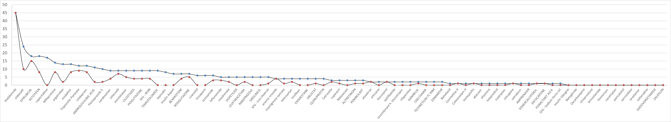
Long tail of emergent uses and exaptations per drug
Emergent uses
Exaptations
thalidomide
Both curves are long-tailed, probably power law.
    Clauset et al. (2009) test:
  P-value = 0.63 (emergent uses)
  P-value = 0.79 for exaptive uses
Tail of distribution includes drugs such as thalidomide, sildenafil, mifepristone. These are not outliers.
sildenafil

Slide 13
Radical innovation 1: ‘impact’
Radical uses: uses that are new-to-the-world. Specifically this means new treatments for previously untreated diseases. The unit of adoption is the population of users characterized by a specific need. Radical uses may activate cascades of further uses.
Semi-radical uses: uses that introduce significant improvement over current treatments. The unit of adoption is micro, typically a sub-population. For instance this refer to uses that address patients who are (or have become) insensitive to existing treatments and whose conditions significantly improve upon discovery of the new use.
Incremental uses: uses that are neither new-to-the-world, nor constitute significant advancement over current treatments, but adds to the existing population of treatments.

Slide 14
Evidence of radical innovations
NME | Entry use | Emergent use
Arsenic trioxide | Trypanosomiasis | Acute promyelocytic leukemia
Arsenic trioxide |  | Myelodysplastic syndrome
Celecoxib | Osteoarthritis | Colorectal adenoma
Citalopram | Depression | Binge-eating disorder
Mifepristone (RU486) | Termination of pregnancy | Depression
Thalidomide | Morning sickness and hypnotic-sedative | Erythema nodosum leprosum
Thalidomide | « | Cachexia associated with AIDS
Thalidomide | « | Kaposi's sarcoma - AIDS related
Thalidomide | « | Aphthous ulcers
Thalidomide | « | Multiple myeloma

Slide 15
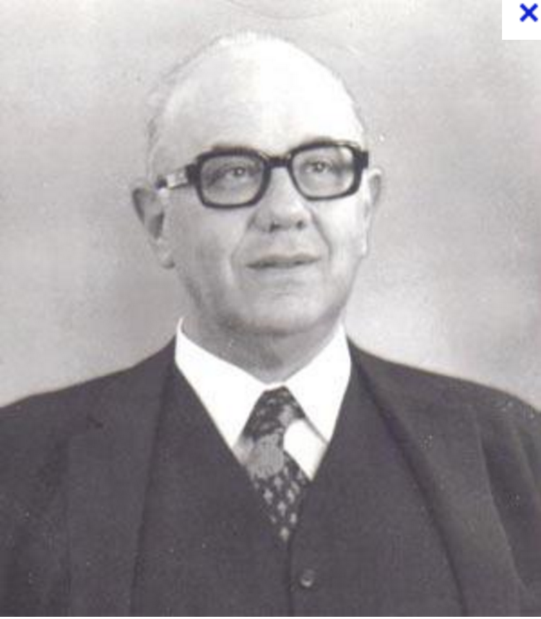
Case: thalidomide
Introduced in the late 1950s as sedative caused phocomelia and was withdrawn in 1962 and banned worldwide. Worst pharmacological scandal in history.
However, in 1964, Dr Sheskin prescribed thalidomide to a terminally ill patient affected by erythema nodosum leprosum, an extremely painful skin condition associated with leprosy. Thalidomide cured ENL and was effective against leprosy. As a consequence, 90% of the leprosy hospitals around the world were shut down (Stephens and Brynner 2009)
to date, thalidomide has been used to treat 130 disorders, for some of which it is the only effective means of arresting a patient’s progressive deterioration (Stephens and Brynner 2009, p. 164).

Slide 16
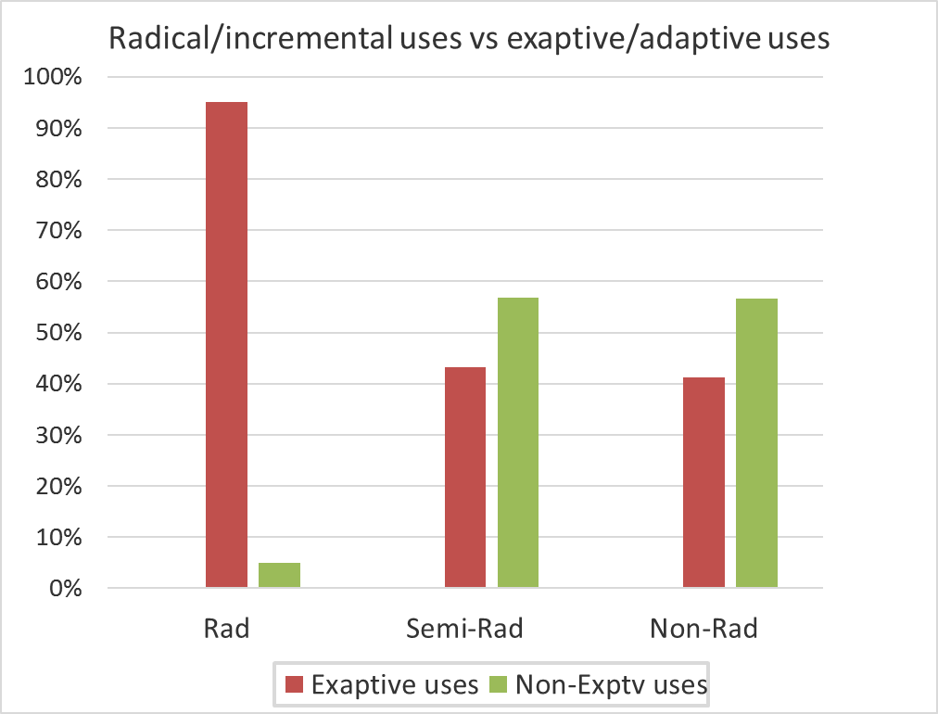
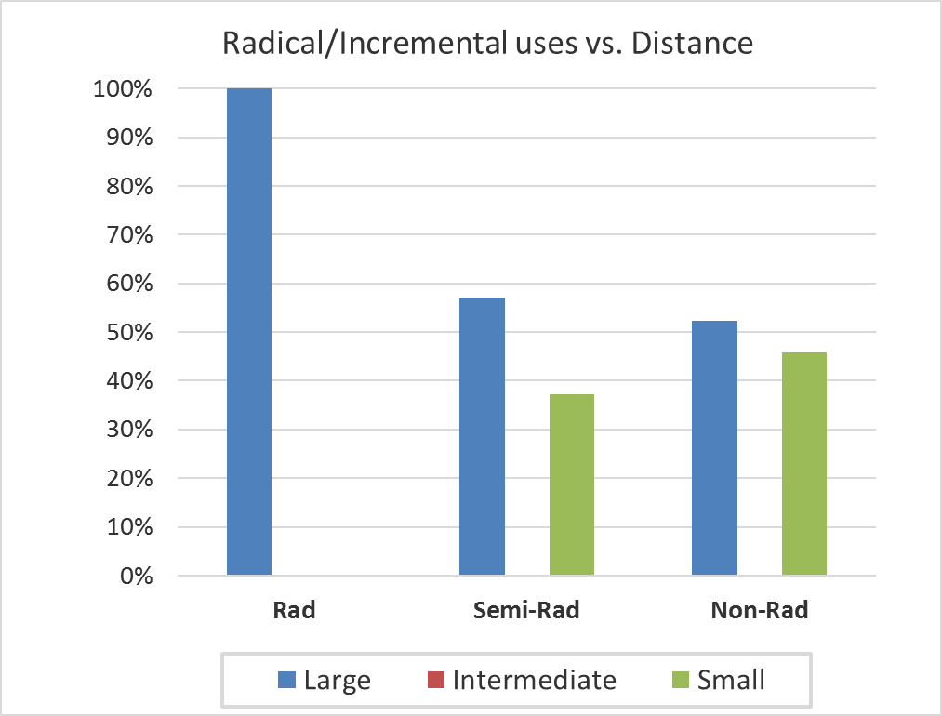
Results
Need space:ICD9 (International Classification of Diseases)
Does radicalness depend on distance (exploration)?

Slide 17
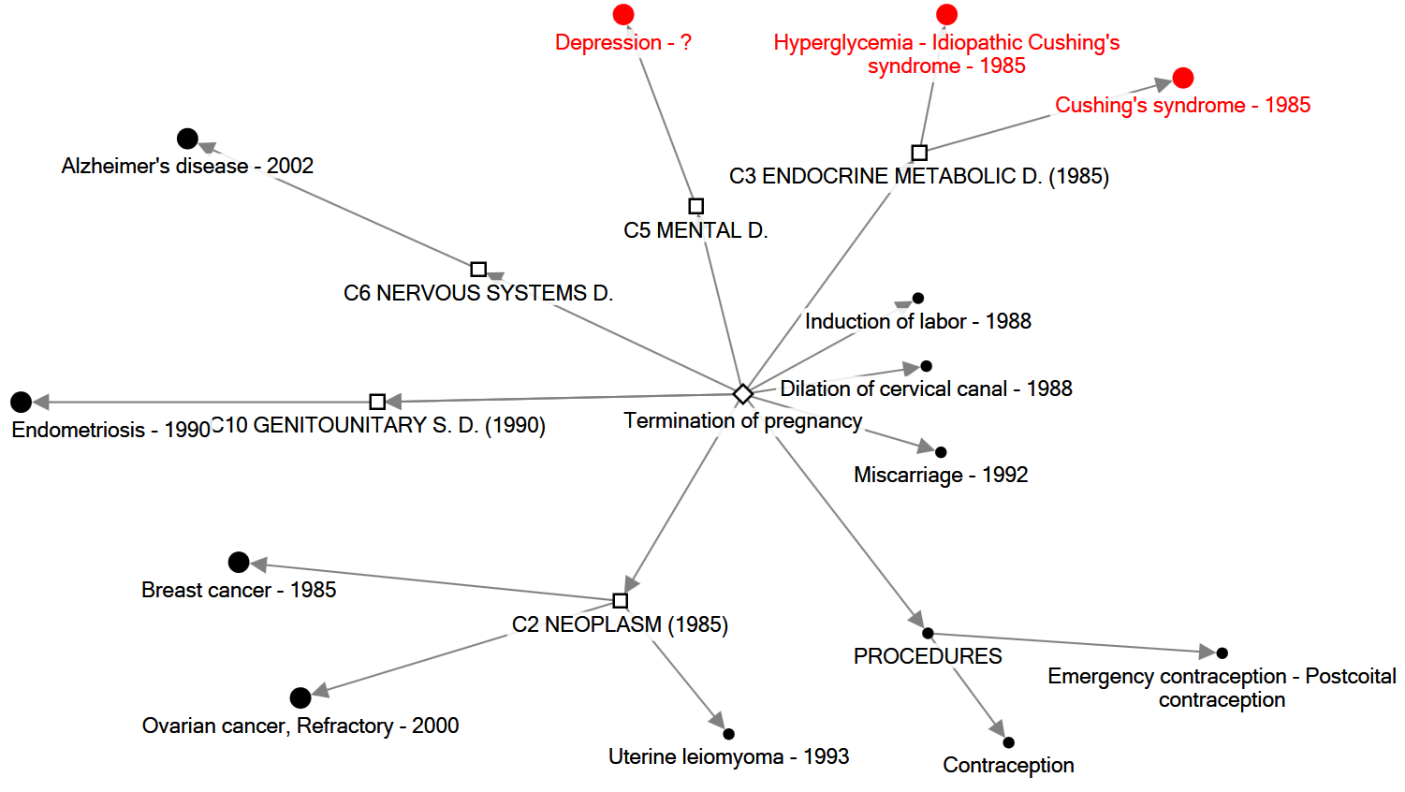
Mifepristone (day-after pill)

Slide 18
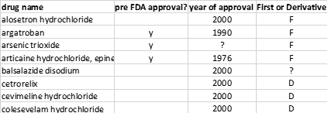
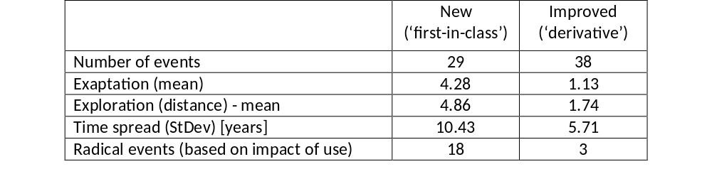
Radical innovation 2: ‘technological novelty’
Classifying artifacts on the base of technological novelty enables to test relationships between technological novelty and functional diversification of technologies

Slide 19
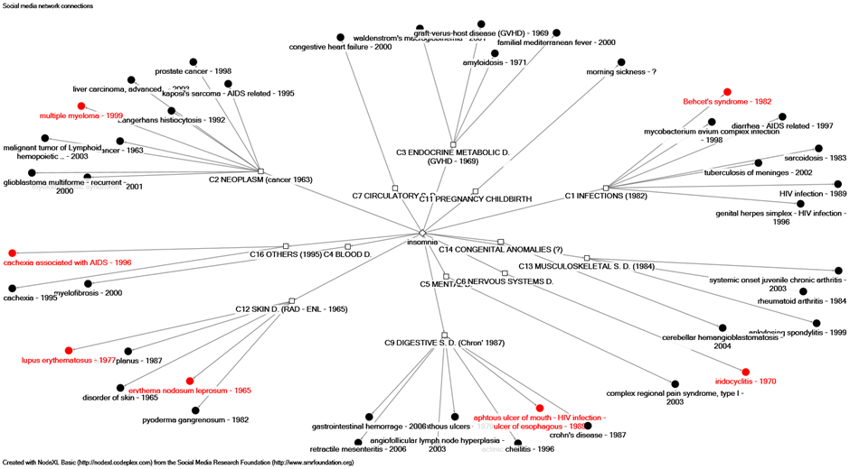
Exaptations as a way to discover new mechanisms of action
Several emergent uses are based on different mechanisms of action than the original use
(Rehman, Arfons, & Lazarus, 2011)

Slide 20
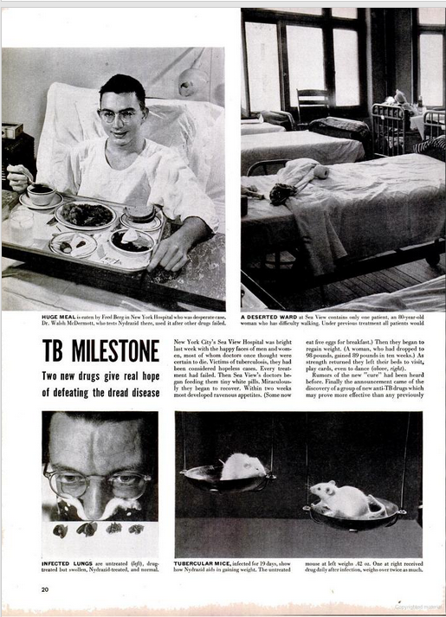
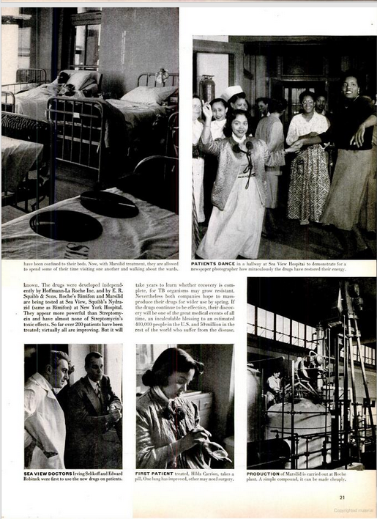
The first antidepressant and the beginning of pharmacological psychiatry

Slide 21
Major exaptations in pharma industry
Drug name | Original use | Exapted | Serendipitous events | Year(s)
Anesthetic | Laughing gas | First anaesthetic | Laughing gas used in fairs. Dentist Horace Wells noticed that volunteers became pain insensitive and used NO for tooth extraction. “a new era in tooth pulling” | 1844
Carbolic acid | Agricultural antiparassites | First antisepsis product |  | 1860s
Mepobramate (Miltown) | Antibiotics (Gram negative) | First tranquilliser to gain wide acceptance | 1940s, experimentation with rats showed sedative effect Touted as “miracle cure for anxiety” became a cultural icon. | @1950
Marsilid | Tubercolosis | First antidepressant | Tuberculotic « euphoric » patients | @1958
Viagra | Coronary heart disease | First erectile dysfunction drug | During phase trial patients suffered unticipated side effects referred as “unexpected benefits” | @1998
@ approval year by regulatory agency

Slide 22
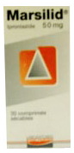
Exaptation and the adjacent possible
Exploration of the adjacent possible via functional adjacency
Designed as
Anti-tuberculosis
Antidepressant and revealed the existence of pharmacological psychiatry
mifepristone
Exploration of the adjacent possible via functional change and occasionally new mechanism of action
thalidomide

Slide 23
Exaptation and the adjacent possible
Invisible-to-paradigm, closed off by dogma, or simply unsuspected AP
Visible-to-paradigm AP
Area where targeted research dominates
Adjacent Possible (AP)
Boundary of current state of scientific and technological knowledge
Area where exploration via exaptation dominates; ex, discovery of antidepressant, microwave oven, antisepsis, X-ray
Stock of beliefs, accumulated experimental evidence, methodologies, methods in the scientific field x, together with supporting institutions, etc.

Slide 24

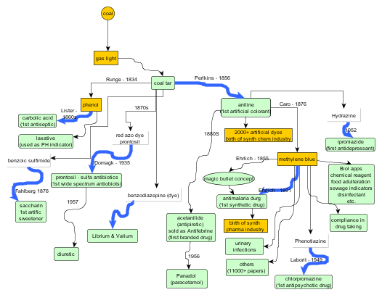
Some observations on the nature of discovery
Coal tar
First artificial colorant
First antiseptic
Origin of modern chemical industry
First antidepressant
First synthetic drug
First wide spectrum antibiotic
First tranquillizer
Origin of modern pharmaceutical industry
First antipsychotic

Slide 25
thank you for your attention!

Slide 26
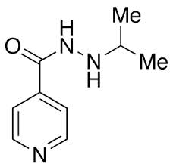

Marsilid - iproniazid
Kline: “ a group of clinical investigators were trying to convince a pharmaceutical house that they had a valuable product rather than the other way around” (Li, 2006)
Designed as
Anti-tuberculosis
antidepressant

Slide 27
Affordances
Iproniazid contains some chemical features that affords neuro-transmitter modulation.
The absorption (not reflection as in radars) of microwave by organic material generates heats and cooking. Microwave absorption affords cooking.
Affording feature may
  coincide with active agent of adaptive function (microwave radiation)
  Be different (in principle a different module, say, an excipient, lithium discovery case?)
Affordance may be based on continuity or not of phenomenon
  Discontinuity
    Marsilid is antibacterial for TB and NT modulator for depression
    Magnetron uses reflection for radar detection and absorption for cooking
  Continuity
    ecographer

Slide 28
Some observations on the nature of discovery
Exaptation: definition
The measure of exaptation
Exaptation and radical innovation
On distance and radiation of technologies

Slide 29
Questions?
Does the distance technologies ‘travel’ matter for innovation?
If yes, why would a larger distance favor radical innovation?
Why is the concept of distance absent in innovation studies?
Is there such a thing as ‘radiation’ of technologies?
If yes, are there general patterns in the radiation of technologies?
If yes, what type of innovations are more likely to radiate?

Slide 30
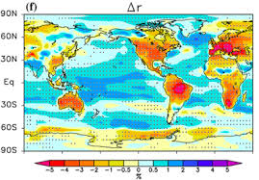
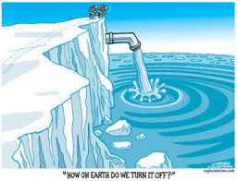
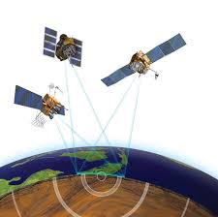
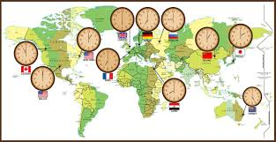
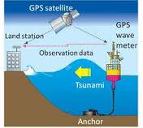


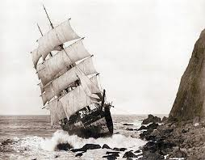




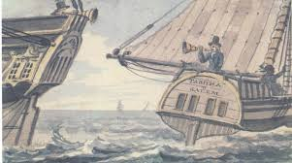

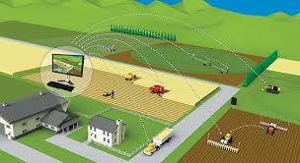


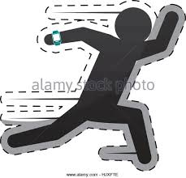
GPS
Humidity measurement
Glacier melting measurement
Earthquake detection
Universal time clock
Tsunami detection
Multiplexing
Assisted landing system
Guidance system
High-frequency trading
Precision agriculture
Electronic monitoring
Fleet management
Volcanic ash measurement
Geolocation

Slide 31
General patterns in radiation
Technologies show a tendency to radiate in adjacent and distant functional spaces.
The number of uses is unprestateable. The number of uses is always larger than the current set.
Uses can be adaptive or exaptive. A fraction of emergent uses is characterized by functional novelty (exaptive)
A fraction of emergent uses is radical
The radiation of exaptive uses is driven by affordances. The radiation of adaptive uses is driven by commonality of mechanisms and adjacency.
About 60% (?) of emergent uses is characterized by a large distance from the original use
Affordances are revealed by exposure to distant contexts
Notes:
1.

Slide 32
What are these ‘things’ (that are associated to a large distance)?
Surprise: large distance is not granted.
Radicalness associated with:
  Exaptation (functionally novel)
  Large distance
Their emergence requires exposure to very different context.
They seem to be based on novel phenomena or pathway.
They are based on unknown affordances that are revealed by exposure to new contexts.
Notes:
Large distance not granted. In fact, nothing prevents an adjacent (emergent) use to have a radical impact, say a drug developed for asthma and that is wildly successful for other bronchiopatic (not asthma-related) conditions.

Slide 33
Exaptive method
Answer to what problem?
Result
Reverse question
Adaptive method
What is the solution?
Problem
Direct question

Slide 34
Reverse question
Many of the essential medical discoveries in history came about not because someone came up with a hypothesis, tested it, and discovered that it was correct, but more typically because someone stumbled upon an answer, after some creative thought, figured out what problem had been inadvertently solved
Meyer (2007) Happy accidents: serendipity in major medical breakthroughs in the twentieth century, p.300

Slide 35
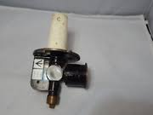
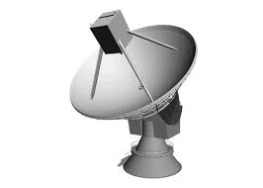

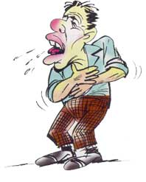

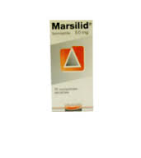
Condition 1: high distance
Context 1
Radar
Context 2
Kitchen appliance
distance
Context 1
Context 2
tuberculosis
depression

Slide 36

Condition 2: conflation of contexts
Context 1∩2
Context 1∩2
radar ∩ cooking
tuberculosis ∩ depression

Slide 37
Thus,
Exaptation is pervasive in technology development.
Exaptation is at the root of the emergence of entire industries (pharmaceutical, organic chemical, and microwave oven industries).
Exaptation leads to the discovery of new science: psychiatric biology (marsilid: antidepressant; chlorpromazine: antipsychotic), effect of microwave radiation on food.
Exaptation is a contributor to radical and incremental innovation.

Slide 38
Statistics:
Long tail of off-labels and exaptations per drug
7
4
1
1
2
1
1
1

Slide 39
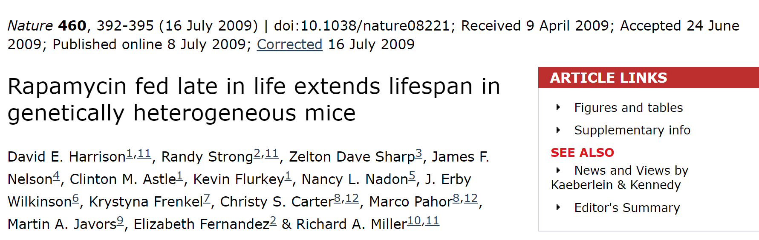
Case: rapamycin (sirolimus)
Discovered in 1960s Rapa Nui, Easter Islands, when scientists combing soil samples for antibacterial properties found rapamycin.
Rapamycin goes from antifungal to:
  Antibiotic
  Anticancer (blocks proliferation of cells)
  Immunosuppressant (main function)
  Life extension drug

Slide 40
Continuity and discontinuity in markets and technologies
Market discontinuity
Tech continuity
Market discontinuity
Tech discontinuity
Different
Market
Similar
Exaptive innovation
Radical innovation
Incremental Innovation
Incremental Innovation
Market continuity
Tech continuity
Market continuity
Tech discontintuity
Technology
Similar Different

Slide 41
Radical uses
Radical uses: uses that are new-to-the-world. Specifically this means new treatments for previously untreated diseases. The unit of adoption is the population of users characterized by a specific need. Radical uses may activate cascades of further uses.
Representative set of innovations (artefacts)
Identify complete set of
Functions
Partition
Partition
Adaptive
Exaptive
High impact
Low impact
Correlate the sets
Notes:
Measure exaptations and adaptations
Representative sample of innovations in a specific sector
Complete list of functions of the technologies in the sample
Ability to discriminate between adaptive and exaptive functions
Ability to identify extreme events

Slide 42
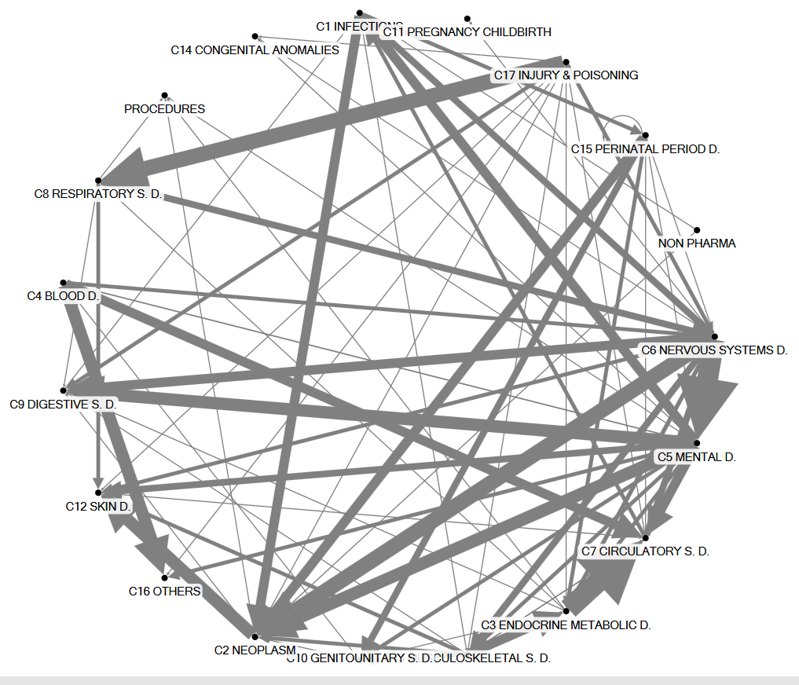
A geography of exaptations

