Slide 1
Experiments on Creativity elements enhancing or hindering creative actions
Massimo Egidi - megidi@luiss.it
Luiss university

Slide 2
Creativity in economics
Schumpeter gives a definition of creativity as the capacity to generate inventions/innovations
An innovation
“….From the standpoint of the observer who is in full possession of all relevant facts, it can always be understood ex post; but it can practically never be understood ex ante; that is to say, it cannot be predicted by applying the ordinary rules of inference from the pre-existing facts.”
(Schumpeter (1947), p. 150)

Slide 3
Creativity and unpredictability
The innovative process is typically characterized by initial conditions in which only one actor or a small group of actors initiate a project born by their imagination . The majority of actors of the economic arena disagree either about the goals to pursue or about the strategy to be actuated, or about the feasibility of the project. According to the majority of economic operators the success of the project is not predictable and the innovator is considered as an oracle , to whom they do not trust
“... Here the success of everything depends upon intuition, the capacity of seeing things in a way which afterwards proves to be true, even though it cannot be established at the moment, and of grasping the essential fact, discarding the unessential, even though one can give no account of the principles by which this is done” (Schumpeter, (1934) 85).

Slide 4
Creativity and competence gap
Now, assume that a grand master is invited for a tournemant in a chess club: if the members of the club have a normal expertise, they will be unable to predict the grand master’s moves because he draws upon a vastly wider repertoire of strategies and can explore in much greater depth than his opponent the possible sequences of moves-countermoves at his disposal.
To the eyes of the club players, the master’s strategy is unpredictable, and exhibits precisely the characteristics that Schumpeter attributes to an innovator.
This suggest to use the parable of grandmaster as a starting point for better understanding the cognitive aspects of innovative and creative processes . So far, then, we could explain innovation purely on the basis of the gap of competence between the innovator and the majority of economic operators. See Heiner (1983), 562
Then Schumpeter is implicitly suggesting that on average the economic operators are systematically below the competence which is needed to cope with the complexity of an evolutionary economic system ! This is exactly the contrary of Fama’s theory of efficient markets!

Slide 5
Creativity is not irrationality
Schumpeter analysis presupposes to assume limits on rationality and knowledge of individuals both in economics and politics; these limits are clarified and explored under the label of “conscious rationality”: in his view individuals may have different degrees of conscious rationality, insofar to practice rationality in a given domain is necessary to hold specific competence and knowledge.
When competence is very high, as happens for the entrepreneurial activity, rationality can be described as process of creative response, i.e. of discovery in uncertain conditions, analogous to Simon procedural rationality.
I argue that these similarities come from the fact that both the authors have to face the same problem: the task of explaining what happens when individuals have to cope with situations of unpredictability, uncertainty and complexity, and accordingly both must give a picture of human rationality that is based on search and innovation, and cannot be limited to the standard model.

Slide 6
Experiments on creativity : are chess grandmasters creative?
De Groot (1965) found that master chess players could reconstruct the position of pieces on a chessboard after only five seconds of study. He found a vast superiority of masters over weaker players in recalling meaningful information, which was not attributable to the masters’ superior memory capacity:
“This result could not be attributed to the masters’ generally superior memory ability, for when chess positions were constructed by placing the same numbers of pieces randomly on the board, the masters could then do no better in reconstructing them than weaker players. Hence, the masters appear to be constrained by the same severe short-term memory limits as amassed through years of constant practice.” (Chase and Simon 1973, pp. 55–6)
De Groot attributed the above-capacity performance of masters to an ability to classify groups of pieces as instances of familiar playing categories and accordingly concluded that the key to expertise does not lie in any superior general processing abilities, but rather in domain-specific skills. These skills provide masters with a fast, unconscious, perceptual capacity of process board configurations.

Slide 7
Experiments on creativity : are chess grandmasters creative?
How the process of creativity in chess playing can be described?
“One key to understanding chess mastery ... seems to lie in the immediate perceptual processing, for it is here that the game is structured, and it is here in the static analysis that the good moves are generated for subsequent processing.
Behind this perceptual analysis, as with all skills ... lies an extensive cognitive apparatus amassed through years of constant practice. What was once accomplished by slow, conscious deductive reasoning is now arrived at by fast, unconscious perceptual processing. It is no mistake of language for the chess master to say that he ‘sees’ the right move.” (Chase and Simon, 1973, p. 56)

Slide 8
Experiments on creativity : are chess grandmasters creative?
The advancements proposed by Simon and colleagues then led to the discovery that the architecture of thinking is characterized by a complex interaction between
the automatic and fast recall of the elements stored in the long-term memory
the conscious process of symbolic manipulation over the mental items.

Slide 9
Psychological Review
Copyright © 1977 C_7 by the American Psychological Association, Inc.
VOLUME 84 NUMBER 1 JANUARY 1 9 7 7
Controlled and Automatic Human Information Processing
Walter Schneider and Richard M. Shiffrin
A two-process theory of human information processing is proposed and applied to detection, search, and attention phenomena.
Automatic processing is activation of a learned sequence of elements in long-term memory that is initiated by appropriate inputs and then proceeds automatically—without subject control, without stressing the capacity limitations of the system, and without necessarily demanding attention.
Controlled processing is a temporary activation of a sequence of elements that can be set up quickly and easily but requires attention, is capacity-limited (usually serial in nature), and is controlled by the subject.

Slide 10
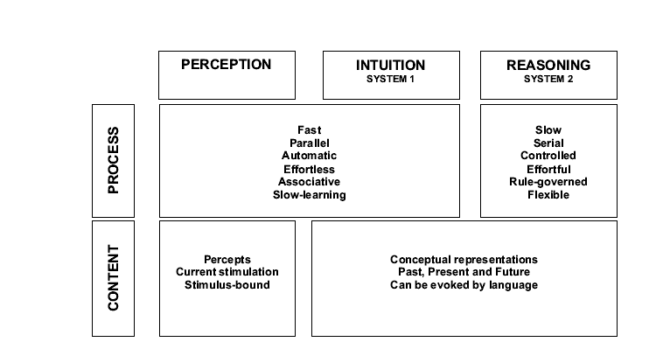
The dual process account of reasoning
From Kahnemann Nobel Lecture

Slide 11
Experiments on creativity
“Long-term memory holds cognitive schemata that vary in their degree of complexity and automation. Human expertise comes from knowledge stored in these schemata, not from an ability to engage in reasoning with many elements that have not been organized in long-term memory.
Human working memory simply is not able to process many elements. Expertise develops as learners mindfully combine simple ideas into more complex ones. A chess expert, for example, combines simple ideas about the best positioning of individual pieces to develop complex schemata of how several chess pieces should be positioned concomitantly.
These schemata organize and store knowledge, but also heavily reduce working memory load because even a highly complex schema can be dealt with as one element in working memory.”
Jeroen J. G. van Merrienboer and John Sweller «Cognitive Load Theory and Complex Learning: Recent Developments and Future Directions” Educational Psychology Review, Vol. 17, No. 2, June 2005 ( C 2005)

Slide 12
Two characteristics of routinized decision making
The response to a given pattern becomes automatic (after the period of learning)
The emergence of a response to a given pattern is out of the voluntary control

Slide 13
Routinization (Mechanization) of thougth
Routinized behavior reduces short-term memory load and mental effort
“In one study (Richard Haier et al. 1992), subjects' brains were imaged at different points in time as they gained experience with the computer game Tetris, which requires rapid hand-eye coordination and spatial reasoning. When subjects began playing, they were highly aroused and many parts of the brain were active (Next Figure ,left panel). However, as they got better at the game, overall blood flow to the brain decreased markedly, and activity became localized in only a few brain regions ( right panel). […..] the brain seems to gradually shift processing toward brain regions and specialized systems that can solve problems automatically and efficiently with low effort.” (Camerer, Loewenstein, Prelec, 2005)

Slide 14
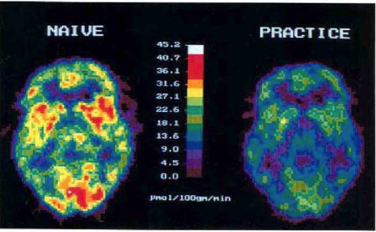

Slide 15

Routinization and Ambiguity in Perception
Missing Corner
It is not a normal cube, but one corner is missing. If you work on it, you can see an alternative interpretation: there is a smaller cube attached to the corner, in front of the larger cube . There is a third alternative view: imagine you’re looking at a room corner, and a cube is placed in that corner.
Uncontrolled eliciting process: The three views are different representations of the same information , but nobody can decide which one make emerge to the consciousness. Then accessibility is a property of memorized items that

Slide 16

Experiments on creativity
In spite of their importance to organizational theory, attempts to document empirically the feature of organizational routines have been very few; Michael Cohen (1994), with his experiment ‘Target the Two’, conducted with Bacdayan , is the first, notable exception.

Slide 17
Experiments on creativity
“One line of recent work in psychology has developed in a way that nicely reinforces traditional organization theory views of routine.
Work on procedural memory in human individuals has shown that it has distinctive properties. It is centered on skills, or know-how, rather than on facts, theories, or episodes (know what) which seem to be more the province of an alternate, "declarative", memory system.
Procedural memory differs from declarative in its long decay times, and greater difficulty of transfer and of verbalization. This fits nicely with properties of routines observed in the field and in the laboratory (Egidi, 1994; Cohen and Bacdayan, 1994).
And it appears to provide a firmer foundation in individual psychology for the characterization found in Nelson and Winter of routines as "tacit" and highly stable analogs of individual skills.” (Michael Cohen et alii, Industrial and Corporate Change, 1996)

Slide 18
Experiments on creativity
In a paper with Narduzzo, « The emergence of path-dependent behaviors in cooperative contexts”, In International Journal of Industrial Organization. 15(6), 677-709 we identify completely simple routinized condition-action rules that characterize different action patters.
Players discover very slowly a set of action rules, which generate routines. They start from generating a set of naive rules of thumb which maps key-configurations of the game onto moves. The simultaneous matching of this rules , that happens when on the board a mixed configuration appears, give rise to a process of learning (adaptation) which allow players to substitute conflicting rules and provide new rules for the ambiguous signals. The convergence speedness to a set of stable rules depends on the "story", i.e on the order of the sequence of boards (with different cognitive difficulties) .

Slide 19
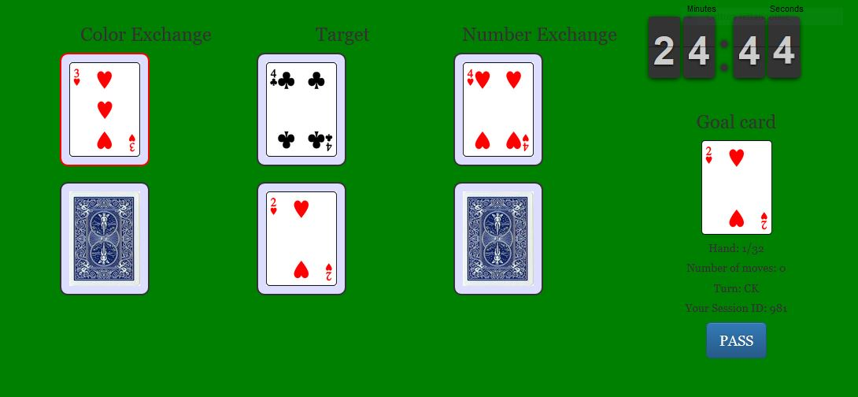
Target The Two

Slide 20
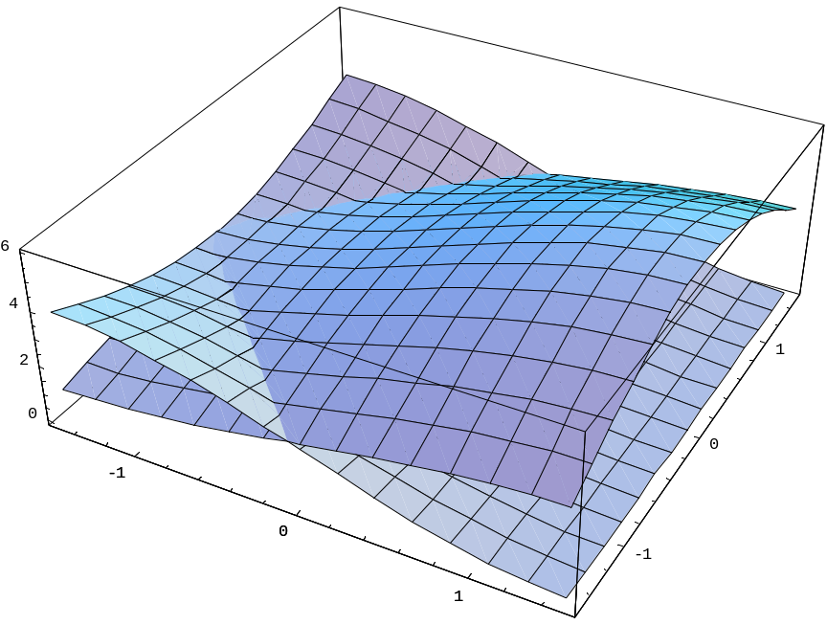
Two different routines’ efficiency

Slide 21
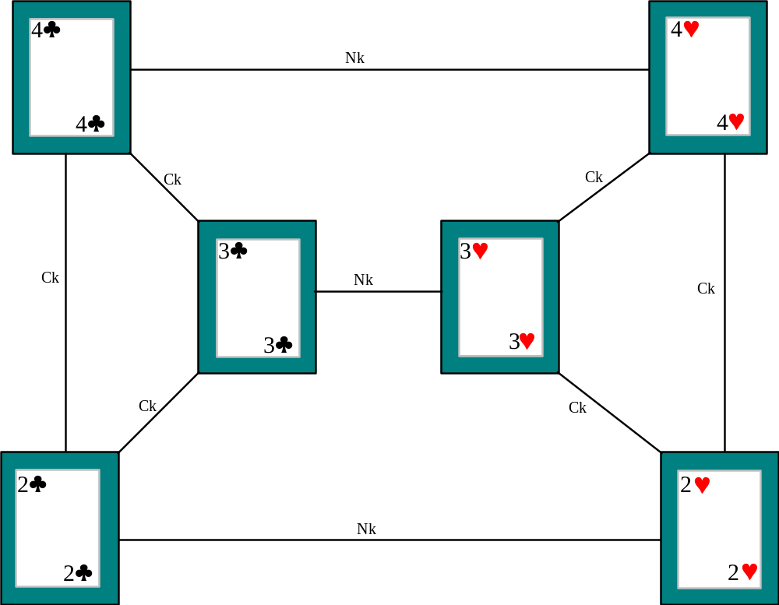
Experiments on creativity: The complete representation

Slide 22
Manipulating the frame of discovery
The working hypothesis of the experiment was that by exposing a group of players to a set of preliminary runs characterized by starting configurations all easily solved by the same strategy, they would be "induced" to discover this solution more easily than the alternative one and to memorize it more deeply.
We selected a set of starting configurations of the board all of which required very few moves to be played with the same strategy “Left”, while the alternative strategy required a higher number of moves. Analogously we prepared a set of starting configurations which were easy to play using the “Rigth” strategy. A tournament was organized as follows: in the first phase one group of players (called the Left group) was exposed to the set of configurations that was more efficiently solved playing the Left strategy. Another group (called the Rigth group) was exposed to hands more easily played with the Rigth strategy. Both groups were exposed to the same boards in the second part of the tournament, which consisted of hands with randomly distributed cards.

Slide 23
Experiments on creativity
We observed the emergence of a persistent differentiation in players' behavior. The group of players exposed to a set of configurations which led more easily to learn one strategy continued to use it more frequently in the second part of the tournament, and symmetric behavior arose in the other group.
Moreover in both groups there emerged a subset of players with strongly routinized behaviors, i.e. groups of players which, after the training phase, used the learned strategy for all runs of the tournament: they adopted a strategy once and for all and insisted on using it even when the configurations could not be efficiently played with the strategy adopted.

Slide 24
Experiments on creativity

Slide 25
Experiments on creativity

Slide 26
Accessibility
Why some players have been able to get out the trap of a routinized behavior , while many other remained locked in the old, consolidated routine?
Put in a different way, what are the elements that govern the choice between exploration and exploitation ? (Jim March)
A key element to answer to the problem is accessibility
As Kahneman notes:
The acquisition of skills gradually increases the accessibility of useful responses and of productive ways to organize information, until skilled performance becomes almost effortless. This effect of practice is not limited to motor skills. A master chess player does not see the same board as the novice (Kahneman, 2002, p. 453)

Slide 27
Experiments on creativity
In both experiments player’s attention was artificially manipulated. In fact during the preliminary training phase players were exposed to card distribution that led players to learn one strategy more easily than the other. After the training phase the key cards of one strategy were familiar to the players, and therefore more accessible than the key cards of the alternative strategy.
Thus the differential accessibility explains in a simple way why a large number of players continued to use the familiar strategy even when inefficient: they did not pay attention to the key card of the unfamiliar strategy.

Slide 28
Experiments on creativity
Of course, a question arises about the reasons why some players repeatedly employ the same strategy, while others are able to learn new ones.
One central element in beginning to answer this question is the role of automatic processes, in directing players’ attention. If players are more familiar with a strategy, the strategy directs their attention and search to the key cards relevant to actuate the strategy . Thus if strategy S₁ is more accessible to a player then S₂, he simply does not pays attention to the cards that should permit him to activate S₂.

Slide 29
Experiments on creativity
It follows that if one strategy comes to the mind of a player more easily than another, the effect is to free the memory load, direct attention, and filter ‘relevant’ information.
In consequence, it could reasonably be expected that the time taken to discover the second strategy varies in relation to the extent to which the first strategy governs the player’s attention. The ease with which the first strategy comes to the mind of a player can help or hinder the discovery of the second.

Slide 30
Hindering the discovery : Confirmations Bias
“The human understanding when it has once adopted an opinion (either as being the received opinion or as being agreeable to itself) draws all things else to support and agree with it. And though there be a greater number and weight of instances to be found on the other side, yet these it either neglects and despises, or else by some distinction sets aside and rejects;”
(Francis Bacon, Novum Organon, )

Slide 31
Confirmation bias
Confirmation bias ” refers usually to unwitting selectivity in the acquisition and use of evidence. The line between deliberate selectivity in the use of evidence and unwitting molding of facts to fit hypotheses or beliefs is a difficult one to draw in practice, but the distinction is meaningful conceptually, and confirmation bias has more to do with the latter than with the former.”
People tend to seek information that they consider supportive of favored hypotheses or existing beliefs and to interpret information in ways that are partial to those hypotheses or beliefs. Conversely, they tend not to seek and perhaps even to avoid information that would be considered counterindicative with respect to those hypotheses or beliefs and supportive of alternative possibilities (Koriat, Lichtenstein, & Fischhoff, 1980).

Slide 32
Confirmations Bias
Confirmation bias reinforces existing routines and directs predictably attention
«Social» and the building of echo chambers
The interaction between system one and system two has different effects: reducing biases in reasoning , creating new routines and re-organizing the system of the existing ones ( self-manipulaof symbols and simbolic representationstion )
The emergence of novelties is … anticipated by relaxing attention and coping with new representation of the old knowledge.

Slide 33
Heuristics come to mind without immediate control, and the only way to modify them is through a slow and effortful process of learning: “the acquisition of skills selectively increases the accessibility of useful responses”; the more the chess player become expert and the more sophisticated – and different – becomes the heuristic that emerges in face to the same distribution of pieces on a given chess board: therefore individuals, improving by prolonged practice their skill on a particular domain, may modify and increase accessibility to the memorized items. But in the short run the heuristic answer to a problem is rapid, effortless and out of the deliberate control. This originates two kinds of interference among the two processes elicited by System 1 and System 2.
On the one hand System 2 may modify, correct or reject the proposal of System 1. On the other hand the working of reasoning process (System 2) may be undermined by System 1 that can override with intuitive answers the results of System1.
Reasoning is therefore limited by two kind of limitations: on the one hand the interaction between the two systems, on the other the limits of computing ability of the (short term memory).

Slide 34
Accessibility
The fragility of the human capacity for reasoning can be corrected only in the long run because, according to the dual model, the recall of items that could hinder or foster the responses to given problems cannot be consciously controlled: the memorized items have different degrees of accessibility. In consequence, the only way to modify accessibility is through a slow process of learning .
According to Kahneman “the acquisition of skills selectively increases the accessibility of useful responses”. Chess provides a clear example: the more expert the chess player becomes, the more sophisticated – and different – becomes the heuristic that emerges when faced with the same distribution of pieces on a given chess board. Therefore individuals, improving their skill on a particular domain through prolonged practice, may modify and increase accessibility to the memorized items. Kahneman (2002), 453

Slide 35
Accessibility
Two conflicting processes are active: one the one hand the automatization of one strategy reduces the mental load permitting the exploration of new alternatives; on the other hand, automatization implies high accessibility to the familiar strategy and this, in turn, leads the attention to the strategy’s key-cards.

Slide 36
Accessibility
Once a player is familiar with one strategy and has reduced the mental load for solving the task, he may search for different strategies if his attention is not strictly focused on the key cards of the familiar strategy.
We can thus argue that a key element in understanding what triggers the search of a new strategy, is the strength with which the routinization directs the attention of the players, preventing a better solution being found.

Slide 37
Accessibility
This point has been clearly discussed by Bilalic, McLeod and Gobet (2008,2010) in recent papers. They show that having found one solution, expert chess players were looking for a better one. But their eye movements showed that they continued to look at features of the problem related to the solution they had already envisaged. So there are contrasting elements that prevent or lead to the discovery of a new solution and it is clear that some of these elements are not the product of a conscious deliberation .

Slide 38
Accessibility
An advancement in this respect, is due to Schuck et alii (2015) . Through multivariate neuroimaging analyses (MPFC) they show that before the spontaneous change to an alternative strategy, the medial prefrontal cortex encoded information that was irrelevant for the current strategy but necessary for the new one.

Slide 39
exploitation and exploration
A key element to understand the emergence of search and discovery is related to the opposition between strategy exploitation and exploration. This opposition has been first highlighted by Jim March (1991) and later discussed by Levinthal and March (1993). They suggest that during the adjustment to changing external conditions, organizations can be trapped into using strategies which only prove efficient in the short run.

Slide 40
exploitation and exploration
Organizations may not be able to jump out of the trap and reorganize themselves in a more efficient way when the external conditions change. As we have already seen, the same happens in Target The Two and thanks to the experimental data we can distinguish between the individual and the organizational elements that govern routinization and innovative behaviour.

Slide 41
exploitation and exploration
1 Uncertainty is an endogenous element implicit into the mental process of decision and creativity
2 The exploration/exploitation (march) mechanism has a individual counterpart which is largely unconscious and open only to long run process of learning and reinforcing of the competence
3 The notion of "cognitive traps", then, can be considered in both individual (Schuck et alii , 2015) and organizational (March and levinthal) contexts, and the problem of increasing the understanding of the connections between the micro, (neural and psychological) approach, and the “macro” (organizational data from the field) approach, is a challenging problem to pursue.

Slide 42
END

Slide 43
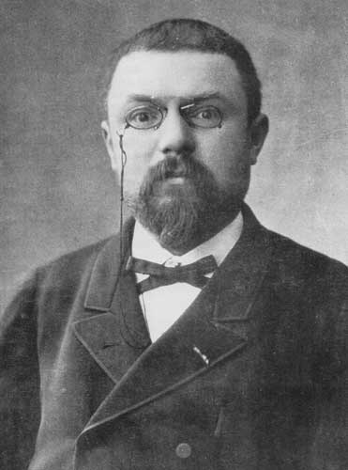
Henri Poincaré
Nancy, April 29 th 1854 – Paris, July 17th 1912
In fact, what is mathematical creation? It does not consist in making new combinations with mathematical entities already known. Any one could do that, but the combinations so made would be infinite in number and most of them absolutely without interest. To create consists precisely in not making useless combinations and in making those which are useful and which are only a small minority. Invention is discernment, choice.

Slide 44
Henri Poincaré
Nancy, April 29 th 1854 – Paris, July 17th 1912
To invent, I have said, is to choose; but the word is perhaps not wholly exact. It makes one think of a purchaser before whom are displayed a large number of samples, and who examines them, one after the other, to make a choice. Here the samples would be so numerous that a whole lifetime would not suffice to examine them. This is not the actual state of things. The sterile combinations do not even present themselves to the mind of the inventor. Never in the field of his consciousness do combinations appear that are not really useful, except some that he rejects but which have to some extent the characteristics of useful combinations.

Slide 45
Henri Poincaré
Nancy, April 29 th 1854 – Paris, July 17th 1912
Inspiration and sudden illumination
….. Most striking at first is this appearance of sudden illumination, a manifest sign of long, unconscious prior work. The rôle of this unconscious work in mathematical invention appears to me incontestable, and traces of it would be found in other cases where it is less evident.
…. The need for the second period of conscious work, after the inspiration, is still easier to understand. It is necessary to put in shape the results of this inspiration, to deduce from them the immediate consequences, to arrange them, to word the demonstrations, but above all is verification necessary.

Slide 46
Poincaré intuitions were rigth
Studies of cognitive neuroscientists show that the entire creative process– from preparation to incubation to illumination to verification-- consists of many interacting cognitive processes (both conscious and unconscious) and emotions. Depending on the stage of the creative process, and what you’re actually attempting to create, different brain regions are recruited to handle the task.
In a recent large review, Rex Jung and colleagues provide a "first approximation" regarding how creative cognition might map on to the human brain. Their review suggests that when you want to loosen your associations, allow your mind to roam free, imagine new possibilities, and silence the inner critic, it's good to reduce activation of the Executive Attention Network (a bit, but not completely) and increase activation of the Imagination and Salience Networks. Indeed, recent research on jazz musicians and rappers engaging in creative improvisation suggests that's precisely what is happening in the brain while in a flow state.

Slide 47
Representations
From the problem-space approach there emerged the idea that size of problem space (number of branches at each node and depth of search to a solution node) was a principal determinant of problem difficulty. This is certainly true (and mathematically demonstrable) if problems are solved by random trial-and-error search. However, it does not explain why some problems with quite small problem spaces are difficult for intelligent people. The Missionaries and Cannibals (Hobbits and Ores) problem has a problem space of only 16 nodes, and monster problem versions of the three-disk Tower of Hanoi problem, only 27 nodes. Both problems are known to be difficult for human subjects who encounter them for the first time. The Tower of Hanoi problem has long been a major task environment for work in problem solving. (Kotovsky, et al., 1985, pp. 247–8, italics added)

Slide 48
Representations
Simon claimed that the performance of all reasoning systems crucially depends on problem representation: the same problem might be easy or difficult, depending on the way we describe it. In The Sciences of the Artificial (1996), he discusses the representation problem in the context of design and suggests that problem solving can be read as changes of representation, ‘re-framing’ of a problem in a way that makes the solution easier. A comprehensive discussion of the state of the art in problem representation is provided by Eugene Fink (2002).

Slide 49
Back to Schumpeter
“From the standpoint of the observer who is in full possession of all relevant facts, it can always be understood ex post; but it can practically never be understood ex ante; that is to say, it cannot be predicted by applying the ordinary rules of inference from the pre-existing facts.” (Schumpeter (1947), p. 150)

