Slide 1





ECONOMIC COMPLEXITY:
KREYON Conference
Rome, Sept. 6-8, 2017
Measuring the Intangible Fitness of Countries and Complexity of Products
Luciano Pietronero^{1,2,3,5}
Collaborators: G. Chiarotti^{1,2}, G. Cimini^{1,2,} M. Cristelli^{1,2,5}, R. Di Clemente^{1,2},
A. Gabrielli^{1,2,3},E. Pugliese^{1,2,5}, F. Saracco^{1,2}, F. Sylos Labini^{1,4} , T. Squartini^{1,2},
A. Tacchella^{1,2,5}, A. Zaccaria^{1,2,5}
[1] Institute for Complex Systems, CNR, Rome, Italy; [2] ”Sapienza” University of Rome, Italy
[3] London Institute for Mathematical Sciences, UK; [4] Centro Fermi, Rome,
[5] IFC World Bank Group, Washington

Slide 2

Paul Romer (World Bank, Chief Economist)
Present standard Economy: “Church of Scientology”
Equilibrium approach: Physics of XIX century unable to capture complexity
Fundamental concepts for a new economic theory: interactions, heterogeneity, self-organization, data mining algorithms, emerging properties → Complexity

Slide 3
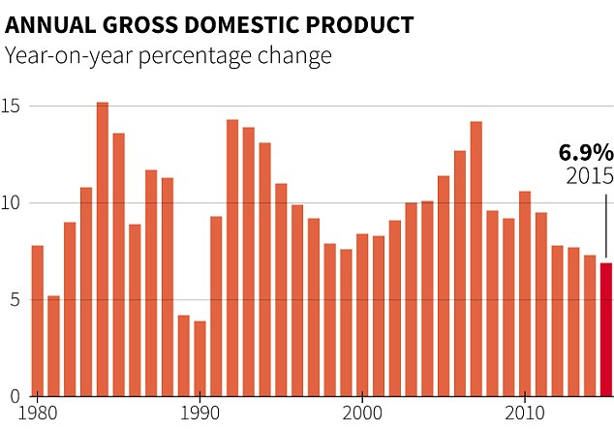
THE FANTASTIC GROWTH OF CHINA 1980-2017 AND ???

Slide 4
https://www.quora.com/profile/Godfree-Roberts
ECONOMIC PREDICTIONS ABOUT CHINA:
1990. The Economist. China's economy has come to a halt.

Slide 5
https://www.quora.com/profile/Godfree-Roberts
ECONOMIC PREDICTIONS ABOUT CHINA:
1990. The Economist. China's economy has come to a halt.
1996. The Economist. China's economy will face a hard landing
1998. The Economist: China's economy entering a dangerous period of sluggish growth.

Slide 6
https://www.quora.com/profile/Godfree-Roberts
ECONOMIC PREDICTIONS ABOUT CHINA:
1990. The Economist. China's economy has come to a halt.
1996. The Economist. China's economy will face a hard landing
1998. The Economist: China's economy entering a dangerous period of sluggish growth.
1999. Bank of Canada: Likelihood of a hard landing for the Chinese economy.
2000. Chicago Tribune: China currency move nails hard landing risk coffin.
2001. Wilbanks, Smith & Thomas: A hard landing in China.
2002. Westchester University: China Anxiously Seeks a Soft Economic Landing

Slide 7
https://www.quora.com/profile/Godfree-Roberts
ECONOMIC PREDICTIONS ABOUT CHINA:
1990. The Economist. China's economy has come to a halt.
1996. The Economist. China's economy will face a hard landing
1998. The Economist: China's economy entering a dangerous period of sluggish growth.
1999. Bank of Canada: Likelihood of a hard landing for the Chinese economy.
2000. Chicago Tribune: China currency move nails hard landing risk coffin.
2001. Wilbanks, Smith & Thomas: A hard landing in China.
2002. Westchester University: China Anxiously Seeks a Soft Economic Landing
2003. New York Times: Banking crisis imperils China
2004. The Economist: The great fall of China?

Slide 8
https://www.quora.com/profile/Godfree-Roberts
ECONOMIC PREDICTIONS ABOUT CHINA:
1990. The Economist. China's economy has come to a halt.
1996. The Economist. China's economy will face a hard landing
1998. The Economist: China's economy entering a dangerous period of sluggish growth.
1999. Bank of Canada: Likelihood of a hard landing for the Chinese economy.
2000. Chicago Tribune: China currency move nails hard landing risk coffin.
2001. Wilbanks, Smith & Thomas: A hard landing in China.
2002. Westchester University: China Anxiously Seeks a Soft Economic Landing
2003. New York Times: Banking crisis imperils China
2004. The Economist: The great fall of China?
2005. Nouriel Roubini: The Risk of a Hard Landing in China

Slide 9
https://www.quora.com/profile/Godfree-Roberts
ECONOMIC PREDICTIONS ABOUT CHINA:
1990. The Economist. China's economy has come to a halt.
1996. The Economist. China's economy will face a hard landing
1998. The Economist: China's economy entering a dangerous period of sluggish growth.
1999. Bank of Canada: Likelihood of a hard landing for the Chinese economy.
2000. Chicago Tribune: China currency move nails hard landing risk coffin.
2001. Wilbanks, Smith & Thomas: A hard landing in China.
2002. Westchester University: China Anxiously Seeks a Soft Economic Landing
2003. New York Times: Banking crisis imperils China
2004. The Economist: The great fall of China?
2005. Nouriel Roubini: The Risk of a Hard Landing in China
2006. International Economy: Can China Achieve a Soft Landing?
2007. TIME: Is China's Economy Overheating? Can China avoid a hard landing?
2008. Forbes: Hard Landing In China?
2009. Fortune: China's hard landing. China must find a way to recover.
2010: Nouriel Roubini: Hard landing coming in China.

Slide 10
https://www.quora.com/profile/Godfree-Roberts
ECONOMIC PREDICTIONS ABOUT CHINA:
1990. The Economist. China's economy has come to a halt.
1996. The Economist. China's economy will face a hard landing
1998. The Economist: China's economy entering a dangerous period of sluggish growth.
1999. Bank of Canada: Likelihood of a hard landing for the Chinese economy.
2000. Chicago Tribune: China currency move nails hard landing risk coffin.
2001. Wilbanks, Smith & Thomas: A hard landing in China.
2002. Westchester University: China Anxiously Seeks a Soft Economic Landing
2003. New York Times: Banking crisis imperils China
2004. The Economist: The great fall of China?
2005. Nouriel Roubini: The Risk of a Hard Landing in China
2006. International Economy: Can China Achieve a Soft Landing?
2007. TIME: Is China's Economy Overheating? Can China avoid a hard landing?
2008. Forbes: Hard Landing In China?
2009. Fortune: China's hard landing. China must find a way to recover.
2010: Nouriel Roubini: Hard landing coming in China.
2011: Business Insider: A Chinese Hard Landing May Be Closer Than You Think
2012: American Interest: Dismal Economic News from China: A Hard Landing
2013: Zero Hedge: A Hard Landing In China
2014. CNBC: A hard landing in China.
2015. Forbes: Congratulations, You Got Yourself A Chinese Hard Landing.
2016. The Economist: Hard landing looms for China
2017. National Interest: Is China's Economy Going To Crash?

Slide 11

BBC NEWS 17 July 2017
China's second quarter growth beats expectations at 6.9%
From the section Business

Slide 12
FORECASTING IN THE ERA OF BIG DATA
MORE DATA ALWAYS LEAD TO BETTER FORECASTING

Slide 13
FORECASTING IN THE ERA OF BIG DATA
MORE DATA ALWAYS LEAD TO BETTER FORECASTING
WRONG!

Slide 14
FORECASTING IN THE ERA OF BIG DATA
MORE DATA ALWAYS LEAD TO BETTER FORECASTING
WRONG!
MORE DATA CAN GIVE MORE INFORMATION
BUT UNAVOIDABLY LEAD TO MORE NOISE
LARGE DIMENSION OF DATA IS PROBLEMATIC
SIGNAL TO NOISE RATIO IS THE KEY POINT
EDUCATION + POLLUTION = ???

Slide 15
Monetary measures
Metrics for intangibles
(GDP, GDPpc, etc)
NEW INFORMATION
M. Cristelli, A. Tacchella, L. Pietronero, The Heterogenous Dynamics of Economic Complexity (2015)
M. Cristelli, A. Tacchella, L. Pietronero, Economic Complexity: Measuring the Intangibles (ebook)

Slide 16
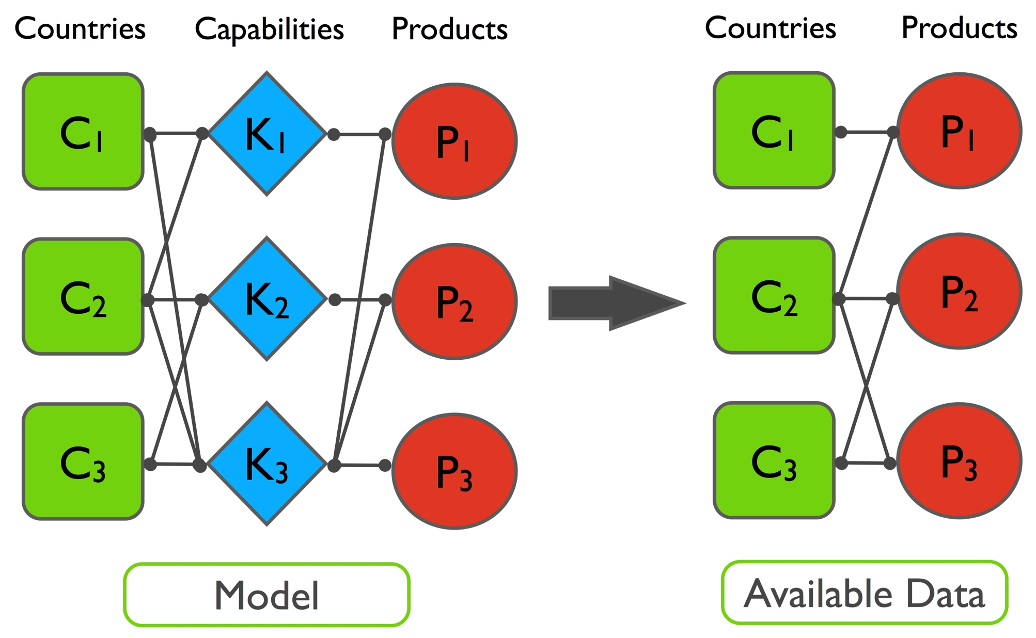
THE CONCEPT OF HIDDEN CAPABILITIES
A COUNTRY IS ABLE TO PRODUCE A PRODUCT WHEN IT OWNS ALL THE CAPABILITIES NEEDED FOR IT (Hidalgo&Hausmann 2009)
BIG DATA = BIG NOISE (Nate Silver: “The Signal and the Noise”)
BIG DATA STARTS WITH SMALL DATA (From 100 to zero parameters)
COMTRADE: real products; services and finance will be added soon
HOW TO MEASURE CAPABILITIES FROM THE AVAILABLE DATA?

Slide 17
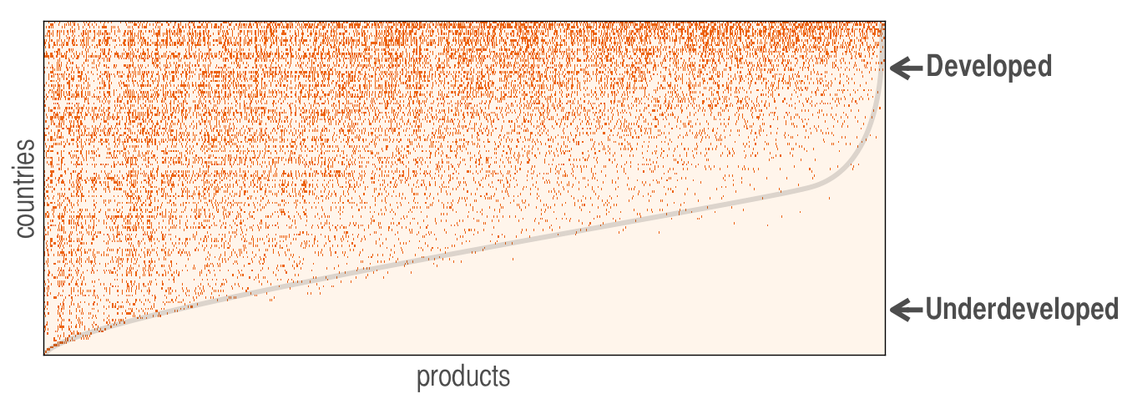
SPECIALIZATION VS. DIVERSIFICATION
DATA DRIVEN APPROACH:
Evidence for leading role of diversification with respect to competitive advantage (specialization)
Globalization
Ecosystems
Evolvability
Adaptation
From Qualitative to Quantitative
Math. Problem: minimal elements to have a triangilar matrix
Complex Hierarchical structure, nestdness etc.
For sectors and companies the situation evolves towards specialization

Slide 18
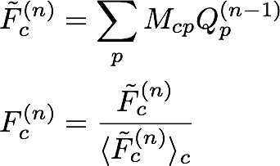
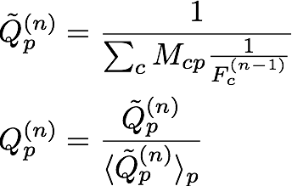
We measure the Fitness of countries (DNA/intangibles) and the Complexity of products with an iterative Google-like algorithm for the bipartite country-product network
Fitness
Complexity
EACH PROBLEM REQUIRES SPECIFIC CONCEPTS AND ALGORITHMS
NETWORK (links rather than sites) IS A KEY CONCEPT
BUT THERE WILL BE NO COOK BOOK
THERE IS LIFE AFTER GOOGLE PAGE RANK (which works independently
on the specific network structure, i.e. communities)

Slide 19
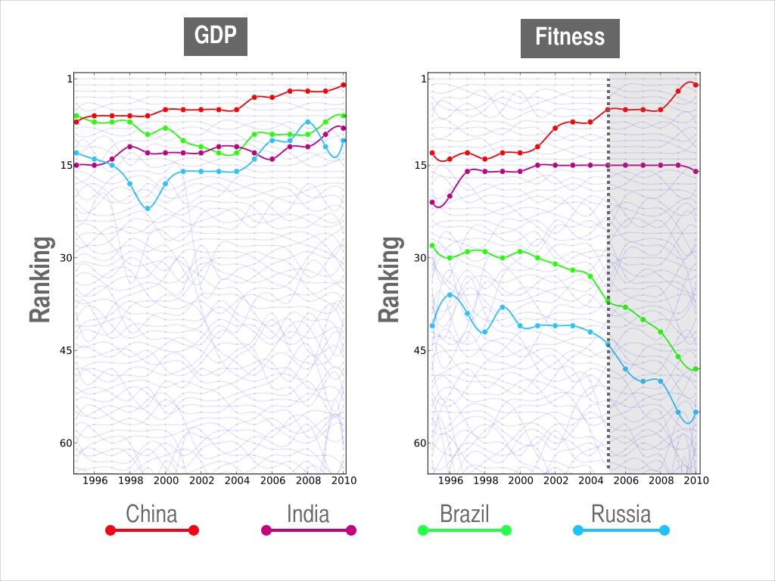
Goldman Sachs 2001:
BRIC countries will dominate the
World economy for the next 50 years
Bloomberg News November 2015:
Goldman's BRIC era ends as
Fund folds after years of losses

Slide 20
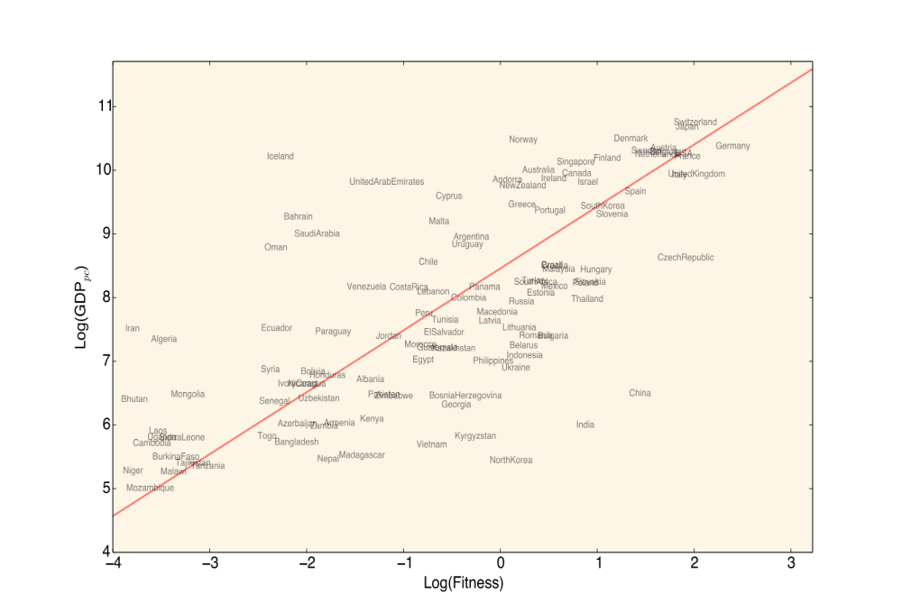
1995

Slide 21
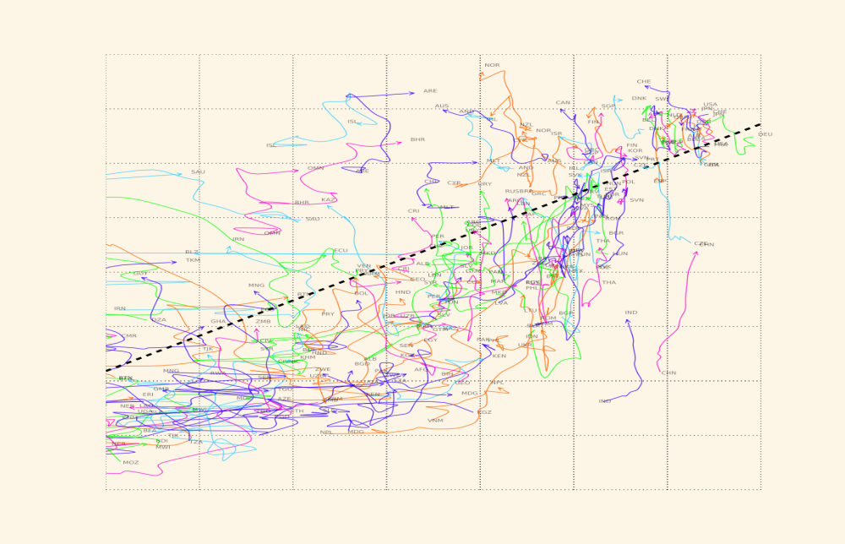
ECONOMIC DYNAMICS IS HETEROGENEOUS

Slide 22
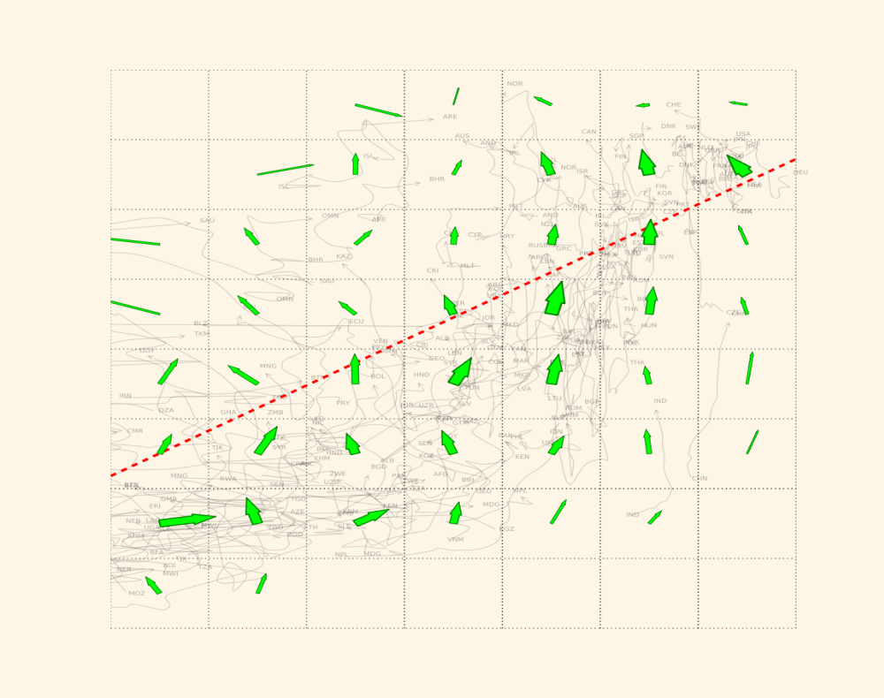
COARSE GRAINED DYNAMICS:
PREDICTABILITY DEPENDS ON THE ZONE

Slide 23
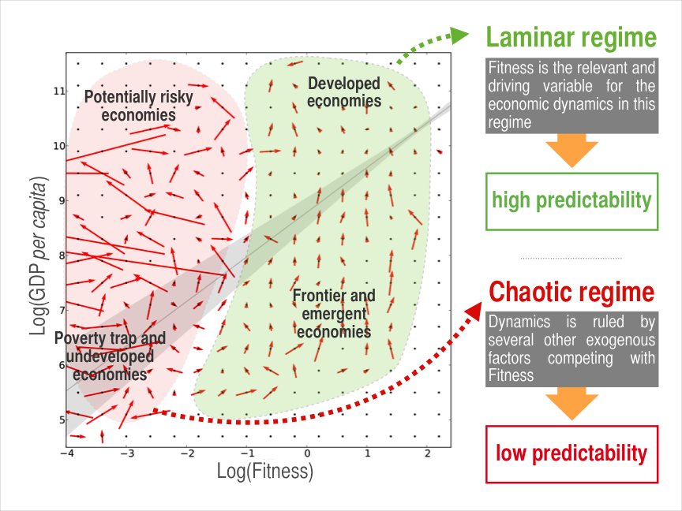

Slide 24
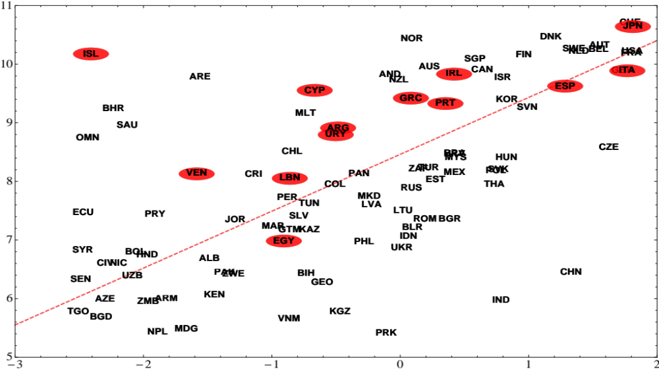
RISK: FITNESS vs. GDP_{pc}
: Major rating downgrades 1995-2010
“HOW MUCH YOU EARN”
“HOW GOOD YOU ARE”

Slide 25
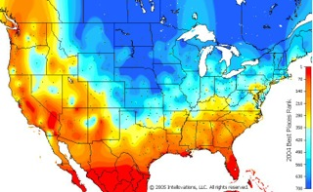
Hetreogeneous Weather Forecasting:
RED: High predictability BLUE: Low predictability

Slide 26
Predictability – Forecasting (Beyond Regressions)
Heterogeneous Growth Dynamics: Selective Predictability
Overview of scienfic predictions:
If one KNOWS the equation of motion:
- Linear dynamics: full predictability. Sun raises tomorrow at 06:22
Halley comet will come back in 121y, 237days, 13h, 45 min, 12 sec
- Nonlinear chaotic dynamics: Lyapunov exponents
Weather forecasts, limit of 3 – 7 days
BUT: don’t buy a calendar for more than 5 million years
If one DOES NOT KNOW the equation of motion:
Method of Analogous: dynamical system approach; effective dimension of
phase space. New in economics; concretely data-driven
Method of Regressions: cause-effect relation; homogeneity of response etc.

Slide 27
Method of Analogues
forecasting the future by the knowledge of the past
Empirical Evo.
Distribution
approach conceptually similar to non-parametric regressions

Slide 28
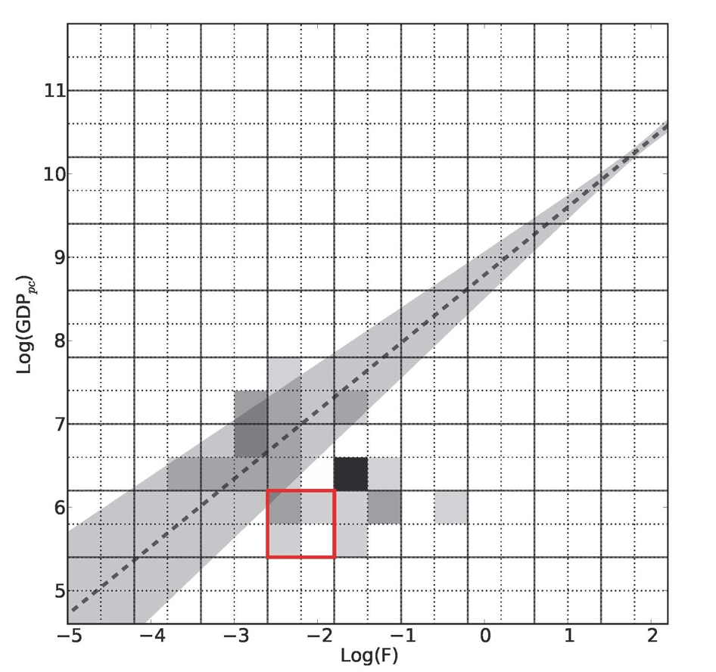
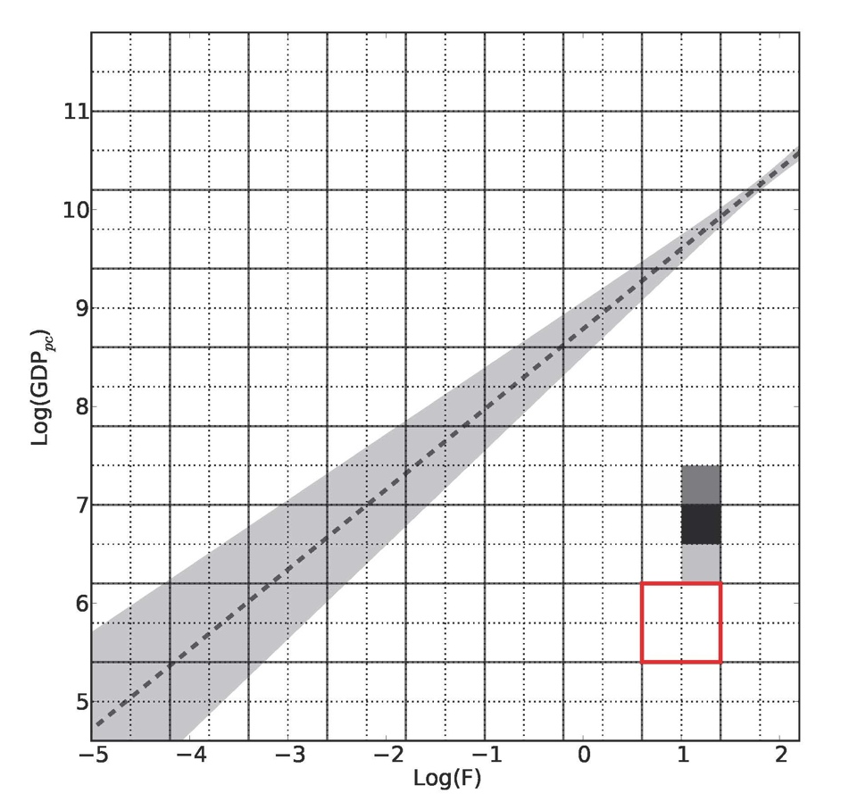
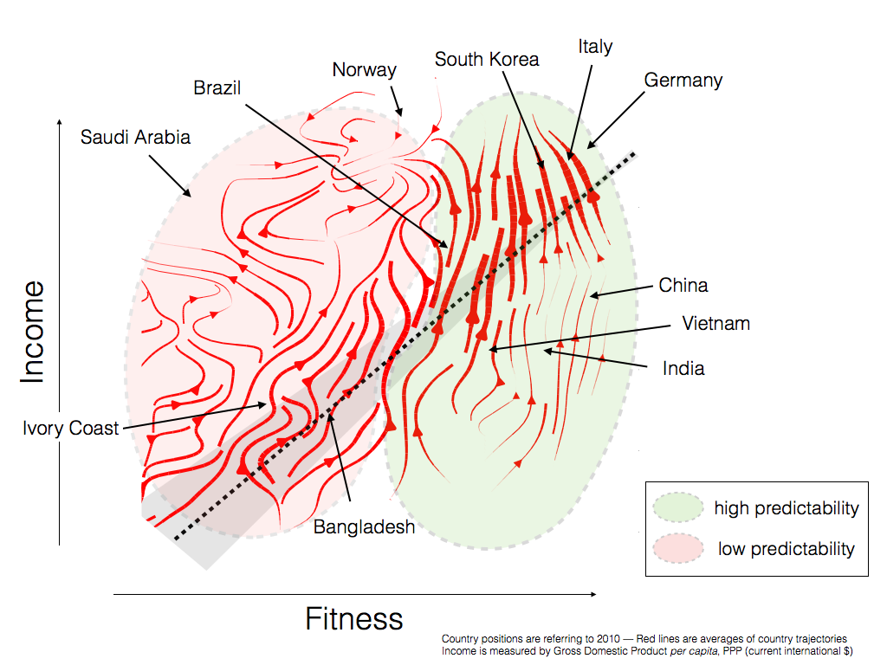
The Selective Predictability Scheme (SPS)
In the laminar regime (green area) the evolution of countries tends to be highly predictable
SPS = forecasting the future by the knowledge of the past (green area)

Slide 29
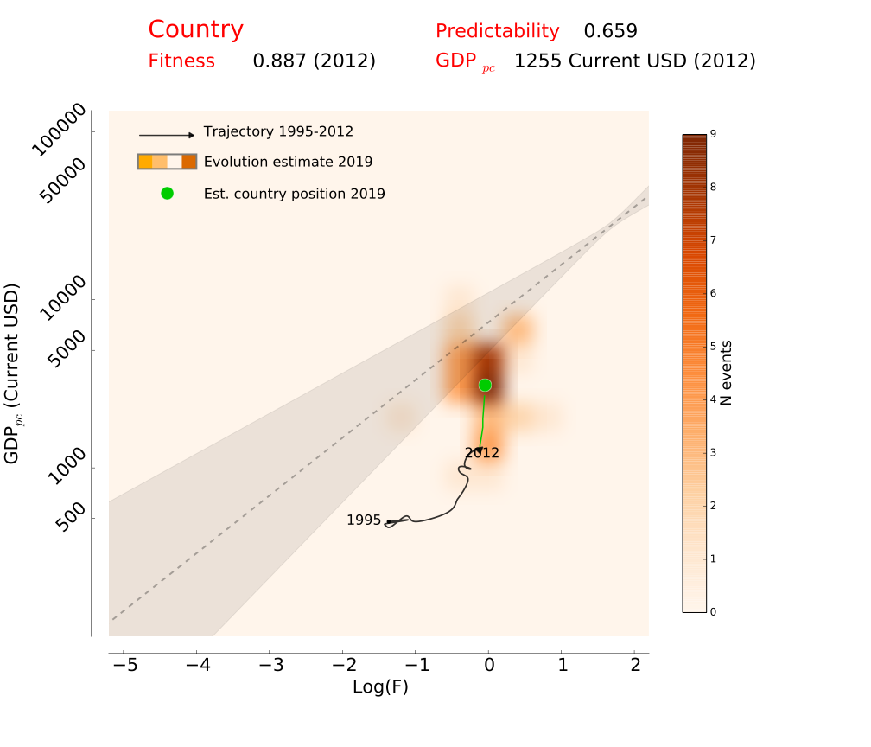
NEW: AZIMUT INVESTMENT FUND
1

Slide 30
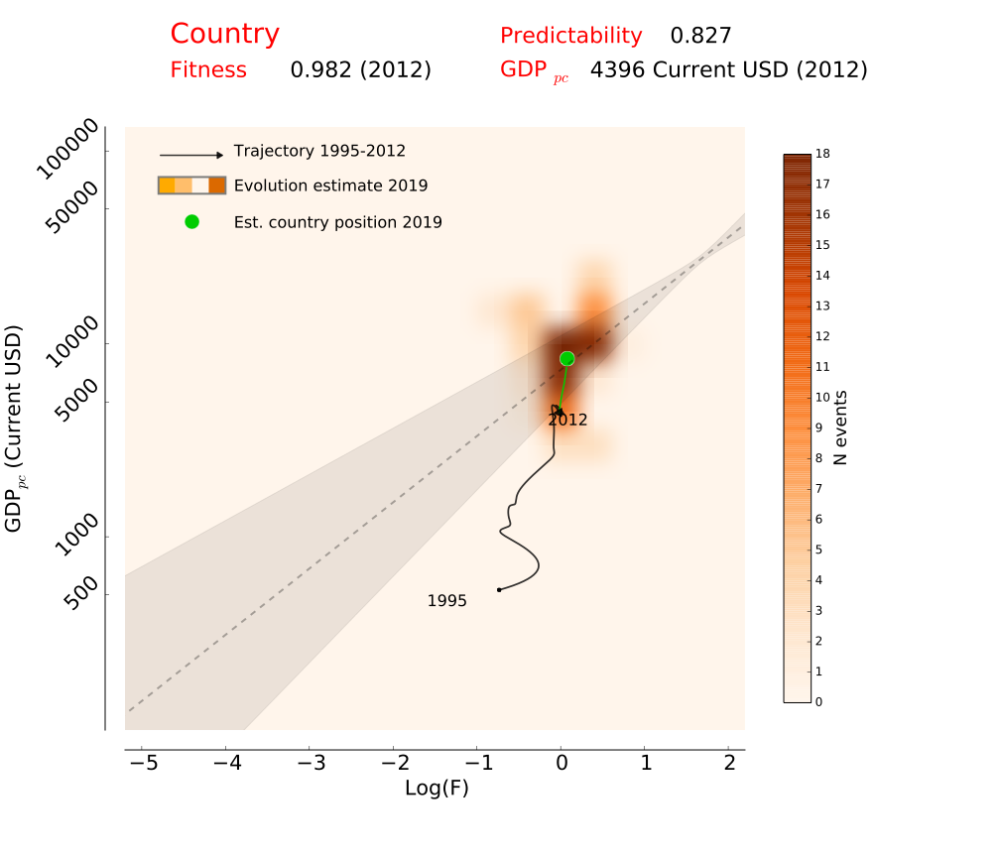
6

Slide 31
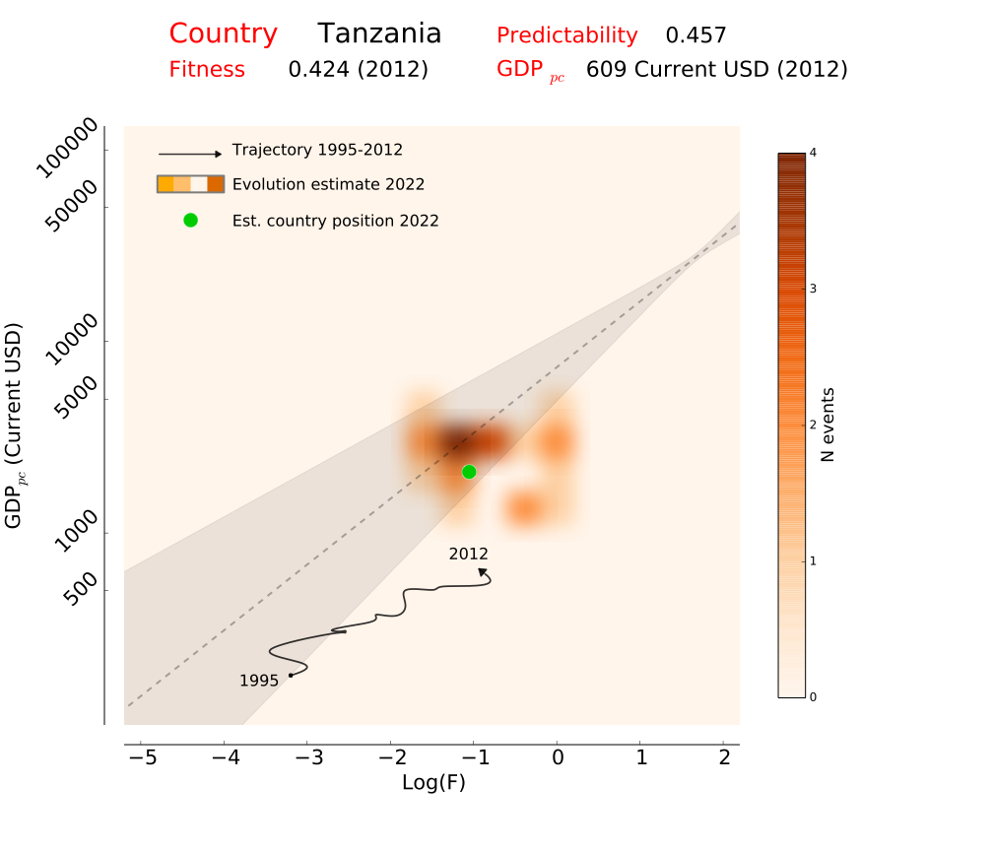

Slide 32
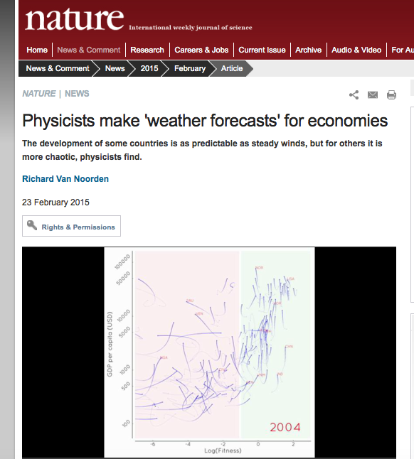
NEW:
M. Cristelli, A. Tacchella, L. Pietronero
THE HETEROGENEOUS DYNAMICS OF ECONOMIC COMPLEXITY
PLoS ONE 10(2): e0117174. doi:10.1371/journal.pone.0117174 (2015)

Slide 33
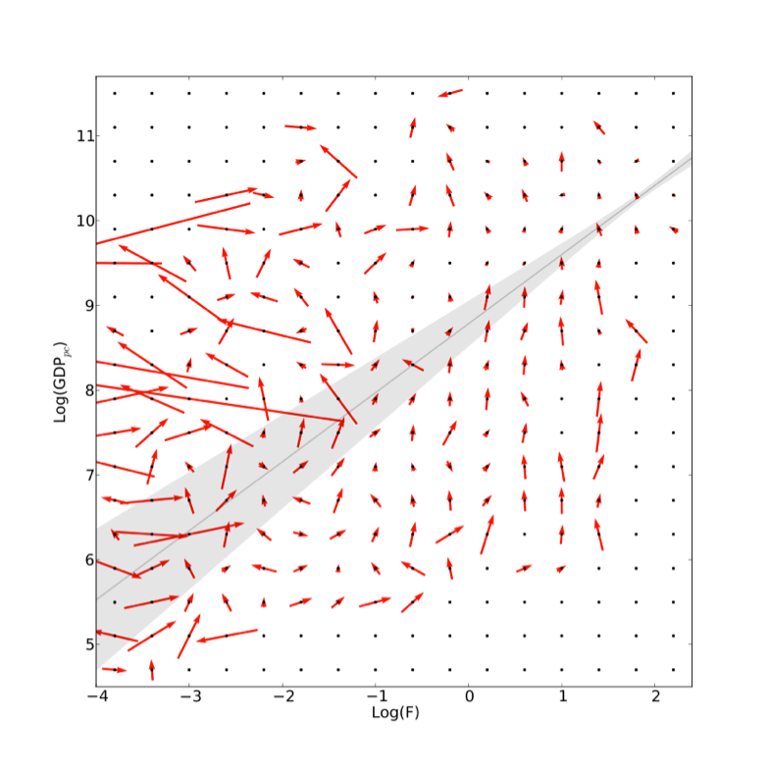
Borrowing concepts from dynamical systems
Laminar regime
Low effective dimension (de ≈ 2)
Fitness is the relevant and driving variable for the economic dynamics in this regime
Chaotic regime
Chaotic dynamics
de ≫ 2
Dynamics is ruled by several other exogenous factors competing with Fitness
SELECTIVE PREDICTABILITY
VERY DIFFERENT FROM STANDARD REGRESSIONS

Slide 34
1. Feature Selector in a suitable space (Fitness-GDPpc Plane) to find candidates for analogues events
2. Operative Method to assess the goodness of the analogues selected and therefore how fit is the strategy to forecast the future with the past (i.e. it measures the level of predictability of the economic dynamics)
Selective Predictability Scheme acts as:

Slide 35
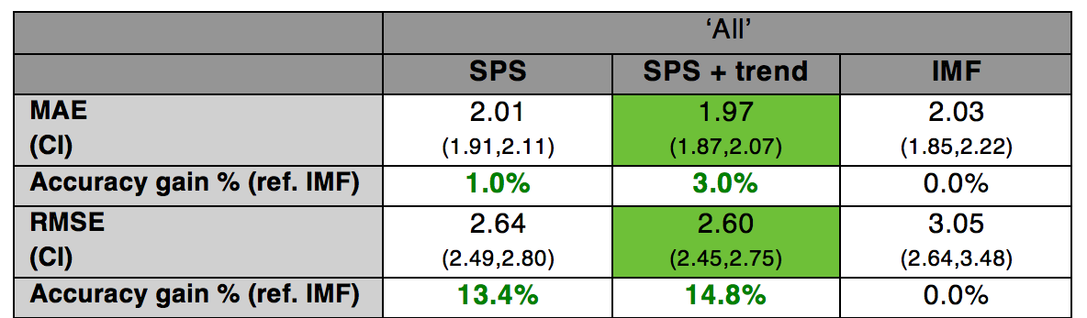
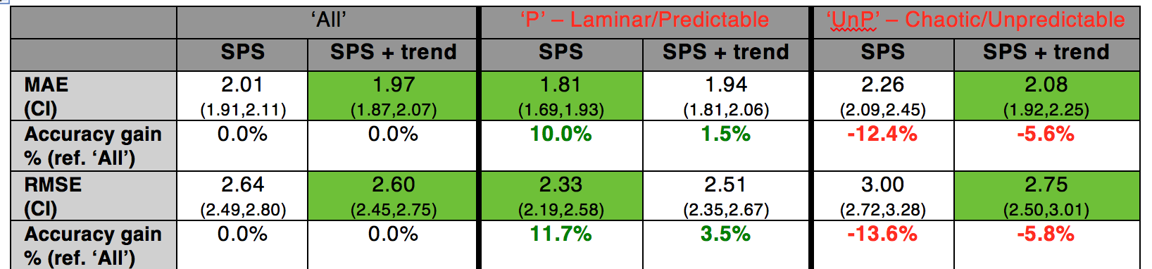
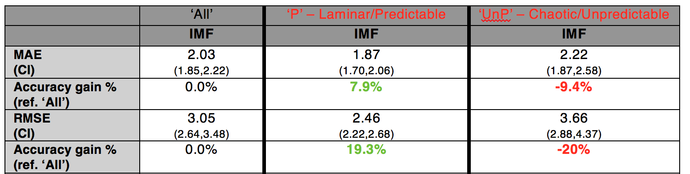
all countries
lam.
regime
lam. regime
matters for
IMF too

Slide 36
NB: IMF models have at least 25 parameters/dimensions, country specific assumption, macro economic assumptions
NB2: IMF has 2400 employees, 1200 are economists.
Behind the scenes of SPS, there are 5-10 persons.

Slide 37
David Pilling Financial Times Nov. 19 2014
“What goes up must eventually come down – even China”
Regression to mean could spell trouble for Asian powerhouses.
What would China look like if it were growing at just 2 per cent a year?
(NB: China has been growing up to 10% a year and now it is 7-8%).
According to an influential paper by US economists Lant Pritchett and
Lawrence Summers. For them, “the single most robust and striking fact”
about growth is “regression to the mean” of about 2 per cent.
Only rarely in modern history, they say, have countries grown at “super-rapid”
rates above 6 per cent for much more than a decade. China has managed to
buck the trend since 1977 by harnessing market forces, engineering possibly
the longest spell “in the history of mankind”. But what goes up, the authors tell us,
Must eventually come down.

Slide 38
Mark Buchannan Bloombergs View March 1, 2015
“China Might Stll be Booming”
Where will China and India be in a decade, economically speaking?
Judging from the abnormal speed at which they have grown in recent decades,
most forecasters think they are due for a slowdown -- and, in the case
of China, possibly even a crash.
As Lant Pritchett and Lawrence Summers have demonstrated, … history shows
that periods of fast growth generally portend reversals back to the world average.
Recently, however, researchers have been developing new ways to forecast
economic performance. A group of researchers at Rome Sapienza, using methods
drawn from the analysis of dynamical systems and adding the new concept of
Fitness, reach different conclusions. The physicists' insight could have big
implications for China and India.
To be sure, the new research is highly unconventional, and provides only a taste
of what we might be able to learn by tapping big data and going beyond the
simple statistical analysis techniques that economists commonly use.
That said, by wading into the messy details of actual economic activity,
it does offer a promising way to forecast growth -- and grounds for much
more optimism about the future of the developing world.

Slide 39
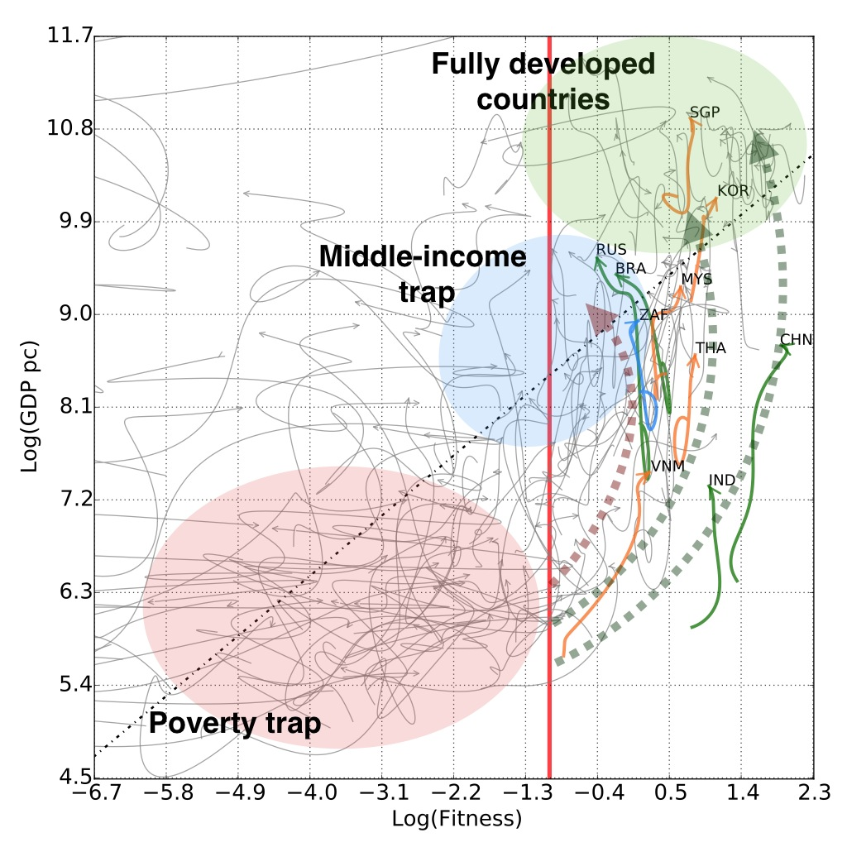
NEW: DEBATE ABOUT CHINA PERSPECTIVES

Slide 40
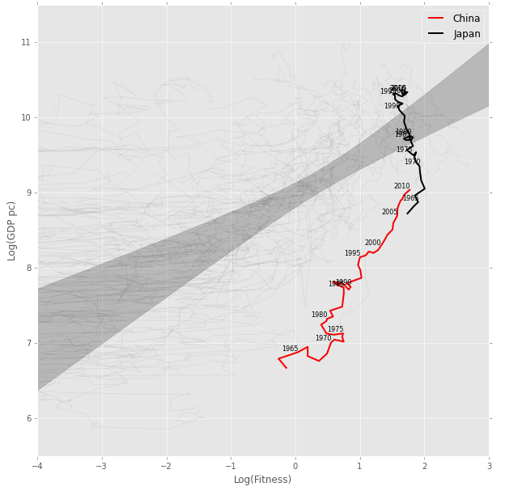
1963-2010

Slide 41
Incorporating the Value Added into
New Development Economics:
Compare the Fitness of the exported products
with that of the intermediate products imported
Measure the Complexity gap between import and final output
Fitness Added: FA =log(Fexport)-log(Fimport)

Slide 42
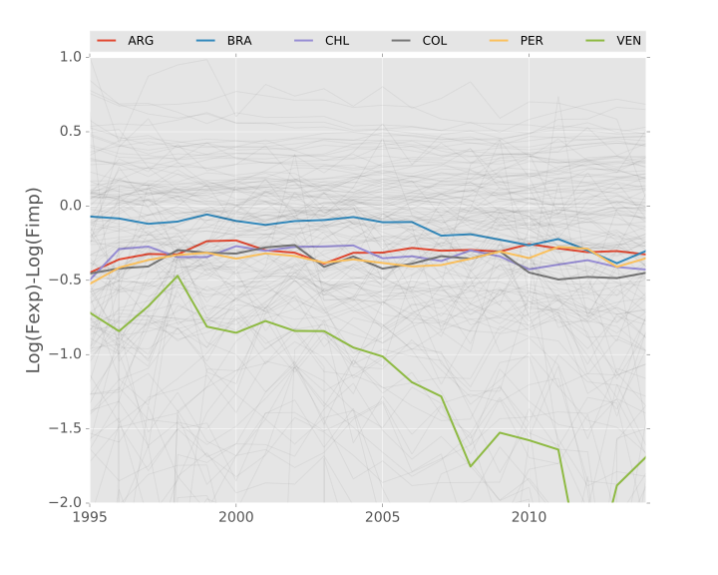
Time evolution FA:1995-2014

Slide 43
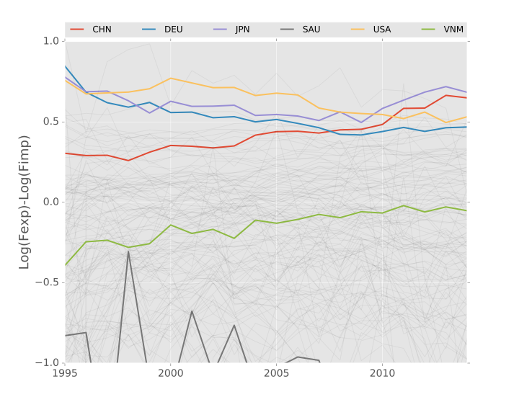
Time evolution FA:1995-2014

Slide 44
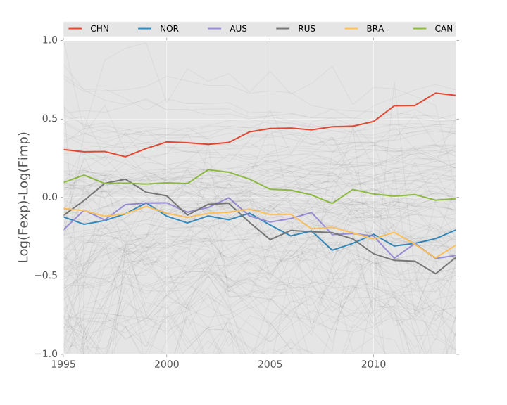
Time evolution FA:1995-2014

Slide 45
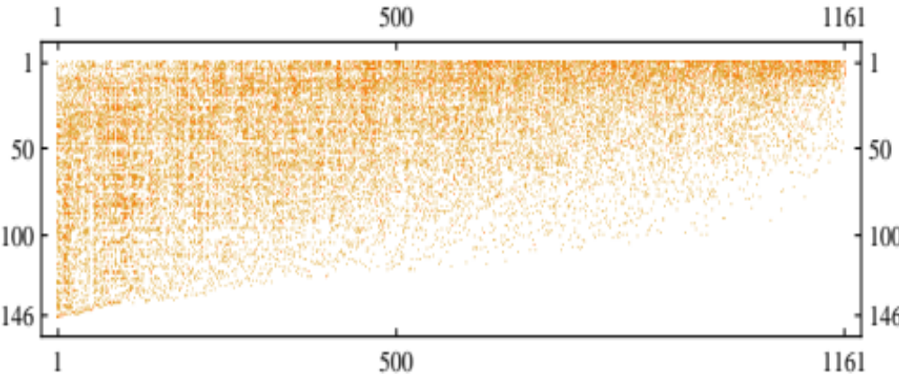
The PRODUCT SPACE:Bipartite C-P network
Contraction: P-P network
Filtering Procedure: selecting “dependency” links
The “Product Space”

Slide 46
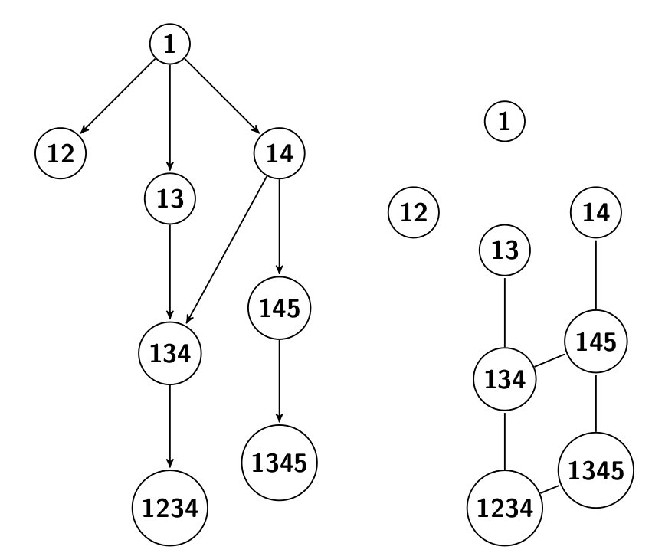
The Complex Taxonomy of Products
Vicinity
Time
evolution
Definition of products in terms of the needed capabilities
Hierarchical, tree-like structure
Directed vs undirected edges (time evolution)
Possibility to understand and forecast development

Slide 47
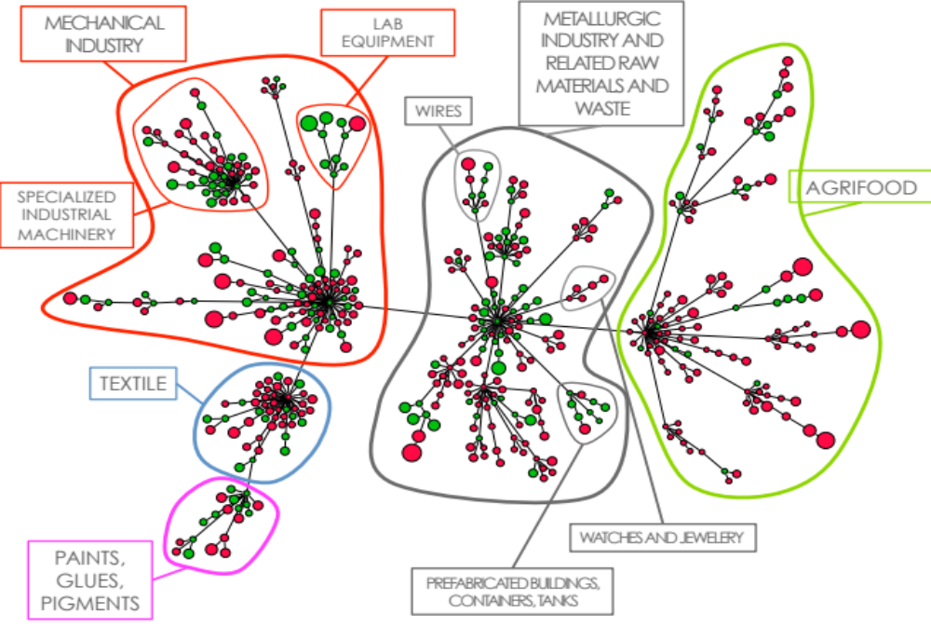
SWEDEN: PORTION OF THE PRODUCT SPACE

Slide 48
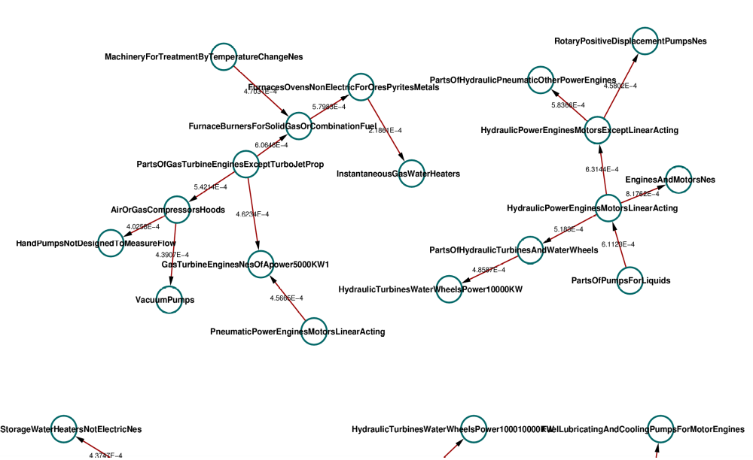
Product Progression Network
Example: components regarding hydraulic turbines, water wheels etc.
Validated & used for consulting by the World Bank: it reflects real processes and supply chains

Slide 49
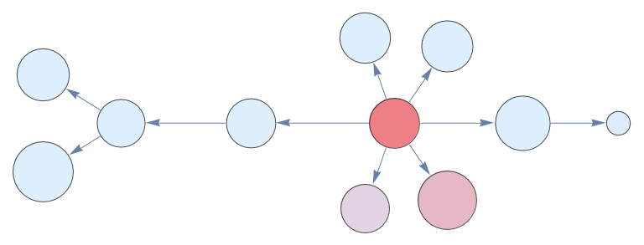
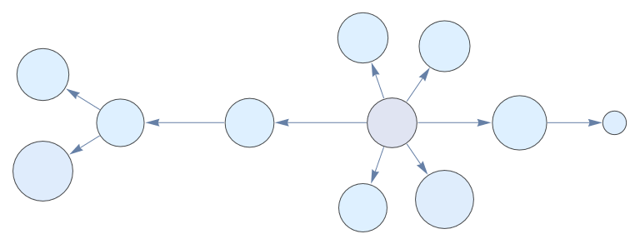
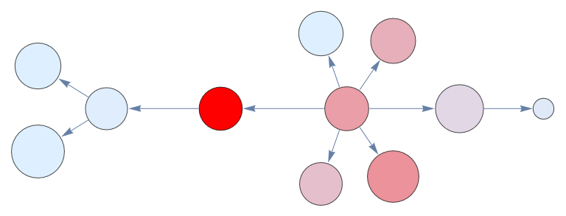
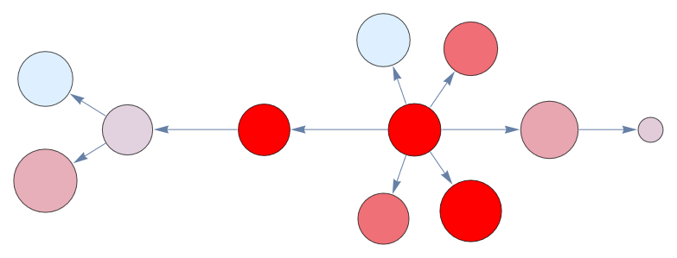
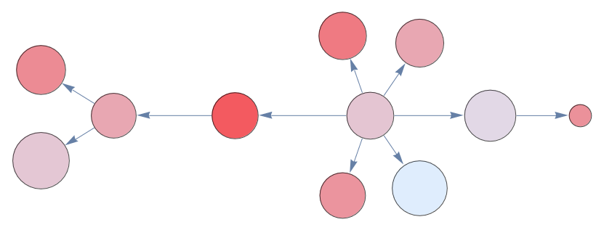
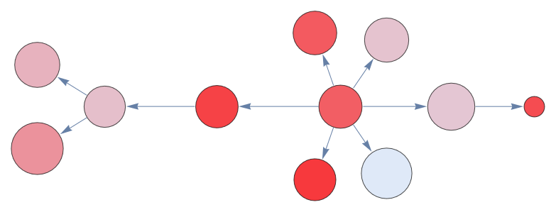
Results: South Korea progression
1963
1963
1963
1966
1966
1966
1971
1971
1971
1977
1977
1977
1993
1993
1993
2000
2000
2000

Slide 50
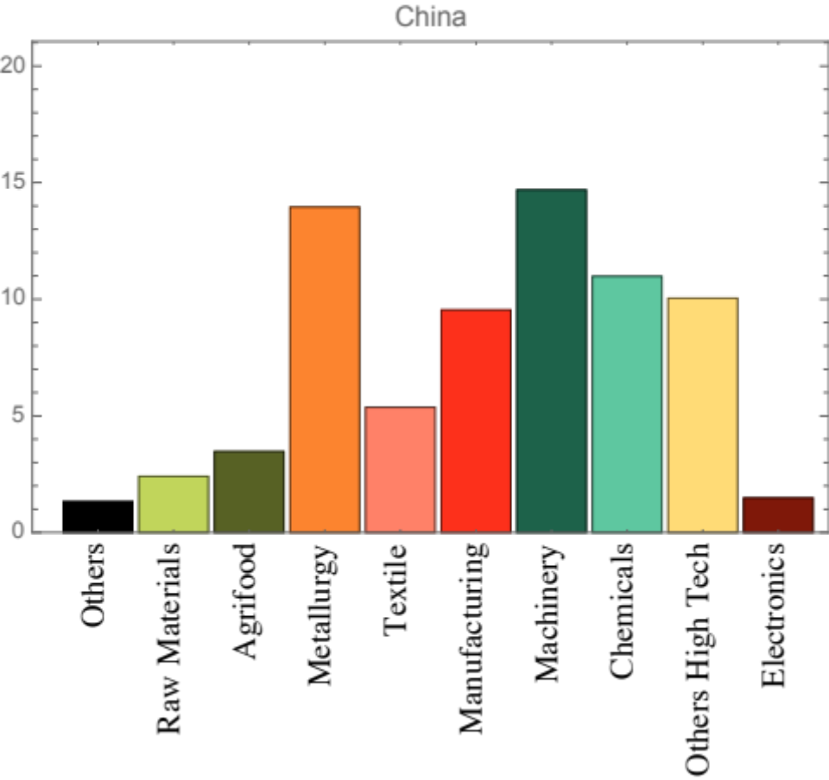
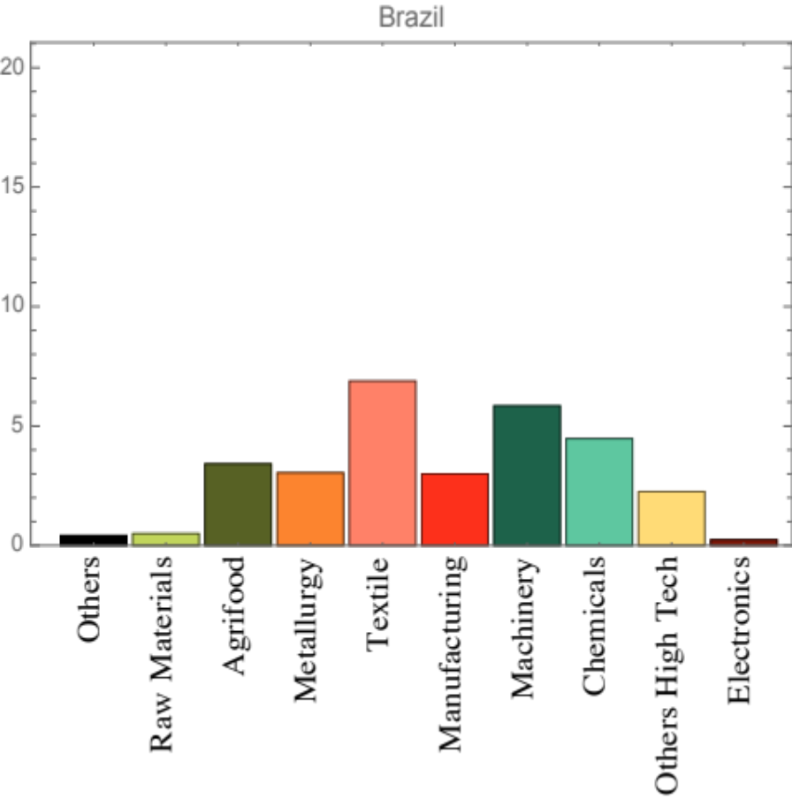
NEW: Forecasting of the new products (sectors) which have
a high probability to appear in the near future

Slide 51
Toy Example
Data
Empirical
Economic Implications
Scale
PATSTAT: INNOVATION ANALYSIS
DEVELOPMENT OF NEW TECHNOLOGIES
◮ EPO Database of Patent offices’ data;
◮ Universal: almost all the patents’ office (over 100), all the patents;
◮ IPC technology fields: hierarchical structure (up to 70,000 fields)
◮ Time Period: late XVIII century-2014;
◮ Huge: over 90 millions (!) patents;

Slide 52
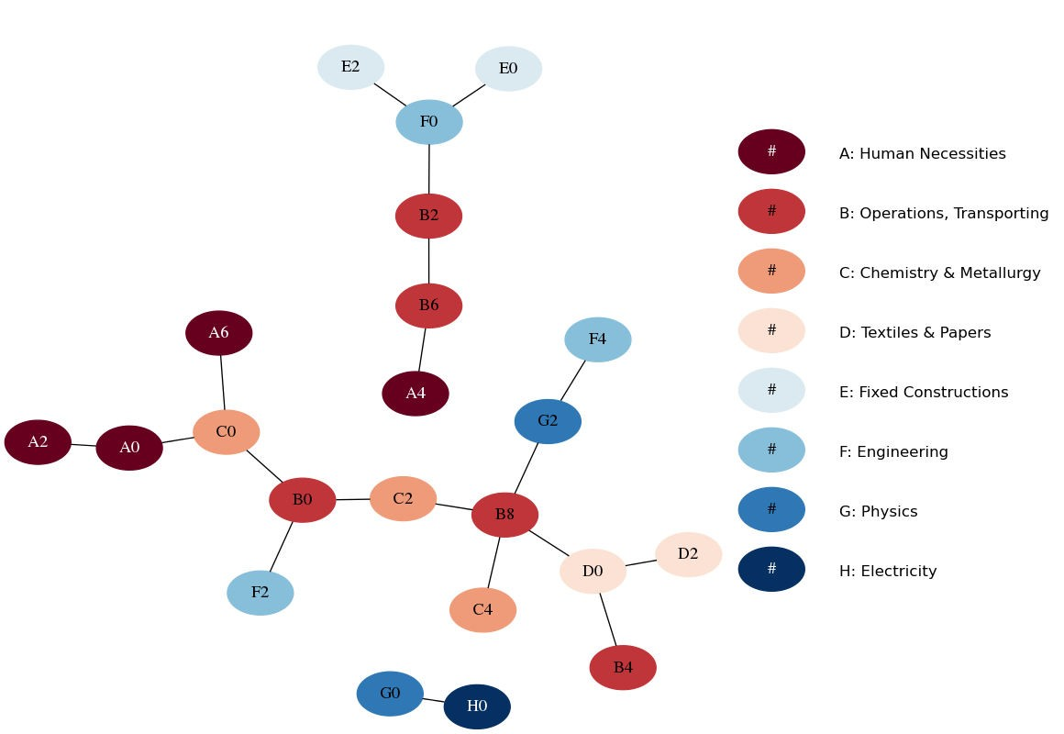
Toy Example Data Empirical Economic Implications
TECHNOLOGY SPACE - FIRM LEVEL
Scale

Slide 53
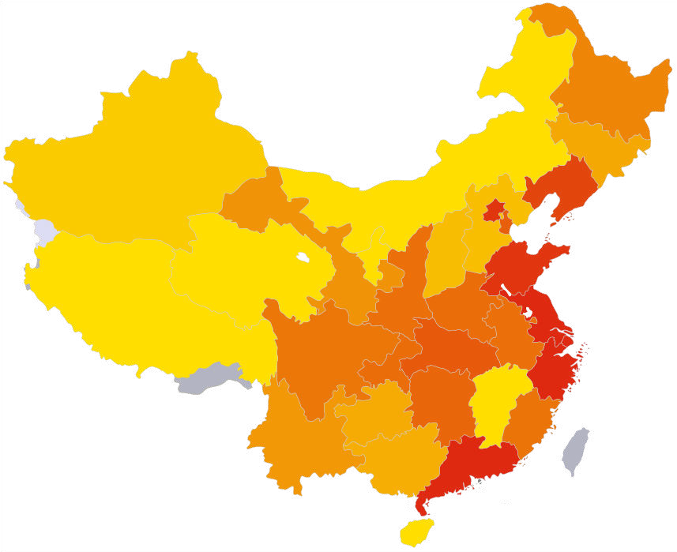
Toy Example Data Empirical
REGIONAL PATENTING FITNESS
Economic Implications
Scale

Slide 54
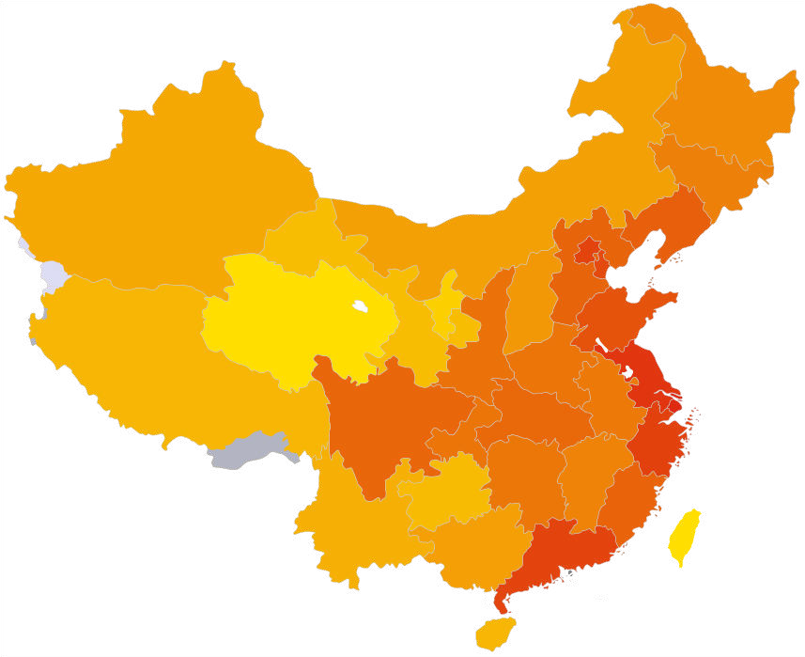
Toy Example Data Empirical
REGIONAL EXPORTING FITNESS
Economic Implications
Scale

Slide 55
The Space of Patents-Products (preliminary analysis):
Network of the correlations between a patent at time t
and a product at time t+1
Question: in which technology should I invest to increase the export of a certain product?
As an obvious generalization of the Product Space, we generate the (directed) network connecting patenting fields and products. It measures the relationship between a country’s patenting activity in a technological field f at time t and the export of the same country in a product p at time t + δ.
Naturally the same formula can be applied at different granularity : at the technological level, at the product level, at the geographical level.

Slide 56
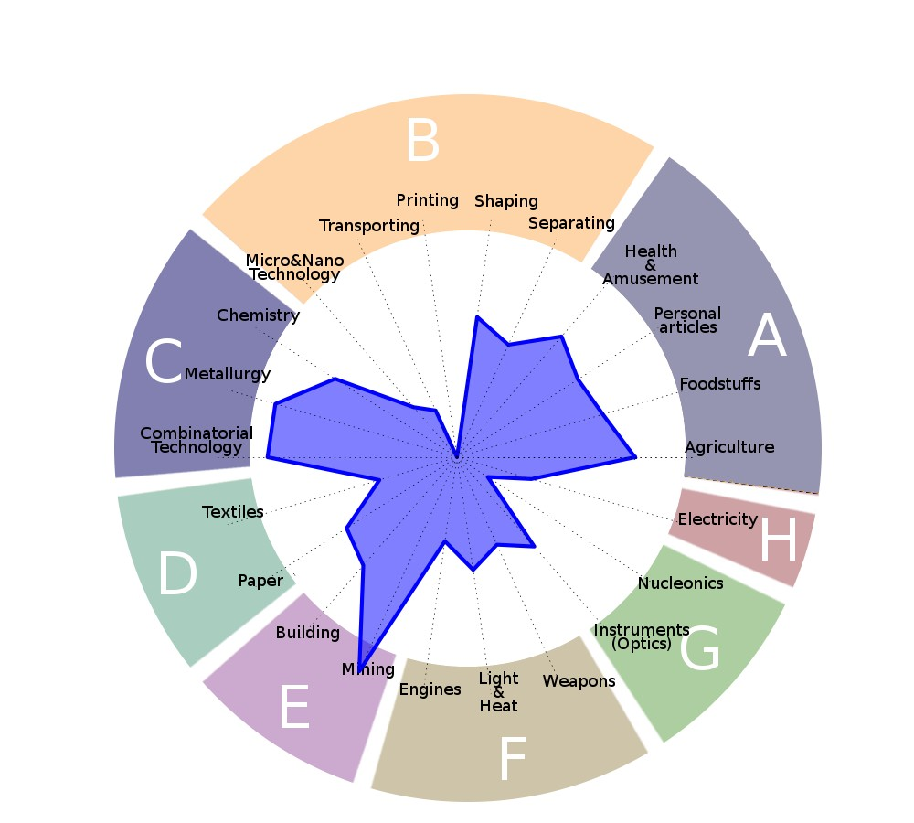
Cooking Salt (NaCl): Patents (technologies) correlated
To the export of salt

Slide 57
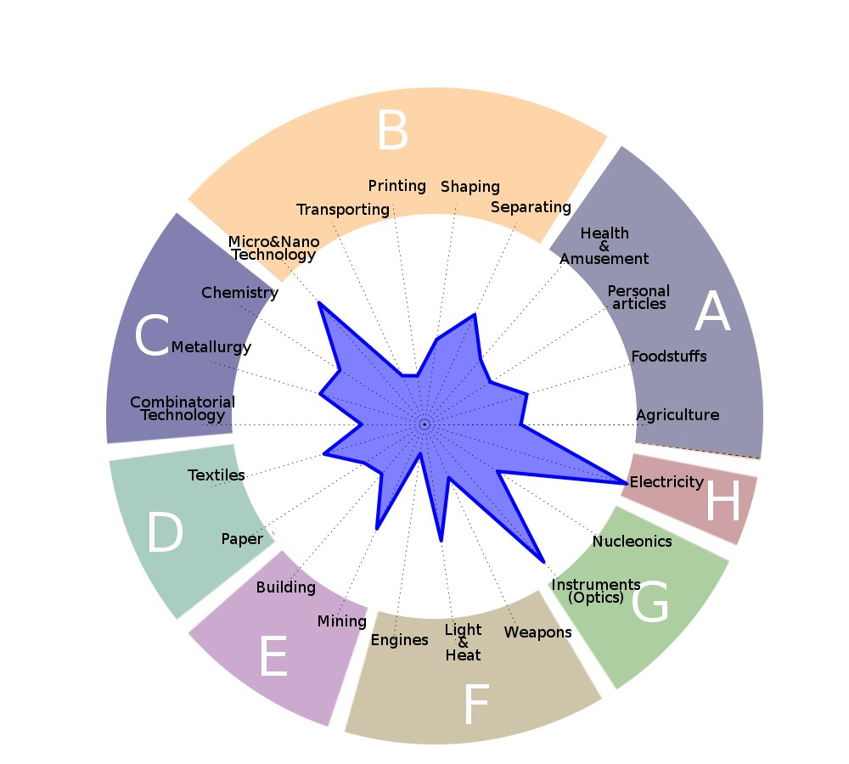
Desktop Computers: Patents (technologies) correlated
To the export of desktop computers

Slide 58
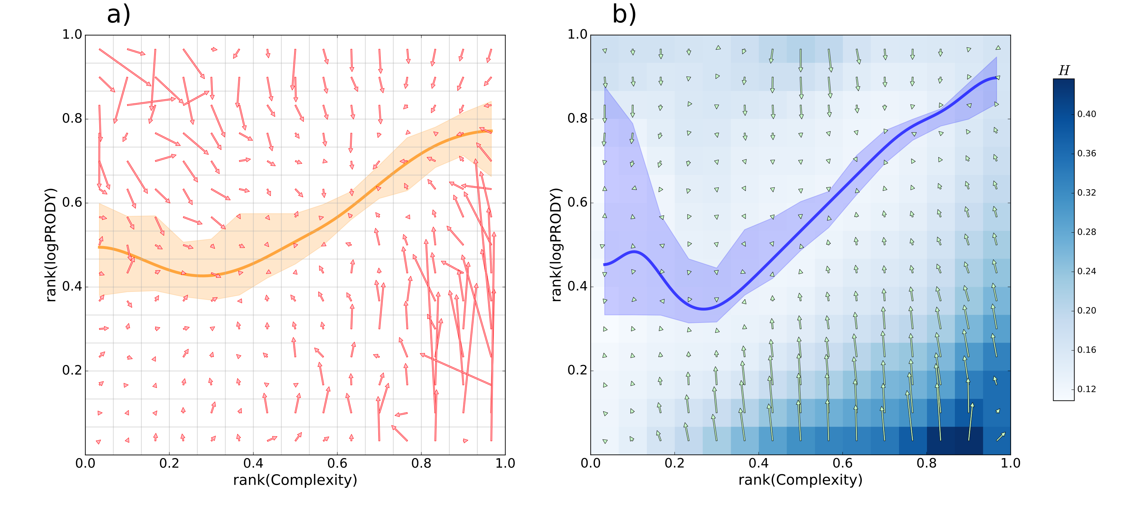
New game: Product Complexity Dynamics
Asymptotic zone corresponds to maximum competition
O. Angelini, M. Cristelli, A. Zaccaria, L. Pietronero (2016)

Slide 59
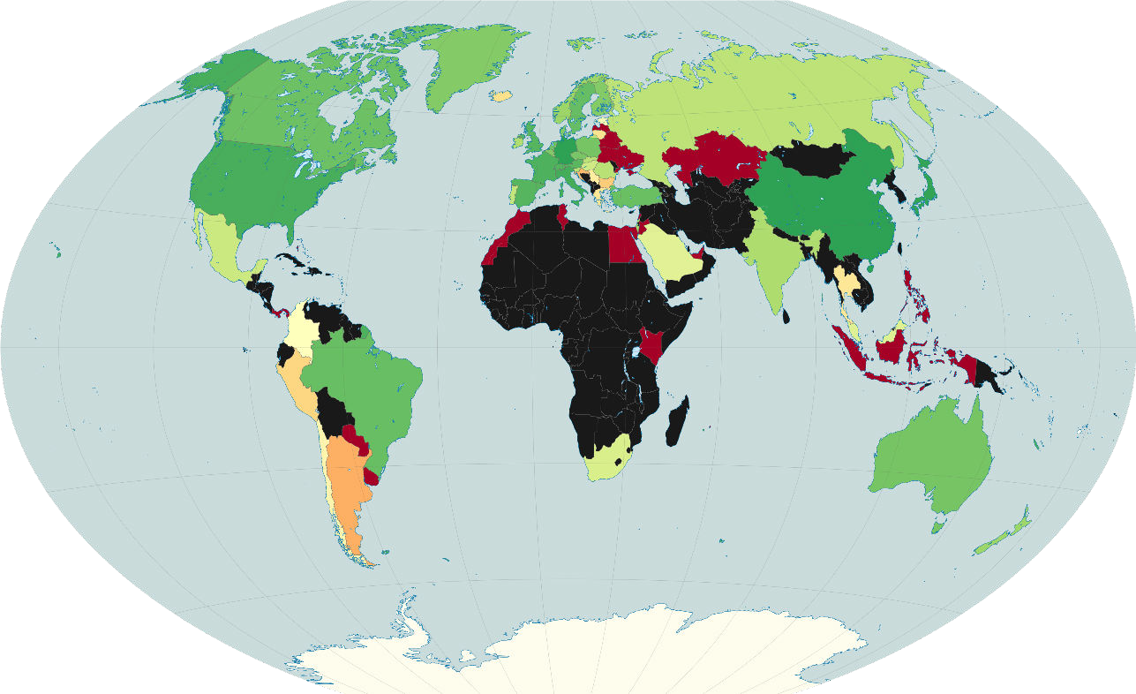
Toy Example Data Empirical Economic Implications
PATENTING FITNESS, WORLDWIDE ANALYSIS
Scale

Slide 60
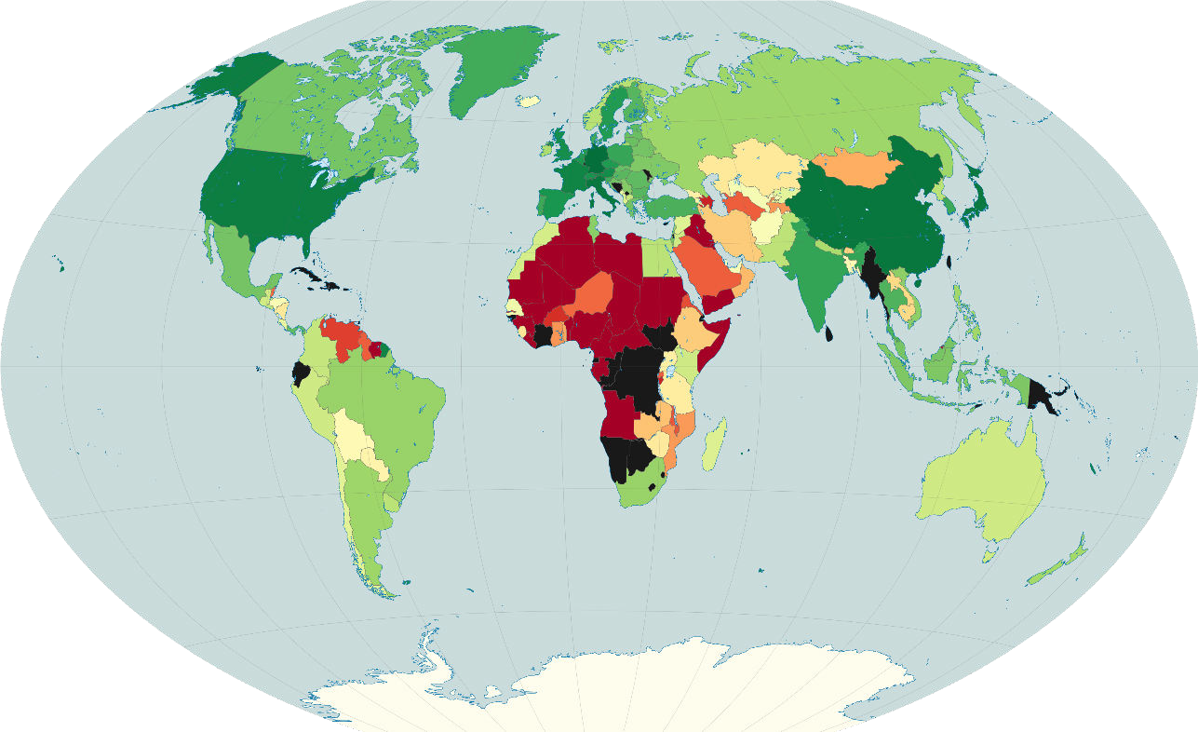
Toy Example Data Empirical Economic Implications
EXPORTING FITNESS, WORLDWIDE ANALYSIS
Scale

Slide 61
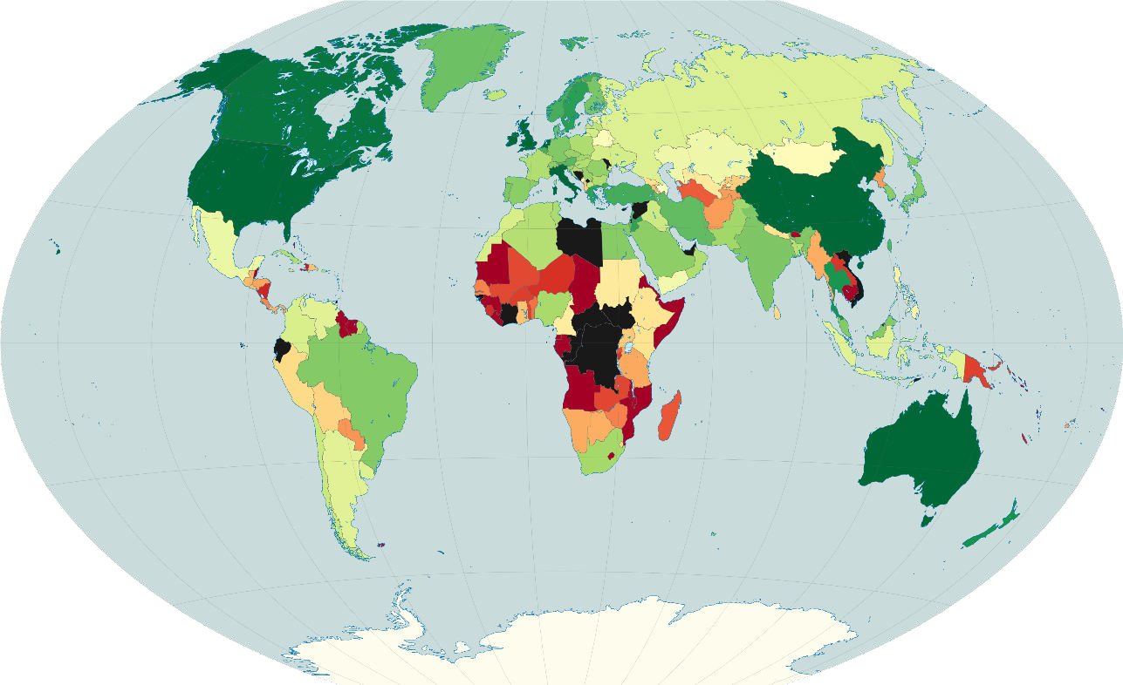
Toy Example Data Empirical Economic Implications
SCIENTIFIC FITNESS, WORLDWIDE ANALYSIS
Scale

Slide 62
SCIENZA DI BASE +
FORMAZIONE +
INNOVAZIONE
= SVILUPPO ECONOMICO

Slide 63
SCIENZA DI BASE +
FORMAZIONE +
INNOVAZIONE
= SVILUPPO ECONOMICO
NON ESATTAMENTE

Slide 64
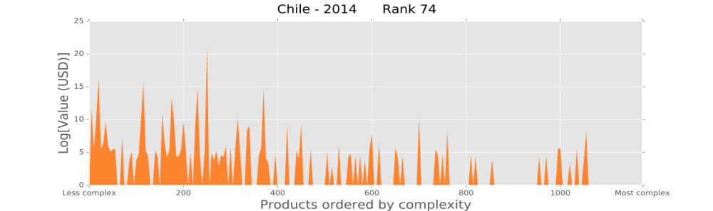

INFATTI:
Negli anni 60 Cile e Corea del Sud erano
simili per scienza e formazione
Ma nel 2014 la loro competitività industriale:
Chile
Rank=74
South Korea
Rank=20

Slide 65
NECESSITA’ DI UN QUADRO
INTEGRATO COMPLESSIVO:
“ECONOMIC COMPLEXITY”

Slide 66
Some developments:
INCLUSION OF SERVICES AND FINANCE
- New data will be provided by World Bank
ENERGY AND SUSTAINABILITY
- Energy content
- Water content
- Material content
- Pollution content
ANALYSIS OF COMPANIES

Slide 67







