Slide 1
How can comics be used to
communicate science?
Fiammetta Ghedini
Kreyon Conference
09/09/2017
Notes:
Making Scientific dissemination raises a tradeoff issue: find the right compromise between telling an interesting, catchy story and being faithful to the facts

Slide 2
Efficient Science communication
Be compelling, catchy, interesting
And at the same time
Faithful to the research being described
Notes:
In my case we had to create full-fledge web comics for a number of high-level scientific projects, with the goal of being attractive, catchy (ERC wants to be more recognized in the society), but of course being at the same time faithful to the research being funded and to the researchers.
Such a project requires inventivity and creativity, there is no obvious solution, because scientific project usually do not lend themselves to compelling story telling.

Slide 3
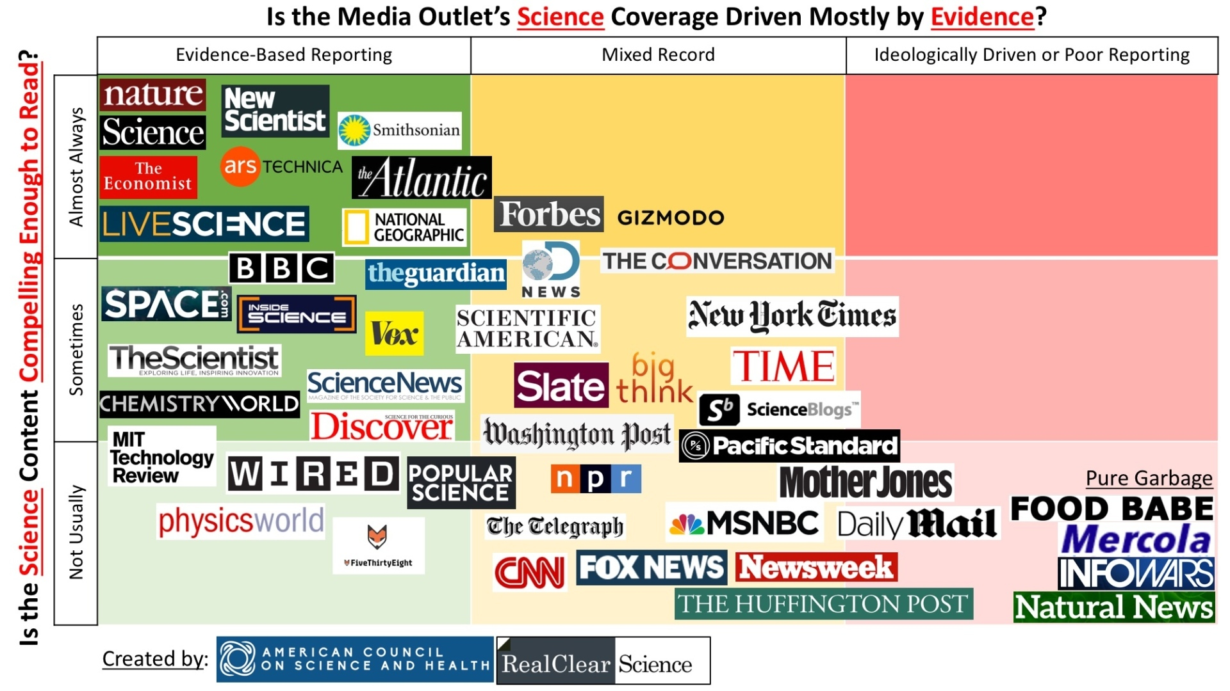
Nature
  543,
  150
Trustworthiness vs Compellingness
compelingness
trustworthiness
Science journalism can be evidence-based, compelling — and wrong, Nature (09 March 2017)
Notes:
Tis is being discussed, fo rin instance in the study by the American Council of Science, and reported in nature. They compare what they call « compelingness » to trushthworthiness for a list of journals. Not surprinsingly Nature is on the top right (achieves both criteria) and junk media on the botoom left.

Slide 4


Challenge:
Turn 16 ERC projects into 16 web comics for a general audience
Notes:
Desrbe the ERCComics project, its goals

Slide 5
What Strategies for Designing such Comics ?
3 case studies:
Flow-Machines: a project about music style and generation
InVivoReprogramming: project about reprogramming cells’ DNA
Beauty: a project about how the narratives of the fashion industry disseminate and promote the evolution of beauty standards
Notes:
3 cases studies, vastly different topics. Are there common strategies ?

Slide 6
Flow Machines #1
Flow-Machines is a highly technical project. We picked up ONE result from the project: a technical result about the generation of non plagiaristic sequences, called MaxOrder ¹
We chose to talk about the difficulty of creating a style, and how the flow-machines vision could help creators
¹ Papadopoulos, A., Pachet, F. and Roy, P. Generating non-plagiaristic Markov sequences with max order Sampling. In Degli Esposti, M. and Altmann, E. and Pachet, F., editor, Creativity and Universality in Language, Springer. 2016

Slide 7
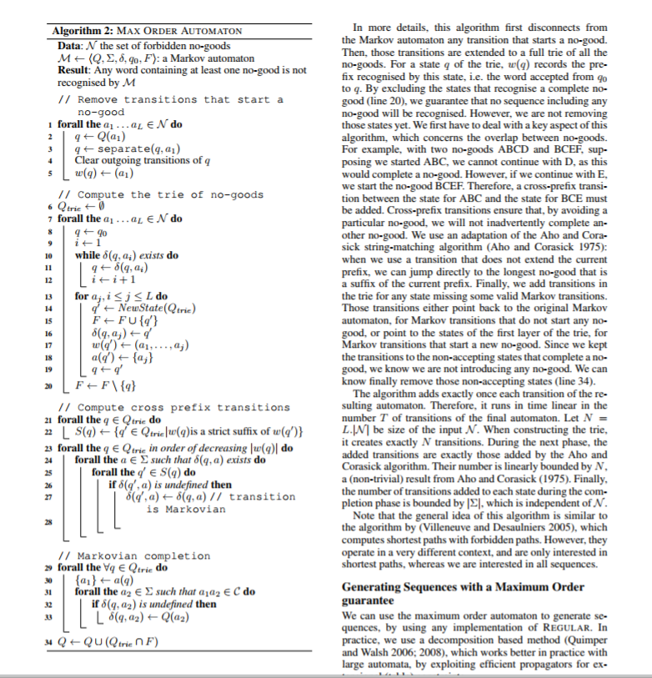
What compelling story can I make with this ??
MaxOrder is a complex algorihm, tp generate non plagiaristic sequences.
It involves automata theory, combinatorial optimization, constraint satisfaction and Markov chains.

Slide 8
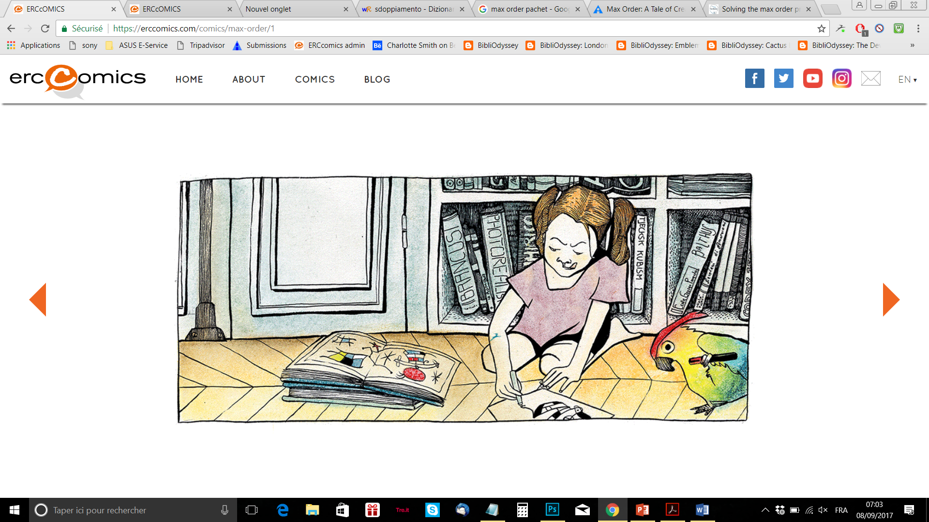
Flow Machines #2
We decided to turn MaxOrder into a character: Max
But the character had to be faithful to the original idea: that of generating non plagiaristic sequences;
So we invented a family for max (a father notably) so that Max started her life by copying everything (like her father)

Slide 9
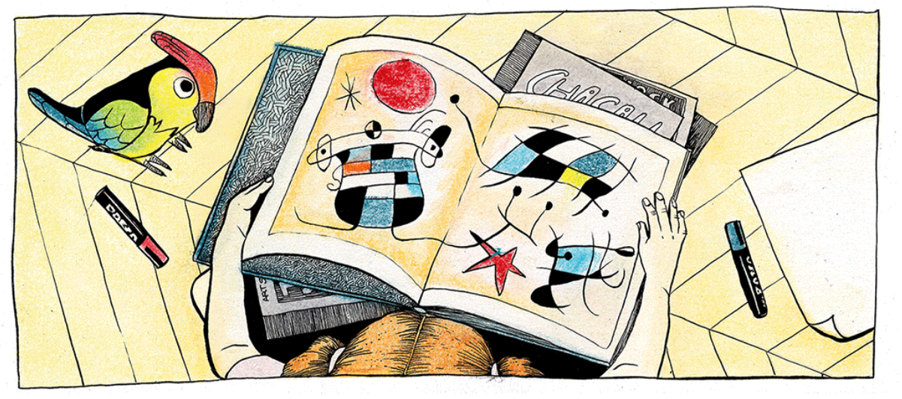

Slide 10
Flow Machines #3
We wanted to talk about the difficulty during creation, to split oneself into two selves: a creator self and an evaluator self ¹
To achieve this, we came up with the idea of having several “meta-levels” in the story. After a few pages, the reader realizes that the story he is reading is actually being created by … other characters
¹ Daniel Martín, François Pachet and Benjamin Frantz The creative process in lead sheet composition. In Lubart, T. ed, editor, The Creative Process: Perspectives from multiple domains, Palgrave Macmillan. 2016

Slide 11
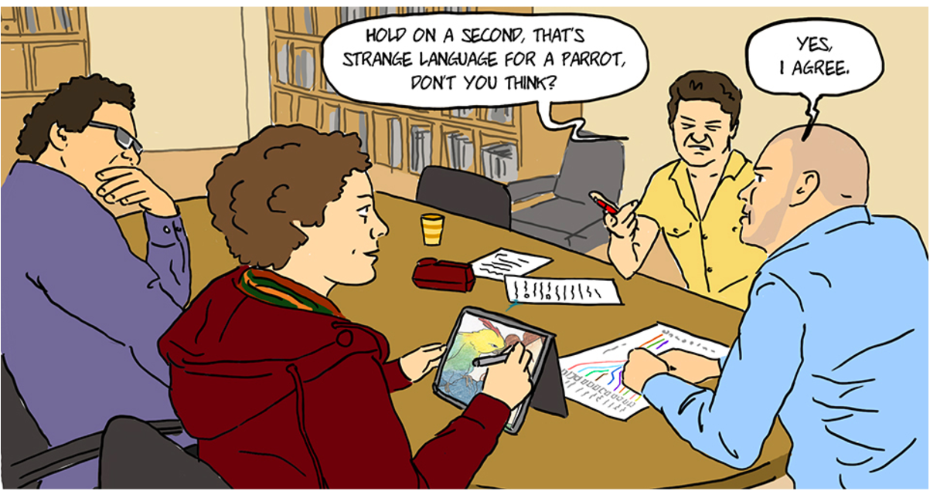
Notes:
If you know the Sony CSL team, you may actually recoginze where these characters come from…

Slide 12
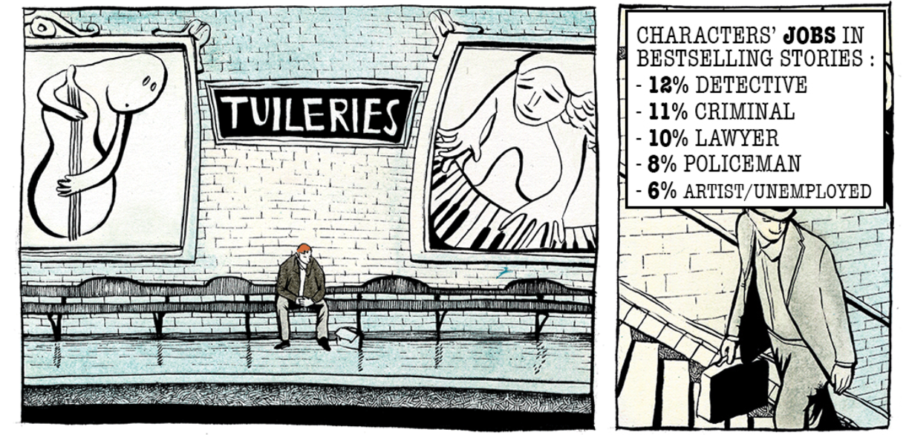
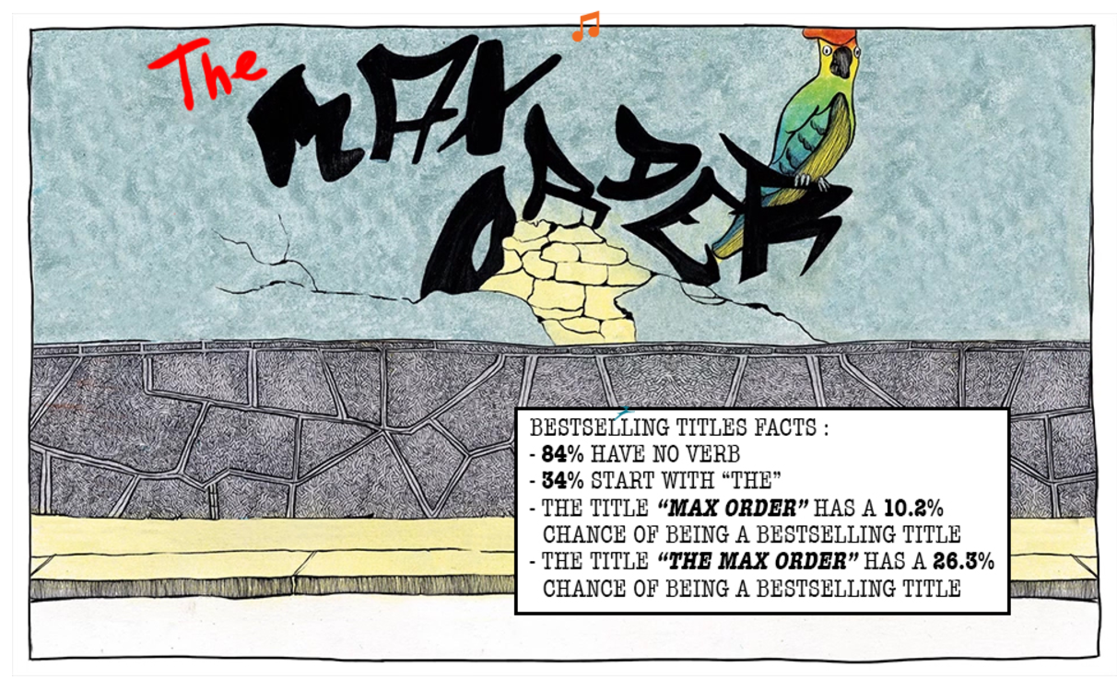

Slide 13
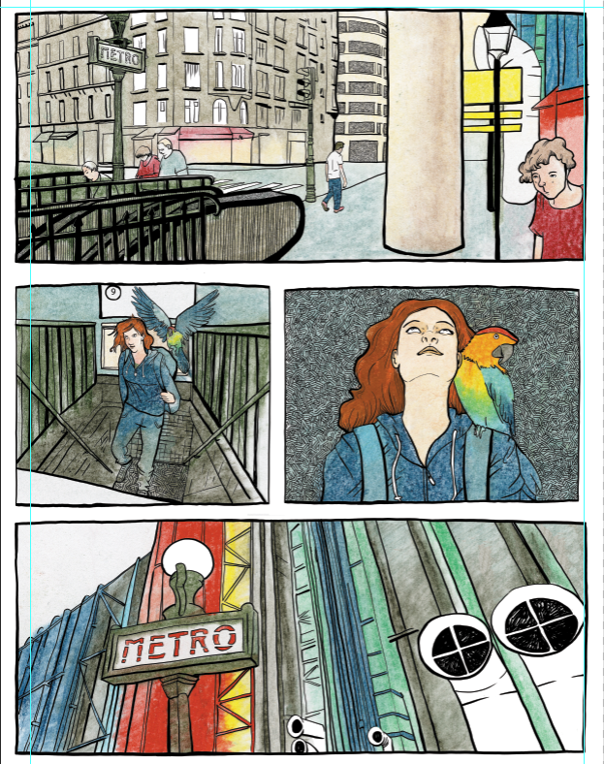
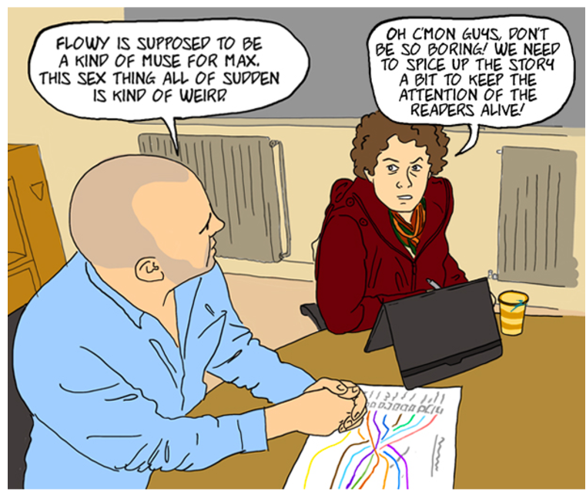

Slide 14
Flow Machines #4
However, the meta-level idea needed itself some elaboration. We had to make sense of these levels. We introduced a third level (!) that would loop back to the main character (Max).
A plot twist at the end reveals the architecture of the story making process. This architecture somehow mimics the vision of the Fow-Machines project.
Read the story to know more ☺

Slide 15
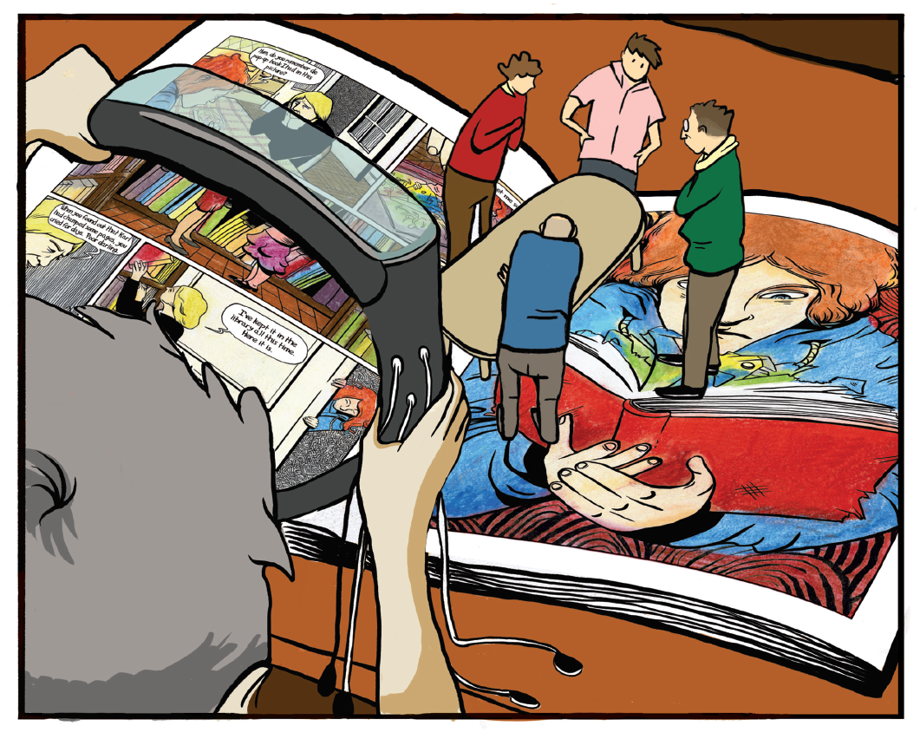
Notes:
The three levels reveal theselves in the end

Slide 16
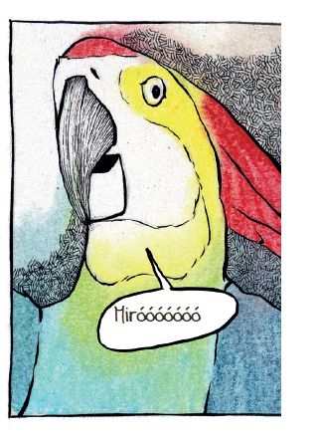
Flow Machines #5
A Flow Machine is NOT an automaton, but a smart assistant, a creative companion: how to reify a software ??
We introduced an animal (a parrot), who is a companion to the main character (Max).
However, this animal has a strange behaviour. Notably, he can move back and forth between the various levels !

Slide 17
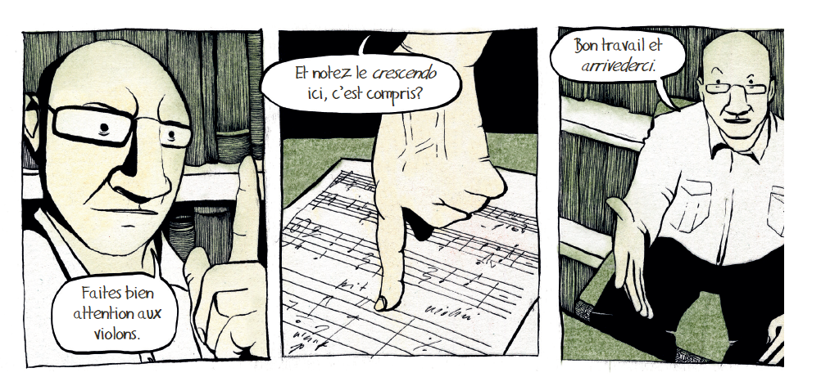
Flow Machines
- Other elements of faithfulness: Ennio Morricone making an appearance, generated music as soundtrack…
Notes:
Because we interviewed him during the project. 5 seconds of audio ?

Slide 18
inVivoReprogramming #1
Adult cells can become neurons: it is possible to turn mature human skin cells directly into brain cells¹.
We invented a setting for human cells: a factory where all cells, once adult, have to go to work.
We introduced a character, Jojo, who is a skin cell whose “impossible” dream is to become neuron.
¹ Malin Parmar and Johan Jakobsson, Turning skin into dopamine neurons. In Cell Research, Vol. 21, 2011, p. 1386-1387.

Slide 20
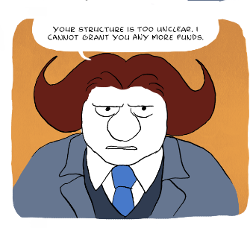
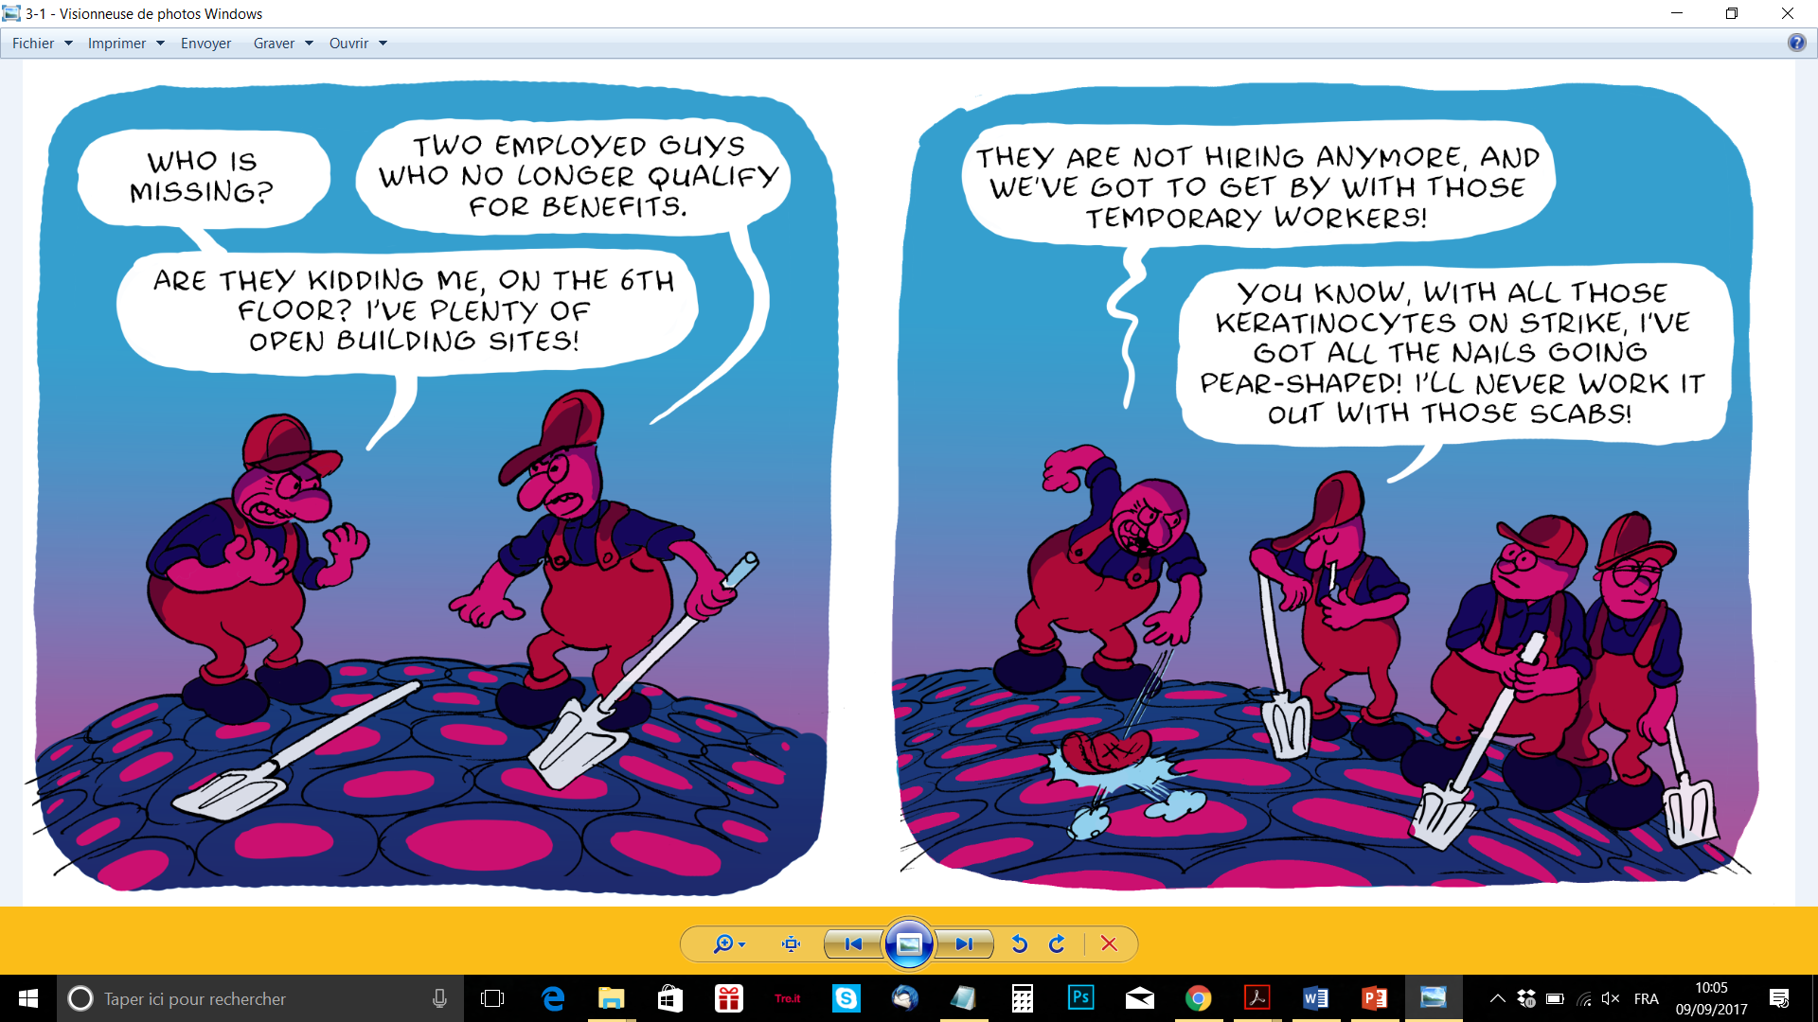
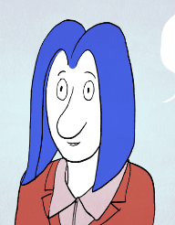

Slide 21
inVivoReprogramming #2
Reprogrammed cells can be transplanted into the brain to restore lost dopaminergic neurons, in order to treat Parkinson’s Disease¹.
In our narrative, an epidemic occurs in the dopamine department of the cells’ factory.
A scientist, Fanny, finds a way to get back some volunteering cells to the embrionic stage and transform them into neurons. But of course, there are some risks…
Kirkeby, A.; Parmar, M.; Barker, R. A. Strategies for bringing stem cell-derived dopamine neurons to the clinic : A European approach (STEM-PD). , in: Progress in Brain Research, Vol. 230, 2017, p. 165-190

Slide 22
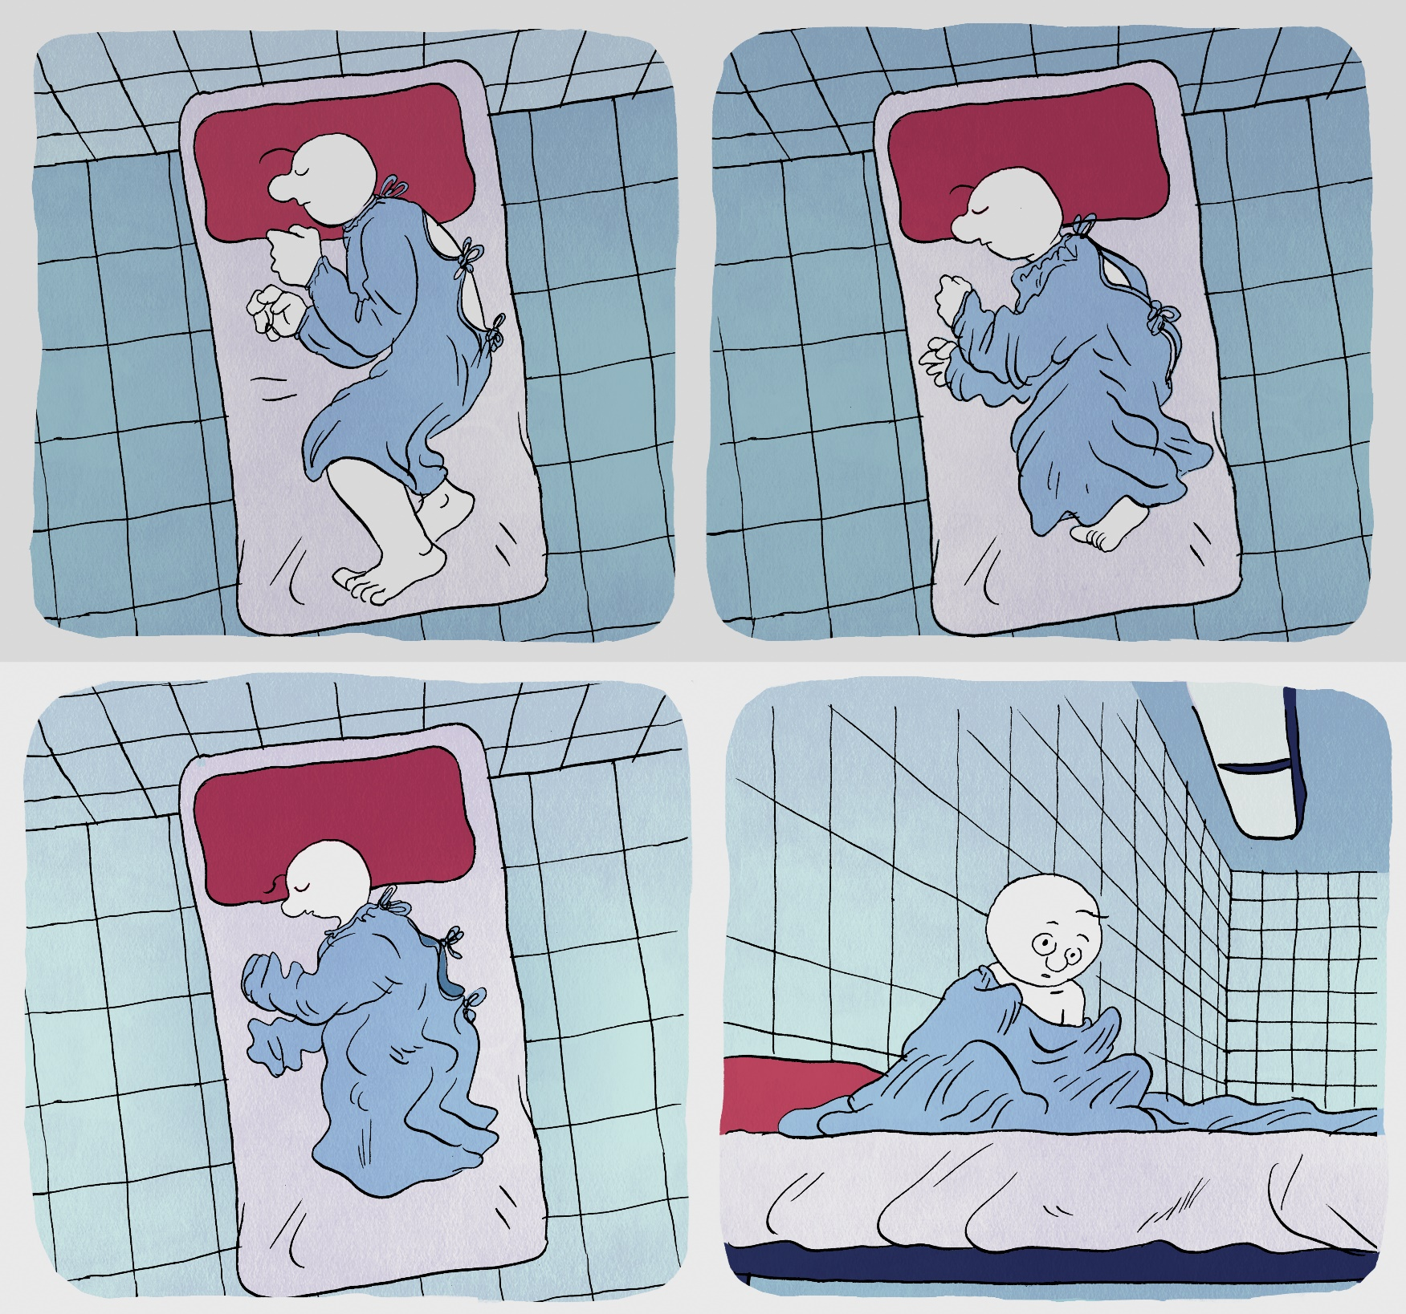

Slide 23
Beauty #1
Looking « bad » carries strong social and moral connotation.
The project has identified as a social resource as another form of capital the « esthetic capital », which can have discriminatory outcomes.¹
We introduced a group of students revolting against this injustice, by promoting non classical beauty standards
Holla, Sylvia & Giselinde Kuipers (2015). Aesthetic capital. In Hanquinet, Laurie & Mike Savage (eds.), International Handbook for the Sociology of Art and Culture. London: Routledge.

Slide 24
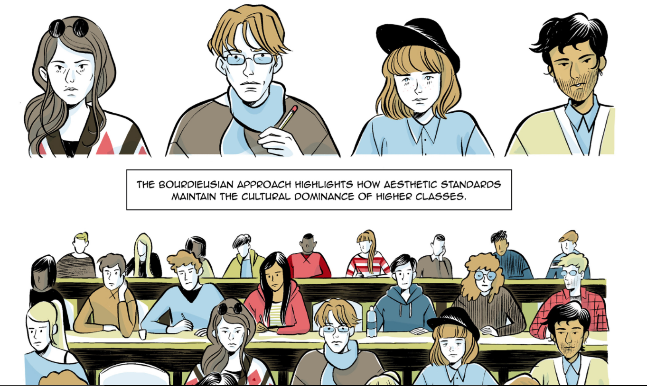

Slide 25
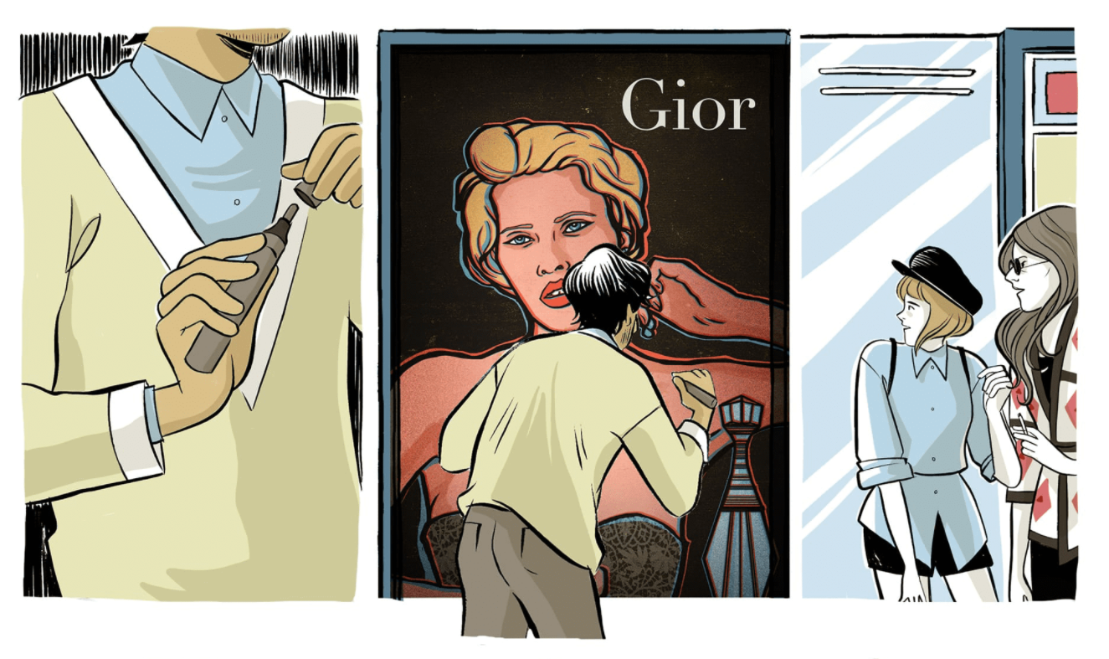

Slide 26
Beauty #2
Over the years, the boundaries of beauty standards are continuously expanded and pushed towards non-classical standards by the fashion industry, and sudden adapted by the younger, urban, educated people.
We introduced another, antagonist group of fashion industry professionals who look for the beauty of the future.
Kirkeby, A.; Parmar, M.; Barker, R. A. How aesthetic logics shape a cultural field: Differentiation and consolidation in the transnational field of fashion images, 1982-2011, in: Poetics 56: 64-84, 2016
Kuipers, Giselinde. (2015). Beauty and distinction? The evaluation of appearance and cultural capital in five European countries. Poetics 53: 38-51. doi 10.1016/j.poetic.2015.10.001

Slide 27
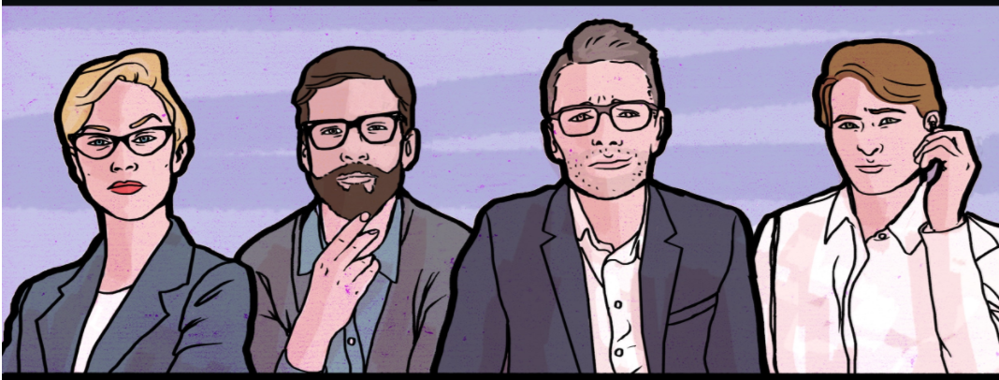
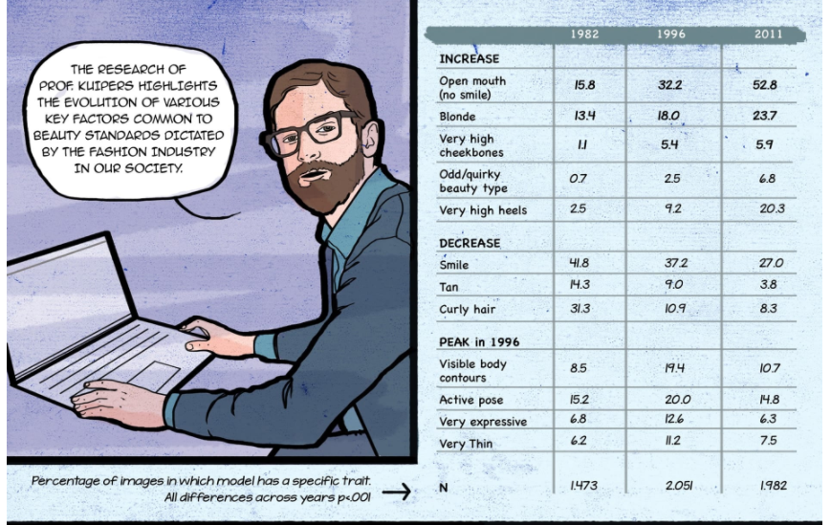
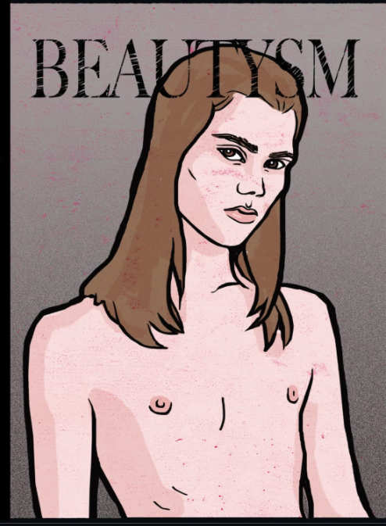

Slide 28
Beauty #3
These two groups create a confrontation that we exploited to create the story.
Indeed the fashion people and the « antibeautysts » students are looking for something similar: ugliness to be exploited and disseminated as beauty…

Slide 29
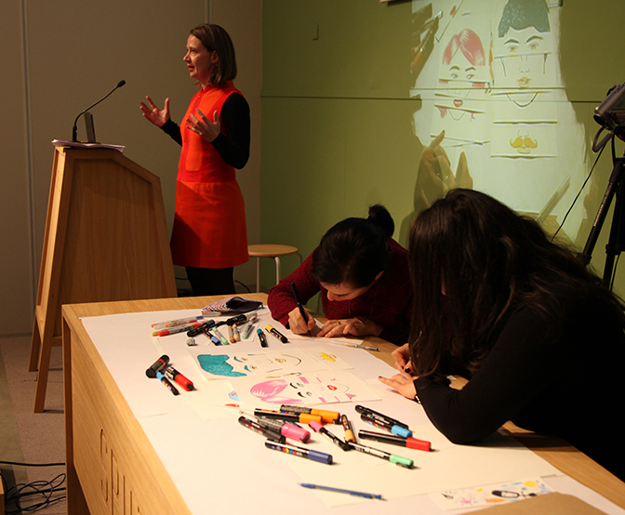
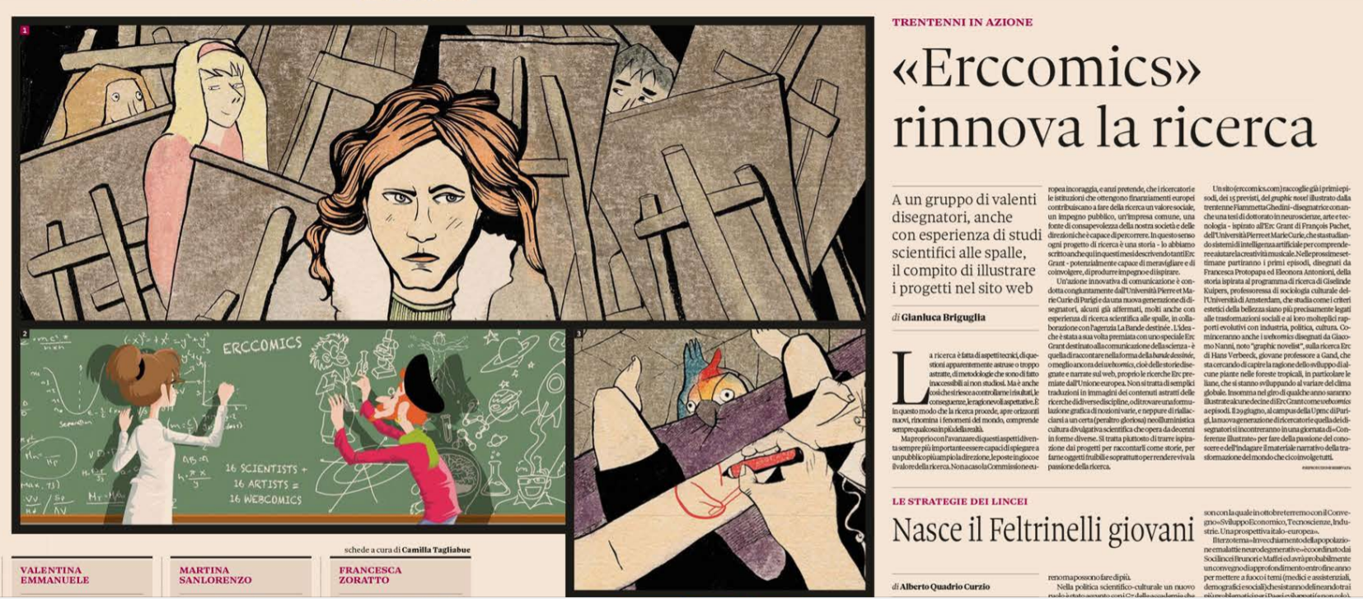
Dissemination
A web comic platform provides the comics to a wide audience: www.erccomics.com
A few thousands unique readers. Enthusiastic reviews (blog for science, blog for comics)

Slide 30
Towards Design strategies?
Turn abstract concepts into concrete characters
Give characters substance (motivations, feelings, ambitions). Adding substance to these characters raise the issue of faithfulness: whatever we invent has to echo the original idea (this is the most difficult part)
Create structure for stories, to be entertaining (unlike research projects!): plot twists; meaningful endings, confrontations, “what if” narratives.
Notes:
(like Rupert represents a proto-cell in the lagoon of Stuart Kauffmann’s talk)

Slide 31
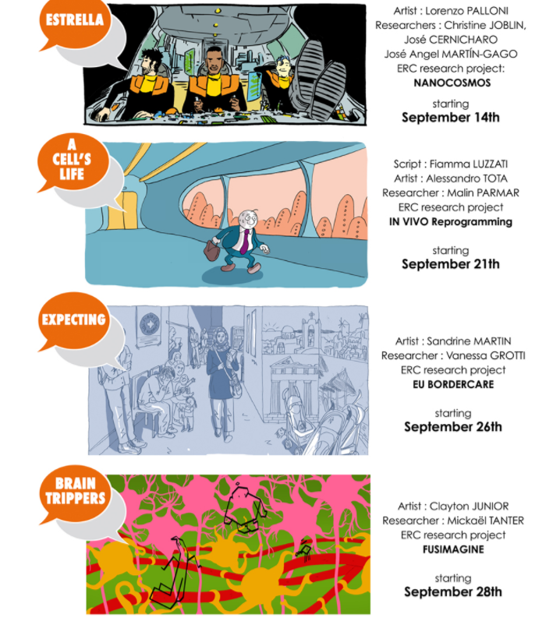
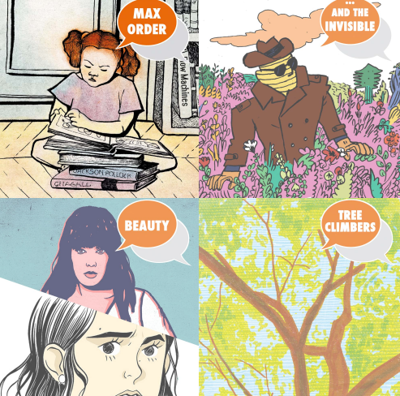
Conclusion
16 projects targeted
4 finished
4 in progress
8 to come in the next 2 years

