Slide 1
SCIENCE GALLERY VENICE:
WHERE ART & SCIENCE COLLIDE WITH
OUR CITIES, OUR ENVIRONMENT, OUR SELVES

Slide 2
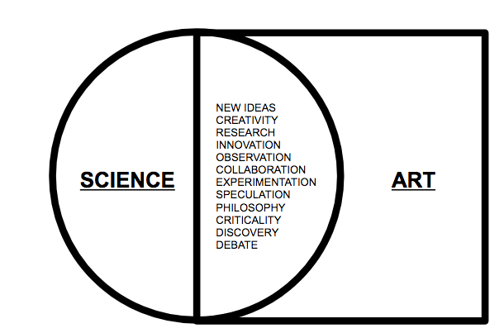
SGV TRANSFORMS PERSPECTIVE THROUGH EXPERIENCE: REGENERATION FOR VENICE, REIMAGINATION FOR THE WORLD

Slide 3
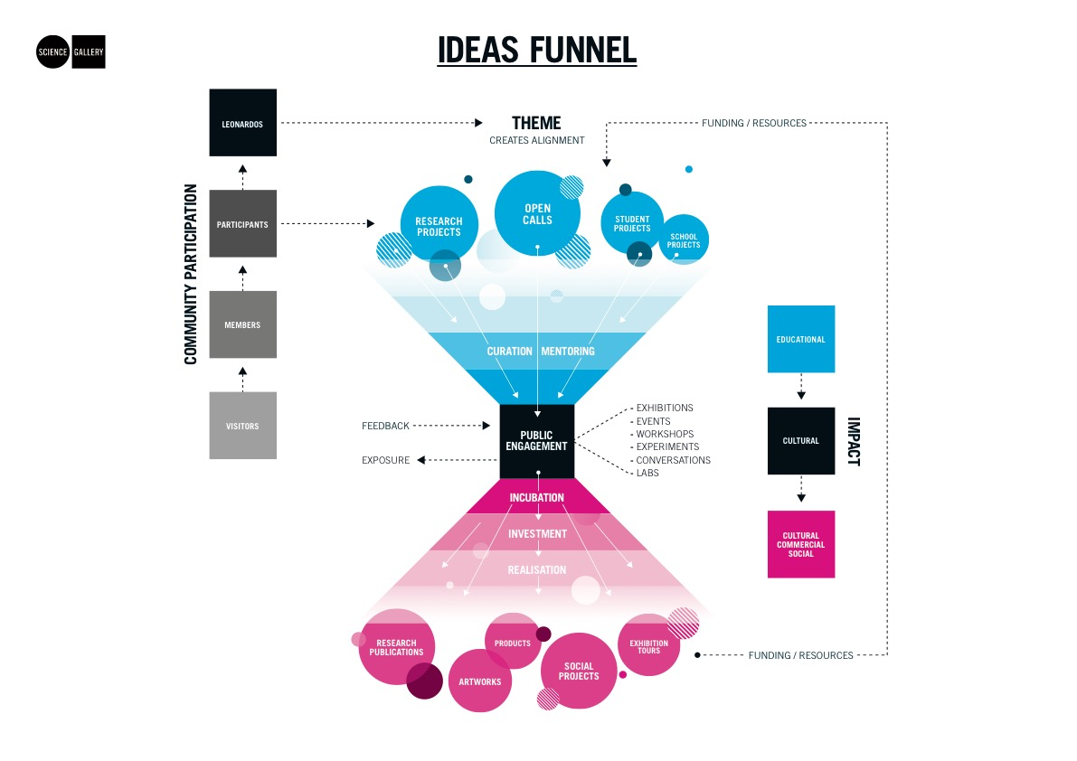
CO-CREATION AT THE HEART OF THE SG MODEL

Slide 4
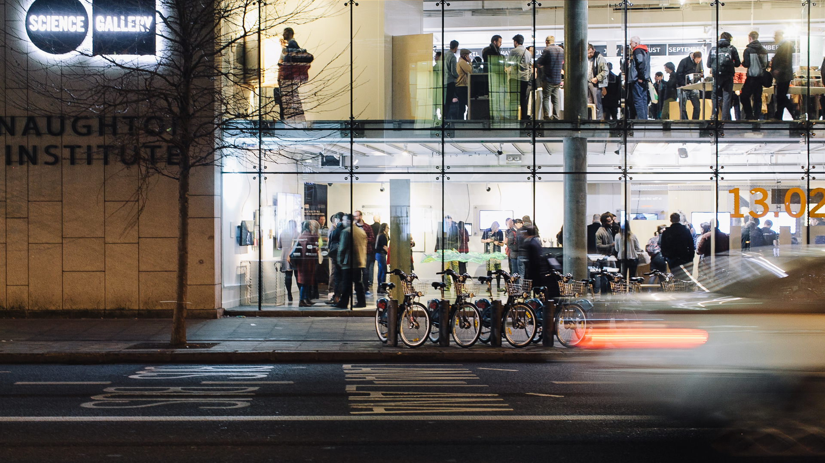
Notes:
In conclusion, this research shows that science centers carry an important responsibility. With their activities, they shape the public that visit them.
They can truly democratize public participation in science; and offer a place for all citizens to become scientific citizens.

Slide 5
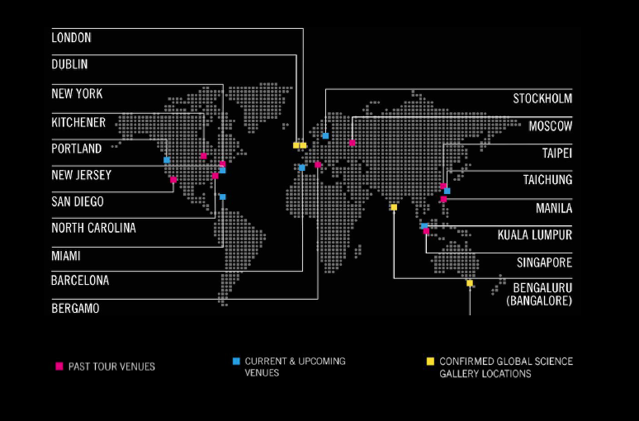
PART OF THE SCIENCE GALLERY INTERNATIONAL NETWORK
Notes:
ASK DANNY IF HE KNOWS WHERE THE LATEST VERSION OF THIS SLIDE LIVES – WITH VENICE!!

Slide 6
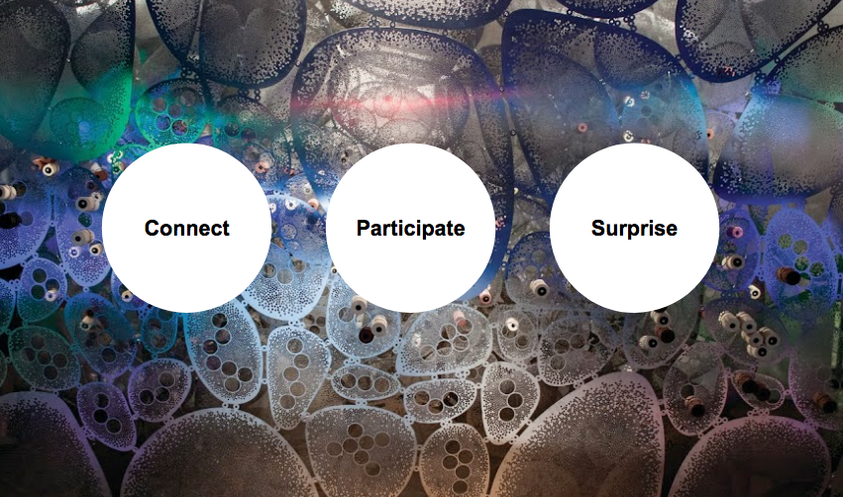
EVERY SCIENCE GALLERY EXPERIENCE AIMS TO:
Connect

Slide 7
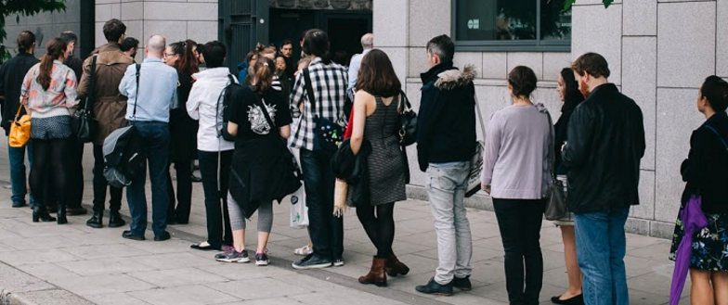
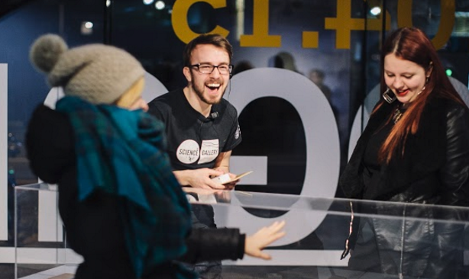
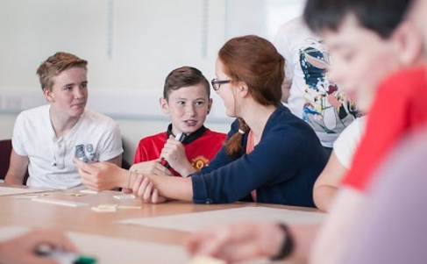
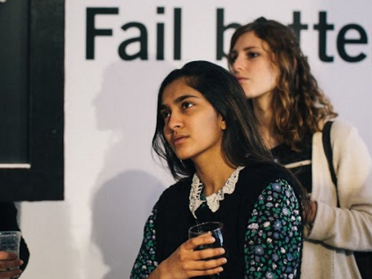

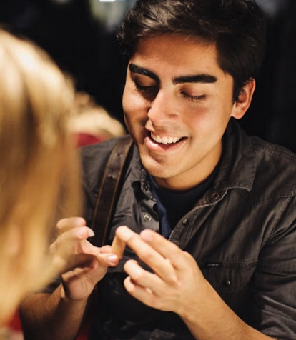
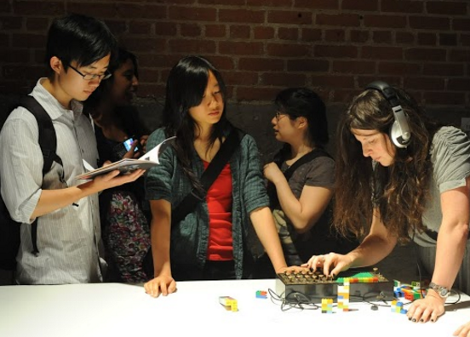
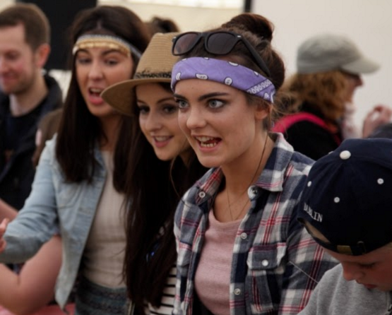
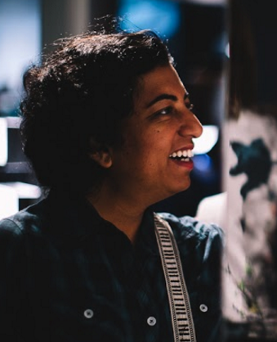
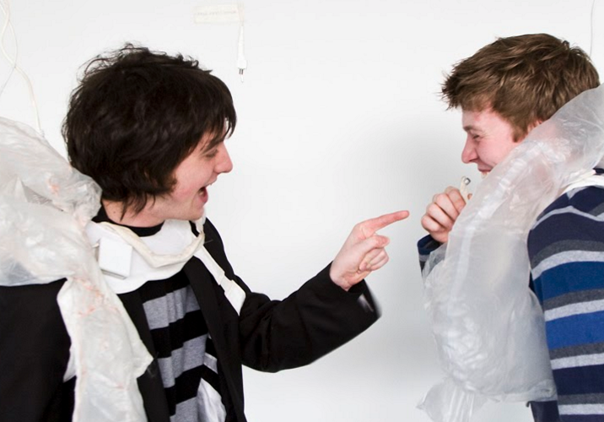
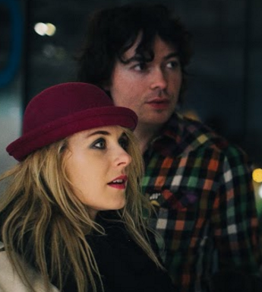
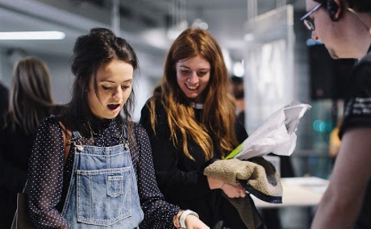
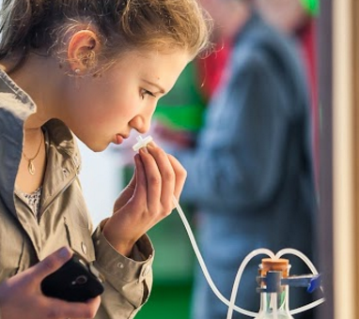
Notes:
Unlike other global science engagement activities that focus strongly on younger children aged 2-14, including science centres and museums, Science Gallery’s core target audience is made up of young adults, aged 15-25 that tend not to participate significantly in science-engagement activities.
A CRITICAL AGE FOR DECISION-MAKING
This age cohort straddles a critical point in relation to key decisions around future courses and careers, and Science Gallery’s university-linked model of science engagement offers an opportunity to bring young adults who would not normally consider studying in university into a positive engagement with “passionate peers” drawn from the university community – the student mediators who animate all Science Gallery programmes. Science Gallery has a significant focus on attracting young women into science and technology, with key programmes in this area including TWIST (Towards Women in Science and Technology).
REACHING UNDER-REPRESENTED GROUPS
Science Gallery Dublin has emphasized working with vulnerable young adults through the Trinity Access Programme (TAP), Bridge to College and Simon Community, and is currently leading a flagship global project Science Learning Plus focussing on social inclusion in art-science engagement with support from Wellcome Trust and the US National Science Foundation. Science Gallery Dublin currently attracts a majority of female visitors to its exhibitions, with different exhibitions attracting between 51% and 64% female visitors in 2014. 42% of visitors are in the 15-25 age group.
DESIGNING FOR THE AUDIENCE
The focus on young adult visitors aged 15-25, on attracting women and girls into science engagement and on social inclusion to involve a broad and diverse community in science engagement is being extended further developed in other Network locations. In Bengaluru (Bangalore), extensive interviews have been carried out with focus groups from the target audience through research carried out by PwC and Niellsen, and audience groups have been consulted in relation to the types of exhibitions and workshops they would like to participate in. Pre-opening creative workshops have already been implemented by Science Gallery involving young people from Sri Lankan refugee schools in Bengaluru in preparation for the development of Science Gallery Bengaluru. Similar consultative activities are planned in other network locations to ensure that the target audience has the opportunity to feed into programme development.

Slide 8
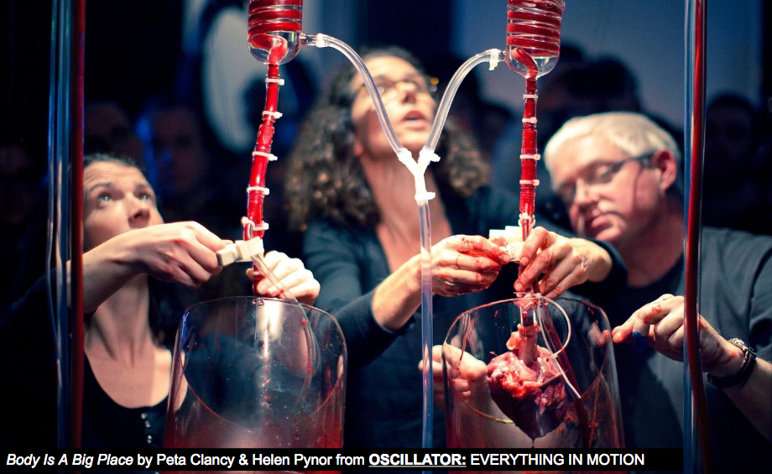
EXHIBITIONS UNLIKE ANYTHING YOU’VE EXPERIENCED IN A MUSEUM

Slide 9
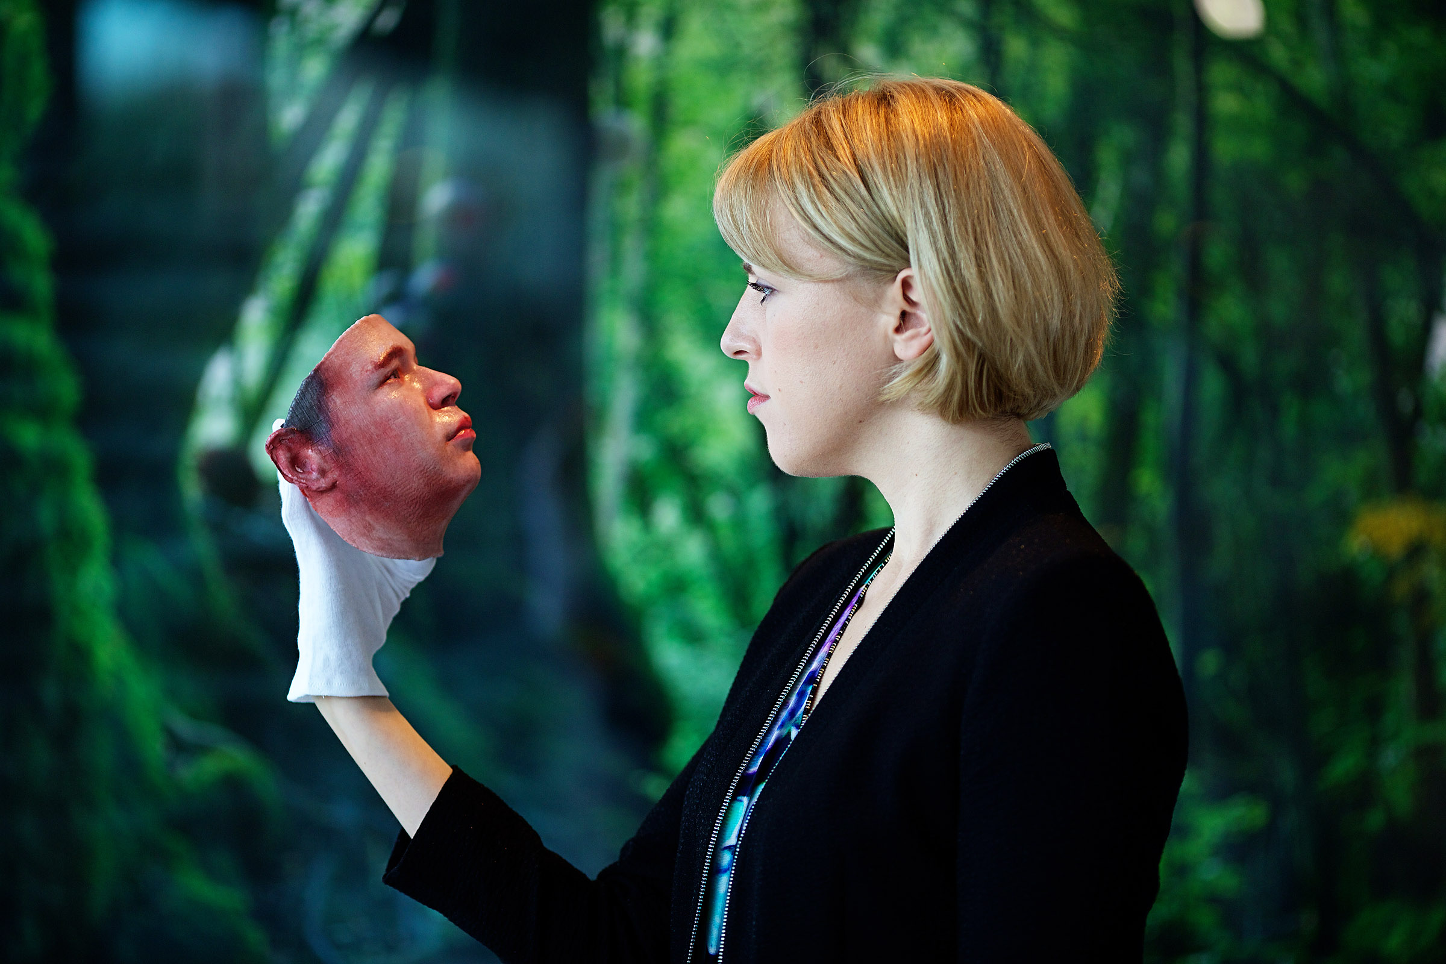
Notes:
My research addresses these questions, and it shows that science centers are places where all visitors can become “scientific citizens”. At the same time, however, there is a danger that only certain people, those privileged by socio-economic status, are invited to participate.
The first part of my research focused on defining what “participation” means in a science center. Scientific citizenship, we said, is the combination of competence and participation.
There’s little doubt that all science centers are well equipped to improve the competence of their visitors. However, when it comes to participation, the situation is quite different.

Slide 10
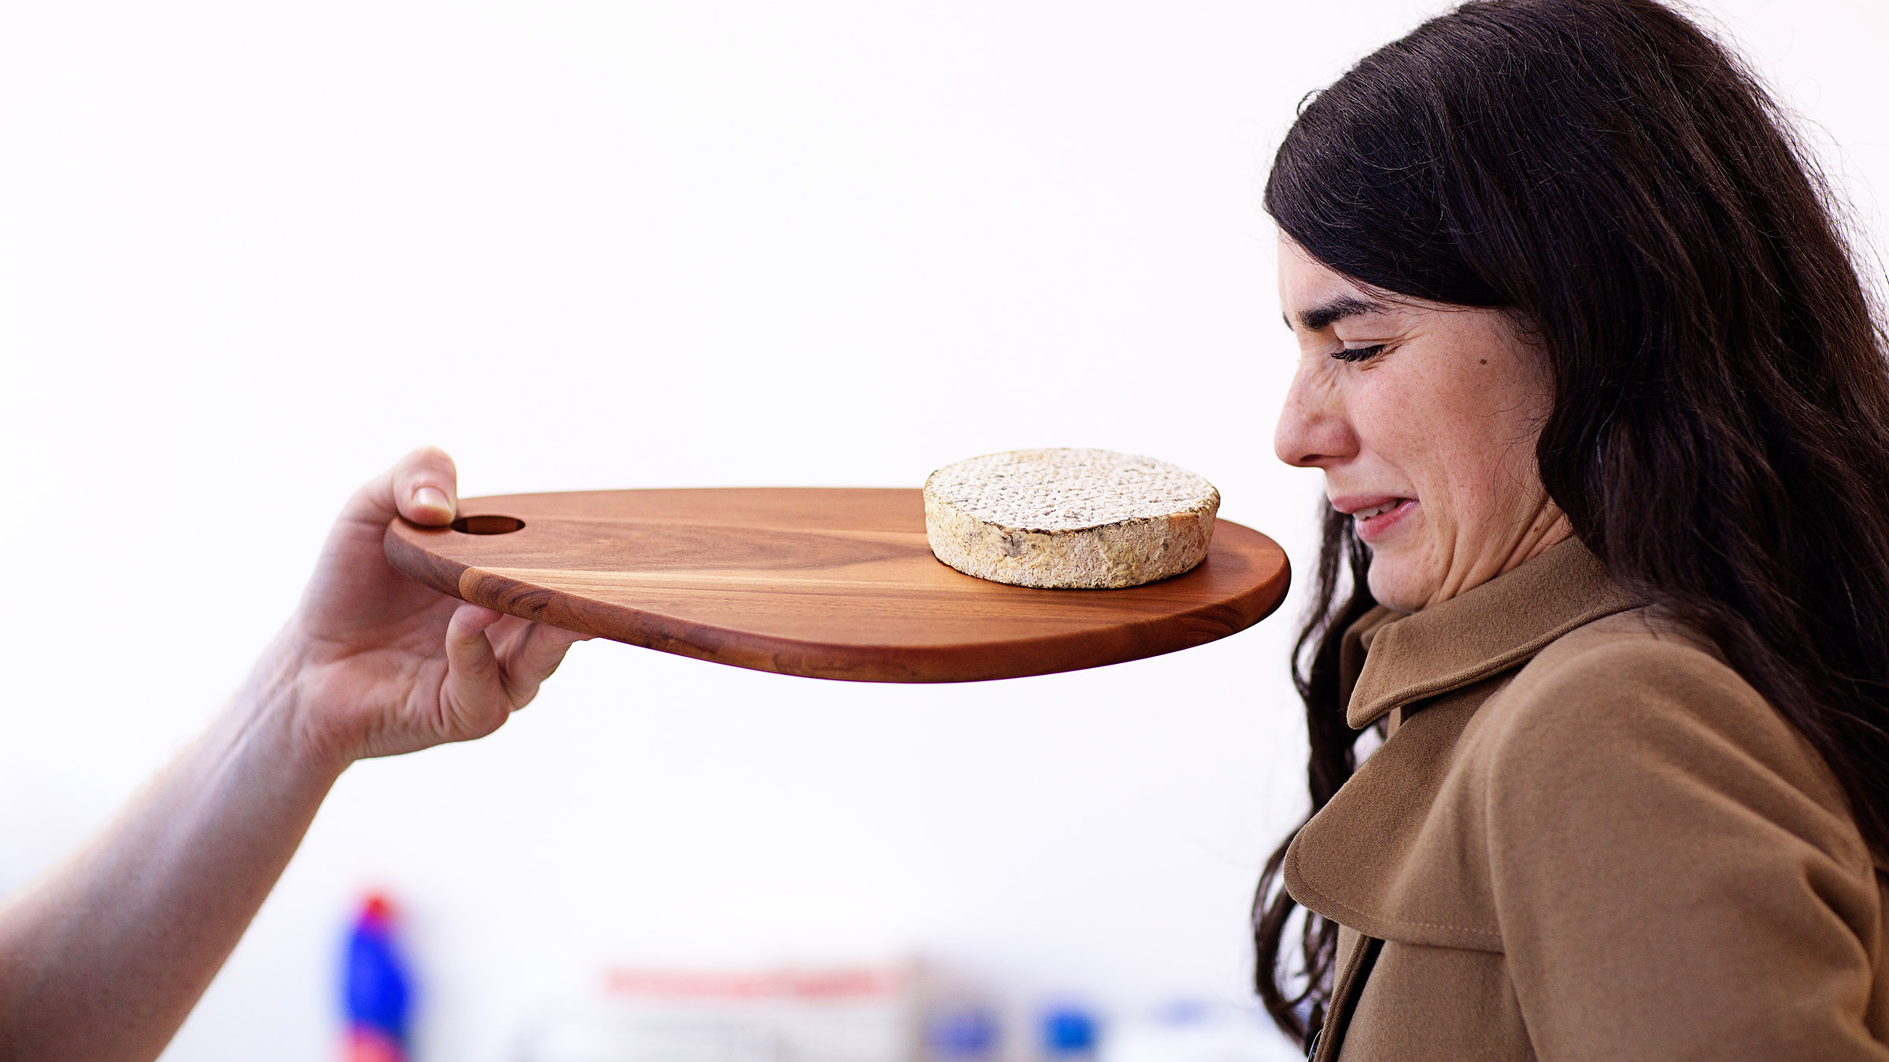
Self Made by Christina Agapakis & Sissel Tolaas from GROW YOUR OWN: LIFE AFTER NATURE

Slide 11
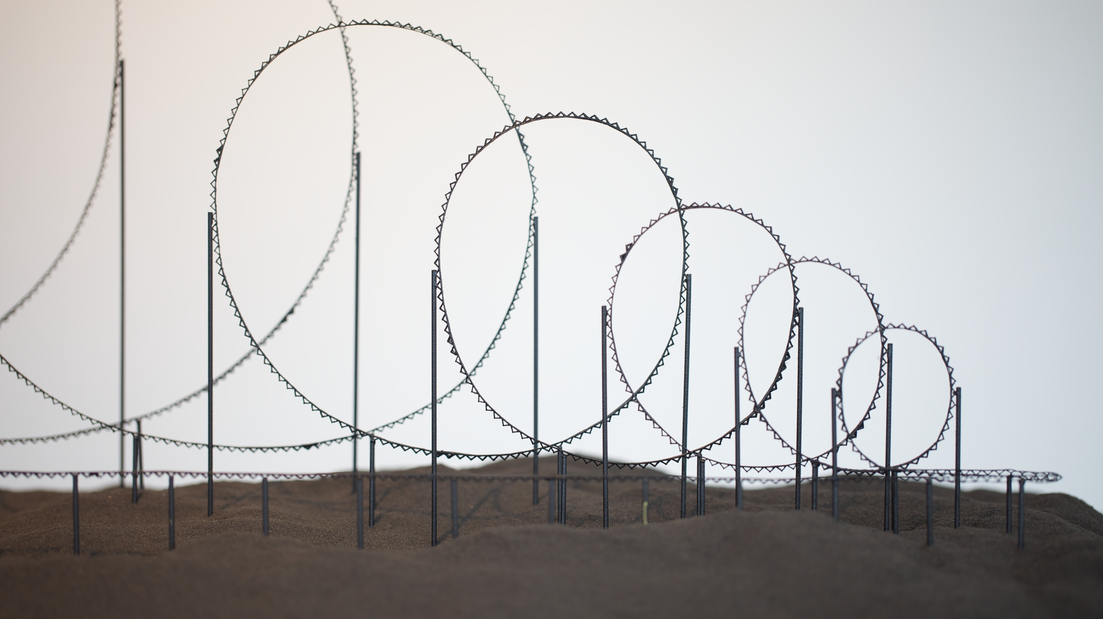
Euthanasia Rollercoaster by Julijonas Urbonas from HUMAN+: THE FUTURE OF OUR SPECIES

Slide 12
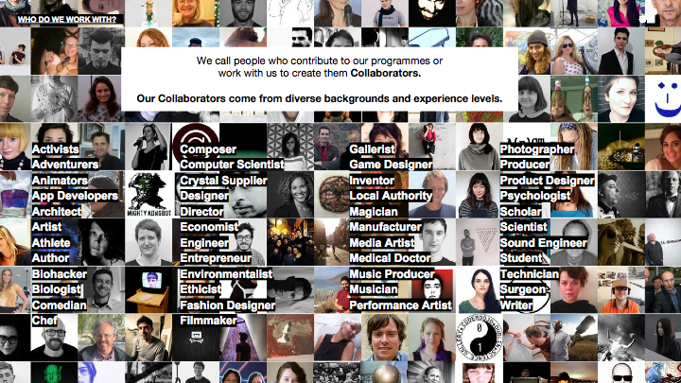

Slide 13
SCIENCE GALLERY VENICE:
RE-GENERATION FOR VENICE, RE-IMAGINATION FOR THE WORLD
SGV will be a living laboratory where arts and science collide; a gallery, workshop and innovation hub for exploring our futures for ecology, the city and living.
SGV’S resources will be accessible to all,
free of charge.
SGV will create immersive experiences for the exploration of how global climate change, cultural heritage science, nano technologies and digital society can collide with fashion, architecture, contemporary art, film, design and music to develop better futures.

Slide 14
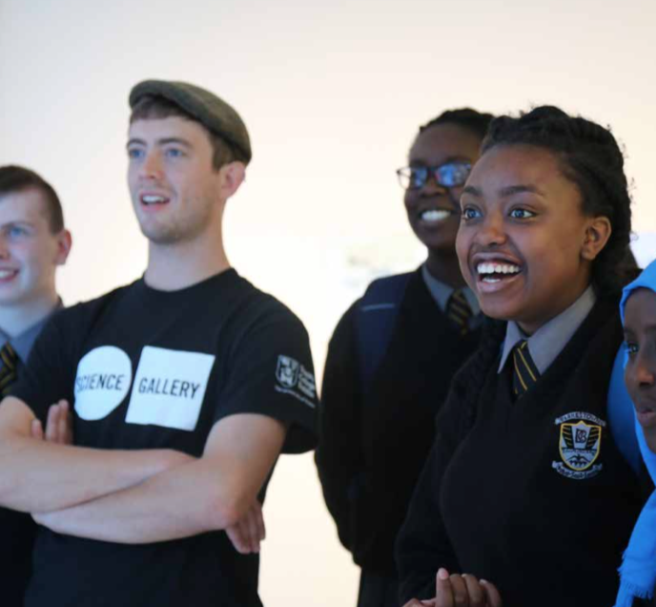
OUR MISSION:
ENABLING YOUNG PEOPLE TO CREATE BETTER FUTURES
Our primary audience is young people, aged 15 – 25. Our mission is to enable them with the art of imagination and the skills of innovation, to ask the questions and seek the solutions to create a better future. But we are open and accessible to people of ALL ages and aim to create connections between the generations.

Slide 15
REGENERATING THE ENVIRONMENT
Sea level rise caused by climate change leads scientists to estimate that Venice will be underwater within 100 years.
(Quartenary International, 2017)
Notes:
Climate Change and Economic Decline are creating a diaspora of young people that places The Serenissima in jeoparday. And that is unfortunate not only for young Venetians, but for the global cultural heritage.

Slide 16
RE-IMAGINING THE WAY WE LIVE
As tourism grows, the Venetian population shrinks as the city is no longer a comfortable or affordable place to live. Since 1950, Venetian population has declined 70% since 1950. 54,000 locals service 23 million tourists. (Comune Venezia, 2017)
Young people see limited opportunity for a future in Venice. An attitude reflected by young people throughout Italy. 53% of Italian young people think the world is becoming a worse place to live, the highest proportion in the world. (Varkey Foundation 2017)

Slide 17

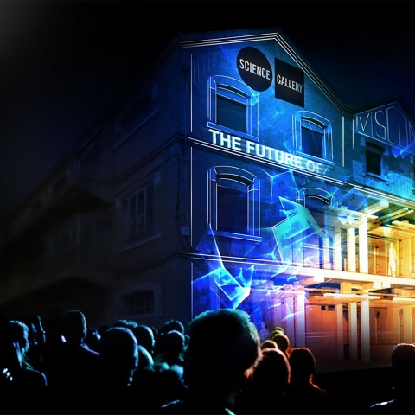
A BEACON FOR GLOBAL IMAGINATION
“The crisis of western imagination is a huge challenge and it’s not one person alone who will change it.” Emmanuel Macron, 2017
We’re re-igniting the spirit of Venice’s visionary heritage that has inspired global imagination for centuries.
We’re extending the Museum Mile beyond its role as a global beacon for cultural appreciation, actively enabling our visitors to become participants in our contemporary renaissance.

Slide 18
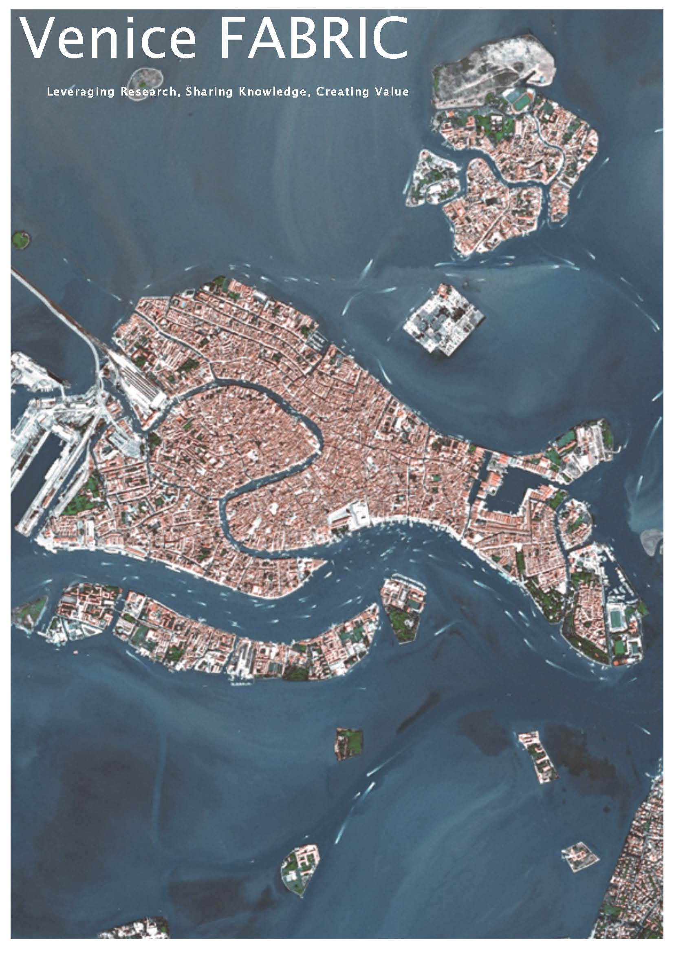
SGV IS A CRITICAL ELEMENT OF VENICE FABRIC:
A CATALYST FOR A BETTER FUTURE
FABRIC will act as a catalyst for an open partnership of national and international scientific bodies and business parties sharing a common interest in the strategic development and implementation of research in science and high technology for innovation.
Ca’ Foscari is actively engaged in shaping up these partnerships, leveraging its network of local, national and international relationships with fellow scientific institutions, financial bodies and the entrepreneurial fabric of the Veneto region.

Slide 19
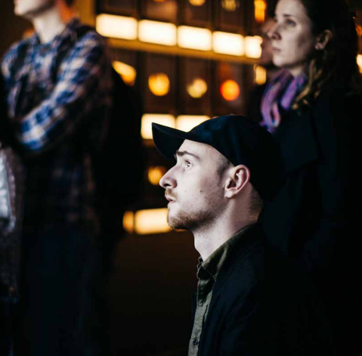
ANNUAL SERIES OF ARTISTIC AND SCIENTIFIC COLLISIONS
3 original exhibitions each year
Innovation Labs for deeper exploration in search of new solutions to our core questions.
Performances and workshops for deep dives into our themes
Pop Up events throughout the city to engage the public
Late night openings
Notes:
Theorists beyond the paradigms, experimentalists testing these theories and bringing them down to earth. Artists do both these things. So there is a natural affinity.

Slide 20
ENGAGING THE PUBLIC WITH CA’ FOSCARI’S KNOWLEDGE, RESEARCHERS & NETWORKS
Ca’ Foscari is playing a leading role in environmental sustainability amongst Italian universities in its research, courses, operations and collaborations.
It is the highest ranked Italian University in the UI Green Metric and 64th out of 516 global universities. Ca’ Foscari is also an initiator of the Italian University Network for Sustainable Development.

Slide 21
COLLABORATING WITH VENICE’S WORLD LEADING CULTURAL ORGANISATIONS
Gallerie dell’Accademia
Palazzo Cini
Accademia di Belle Arti di Venezia
Peggy Guggenheim Collection
Pinault Foundation
Venice Biennale

Slide 22
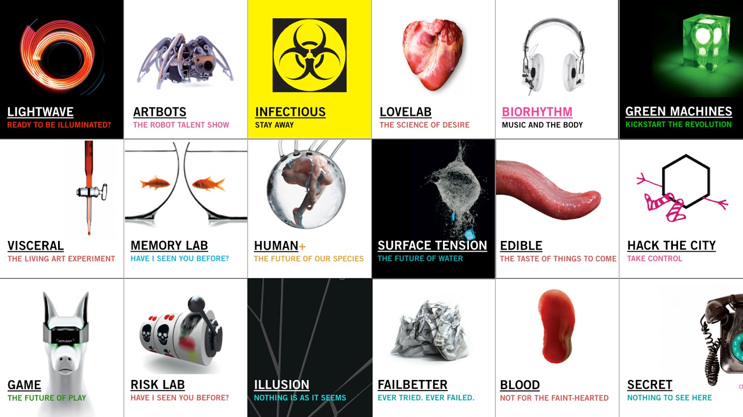
SGV’S FOCUS ON CLIMATE CHANGE AND CULTURAL HERITAGE BRINGS UNIQUE EXPERTISE TO THE NETWORK WHICH WILL BE SHARED GLOBALLY

Slide 23
SCIENCE GALLERY VENICE/ EXPERIENCED LEADERSHIP
Ariane Koek, Director, Science Gallery Venice
Previous experience includes: Founding Director of Arts@CERN, the international interdisciplinary arts/science/technology programme based at the world’s largest particle physics public research laboratory in Switzerland.
Clore Fellowship recipient for interdisciplinary work as a BBC radio and television producer.

Slide 24
SCIENCE GALLERY VENICE/
FROM DORMANT WAREHOUSE TO IDEAS FACTORY
Q4 2017: Director and Deputy Director/Fundraiser begin their new roles
Q4 2017: Architectural firm to be appointed to renovate San Basilio Warehouse
Q1 2018: Pop Up Programming Begins
Q2 2018: First Leonardo Group Appointed
Q2 2020: Move from pop-up activities to our home in San Basilio, Venice’s new cultural quarter.

Slide 25
PARTICIPATE!
MICHELE.BUGLIESI@UNIVE.IT

